Slide 1
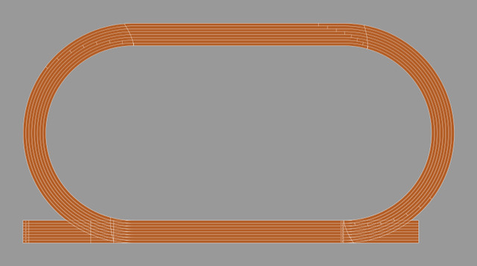
Describe the shape of this athletics track.

Slide 2
What measurements on the track do you know?

Slide 3
Why are the marks for the start of the 200m races staggered?
Why are the marks for the start of the 400m races even more staggered?

Slide 4
You know the length of the 100 metre straight. Use that scale to estimate the lengths of the other parts.
0
25
50
75
100
metres

Slide 5
Estimate the radius of the part circle.
0
25
50
75
100
metres

Slide 6
Estimate the width of eight lanes.
What is the width of a single lane?
0
25
50
75
100
metres

