Slide 1
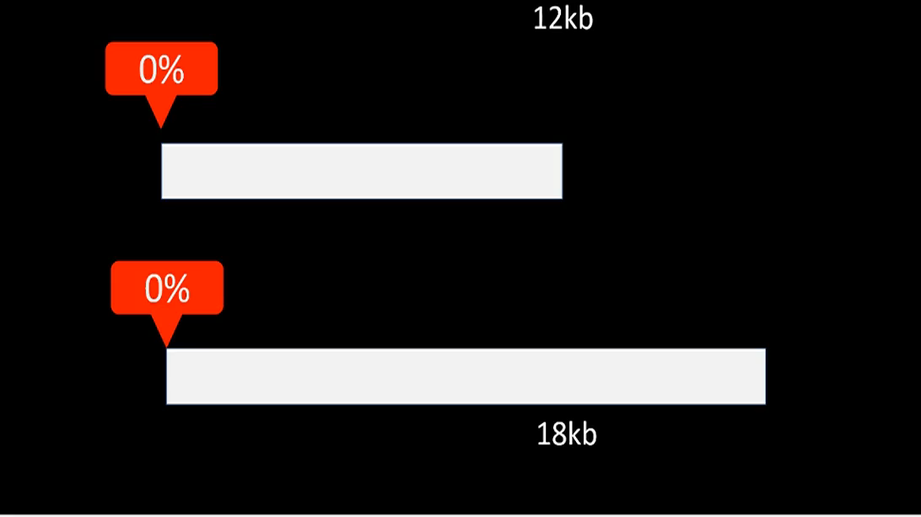

Slide 2
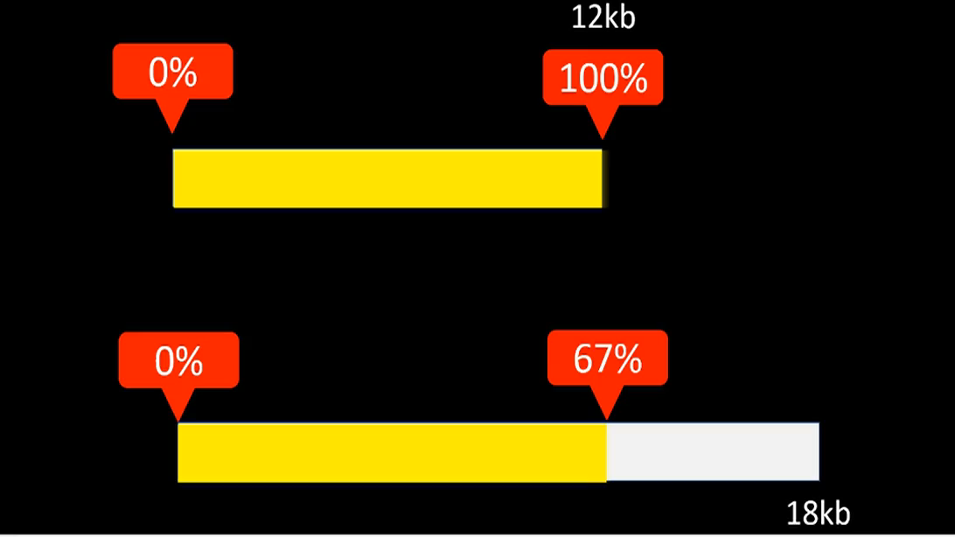

Slide 3

0 %
100%
150 %
rate
$0.00
12kb
18kb
base
amount
$$\frac{}{100}×12=18$$

Slide 4


0 %
$$66⋅\dot{6}\%$$
rate
100%
$0.00
12kb
18kb
amount
base
$$\frac{}{100}×18=12$$

Slide 5


$$75\%$$
100%
rate
15kb
20kb
amount
base
$$\frac{75}{100}×20=15$$

Slide 6


100%
$$133.\dot{3}\%$$
rate
15kb
20kb
base
amount
$$\frac{4}{3}×15=20$$

Slide 7
0 %
rate
$0.00
12kb
30kb

Slide 8
0 %
rate
$0.00
24kb
40kb

