Slide 1
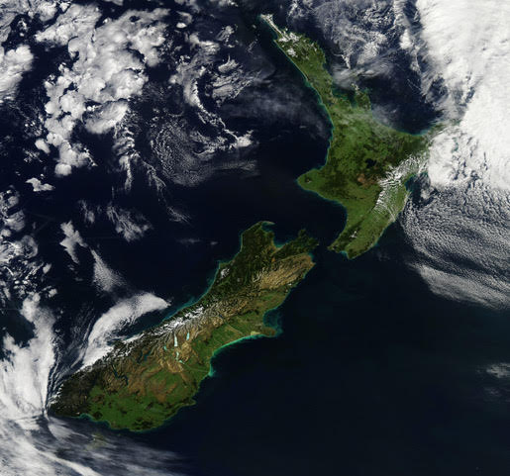
Predicting New Zealand’s weather is quite difficult because it is a small country in the middle of a large expanse of sea.

Slide 2
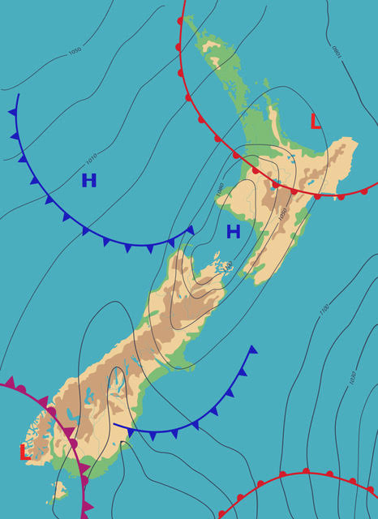
Forecasting rainfall is important as many people have jobs that are dangerous or uncomfortable in wet conditions.

Slide 3
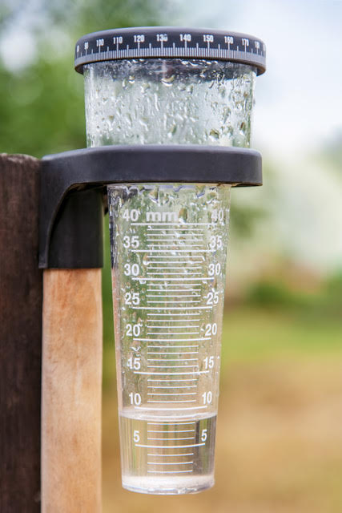
Rainfall gauges measure the depth of water that falls on the Earth’s surface.
What unit of measure is used?
Why do you think that unit is used?

Slide 4
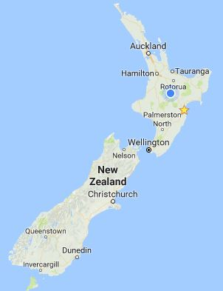
Auckland
1 211mm
Tauranga
1 177mm
New Plymouth
1 398mm
Gisborne
979mm
Wellington
1 215mm
Napier
776mm
Nelson
951mm
Blenheim
720mm
Hokitika
2 901mm
Christchurch
618mm
Milford sound
6 175mm
Dunedin
726mm
Queenstown
741mm

Slide 5
