Slide 1
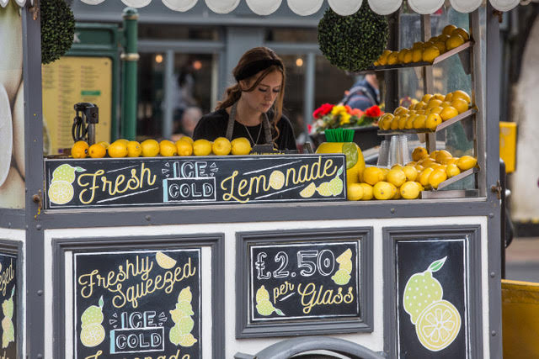
Gina sells real fruit lemonade at the Farmer’s Market each Saturday morning. Her aim is to make as much profit as she can to fund her study at Polytechnic. Her survey showed this:
If I charge nothing then 1000 people will each take a glass of lemonade.
For every 50 cents I add to the price of each glass 100 less people will buy one.
Gina’s demand function shows that the number of glasses she can sell goes down as she increases her price.
Draw a graph of her demand function and write the equation of it. Use quantity of glasses on the x-axis (independent variable) and price in dollars on the y-axis (dependent variable).

Slide 2
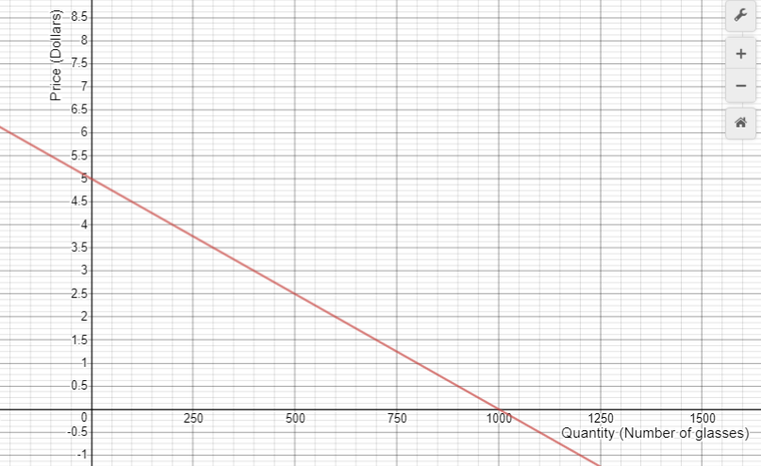

Slide 3
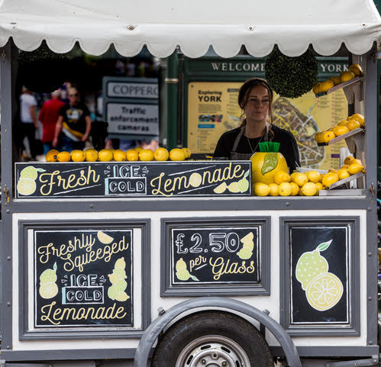
Gina tries to create a function for her total revenue (t), the total amount of money she will take in.
Let q be the number of glasses I sell and p be the price for each glass.
Write an equation for t in terms of q and p.
Can you write the equation just using t and q? Graph your equation.

Slide 4
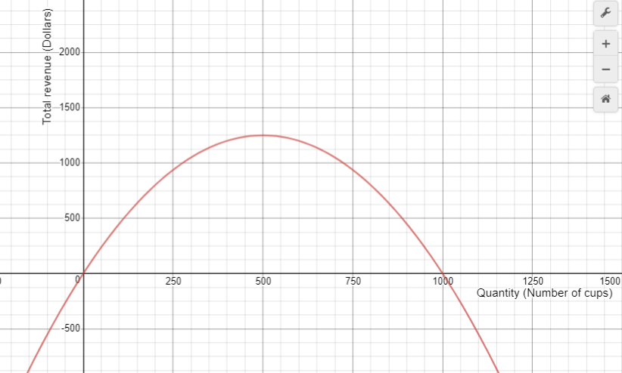
Why is it that Gina makes takes in no money for two values of q? At what number of cups is Gina’s total revenue at its maximum?

Slide 5
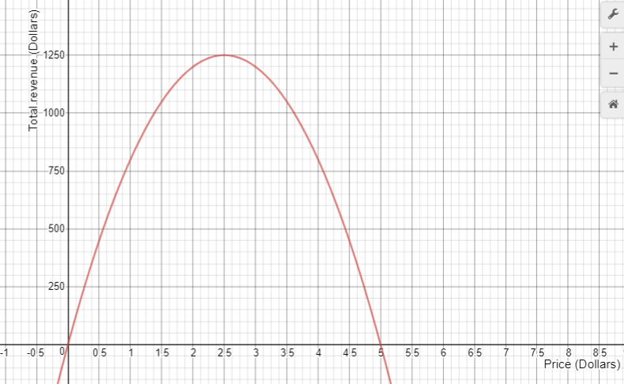
Does the price that maximises Gina’s revenue match the quantity on the previous slide? Explain.

Slide 6
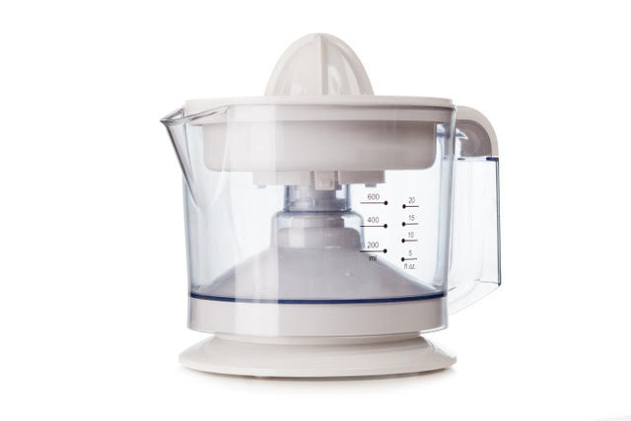
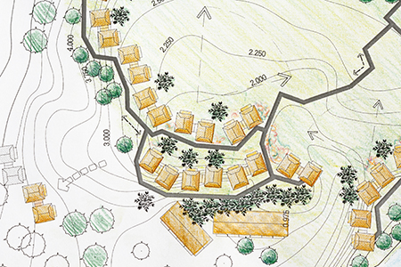
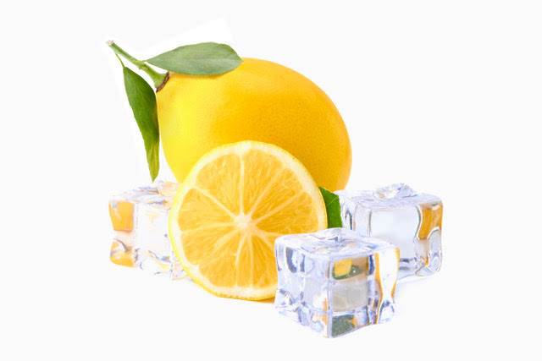
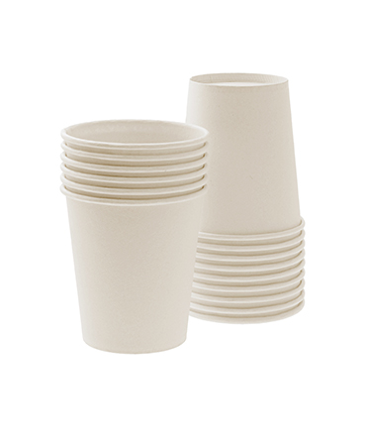
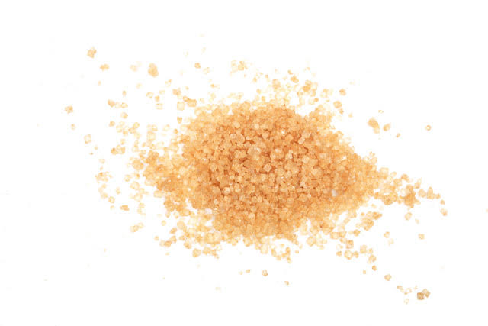
Here are Gina’s costs for each market. Can you write cost (c) as a function of quantity (q)?
Site hire
$80
Refrigerator hire
$100
Electricity
$30
Loan repayment for other equipment.
$70
Lemons
$0.75 per glass
Ice
$0.20 per glass
Bio cup and straw
$0.15 per glass
Sweetener
$0.10 per glass

Slide 7
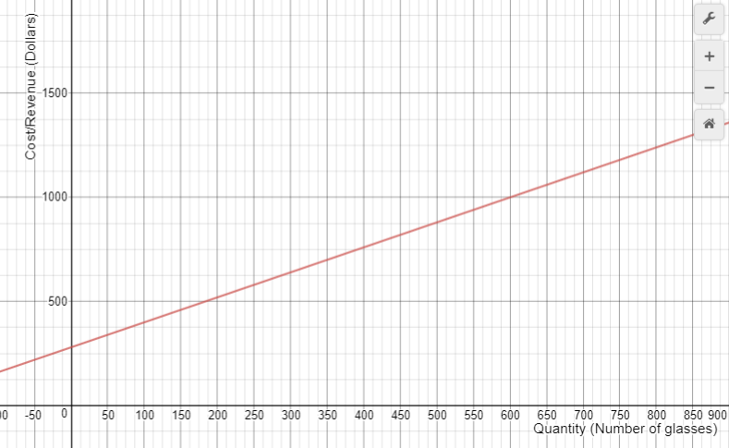

Slide 8
