Slide 1
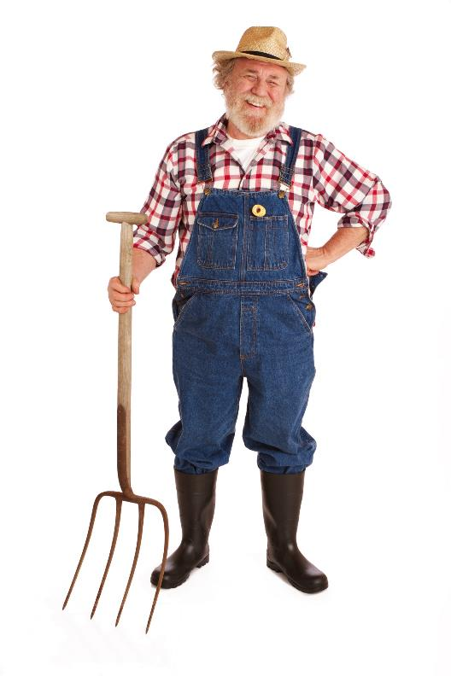
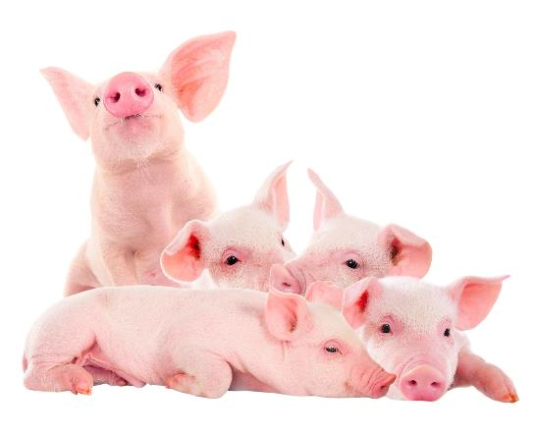
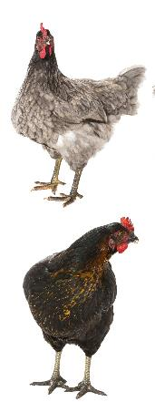
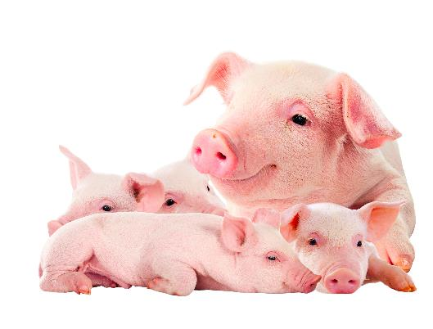
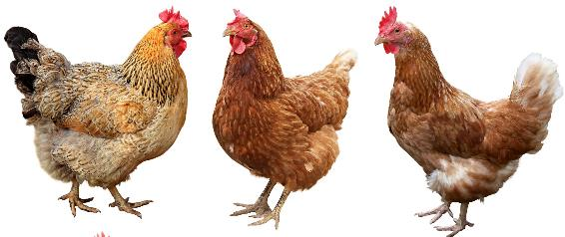
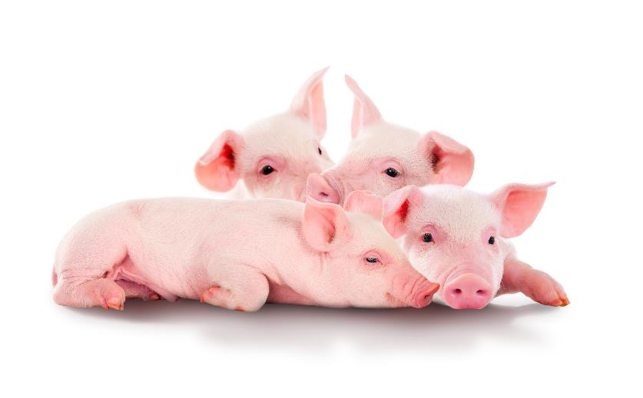
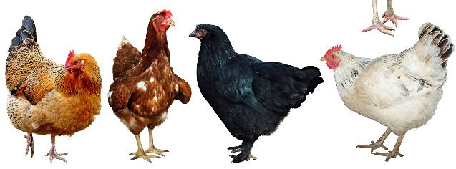
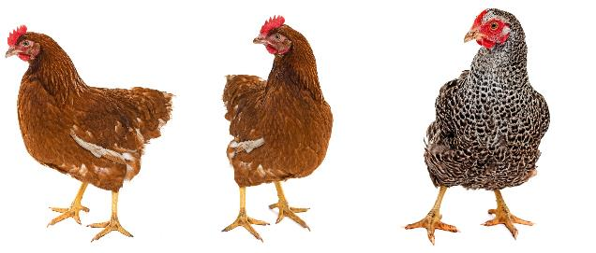
On Old MacDonald’s farm there are only pigs and chickens.
He counts 24 heads and 80 legs.
How many of each kind of animal are there?

Slide 2
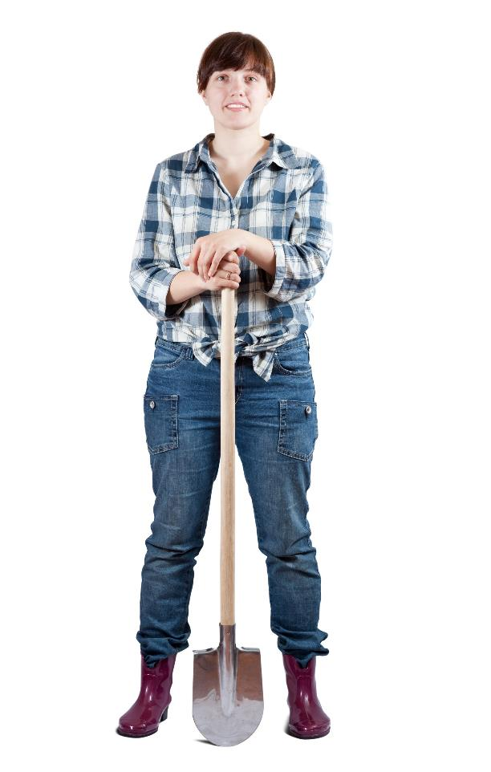
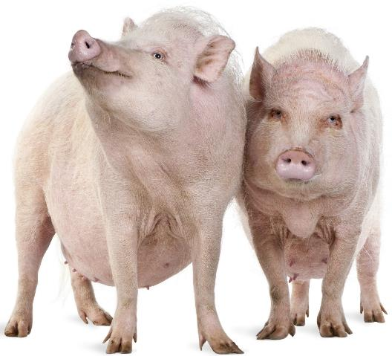
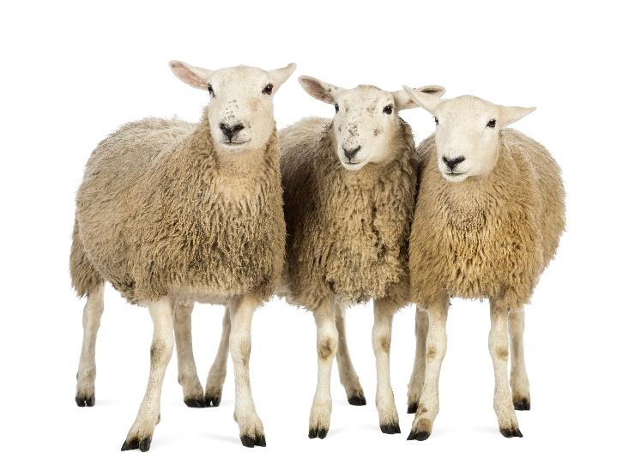
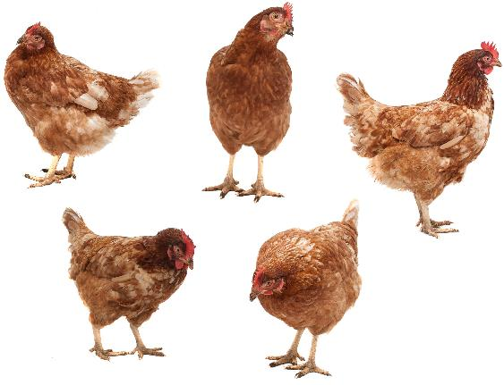
On Maree MacDonald’s farm the ratio of pigs to sheep to chickens is 2:3:5.
Maree has 640 animals in total.
How many of each kind of animal are there?

Slide 3
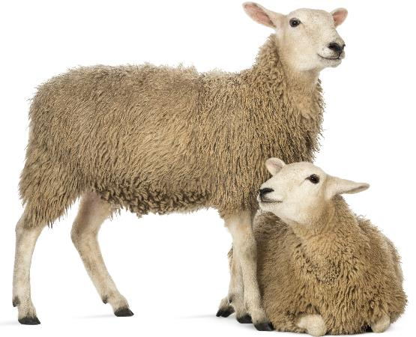
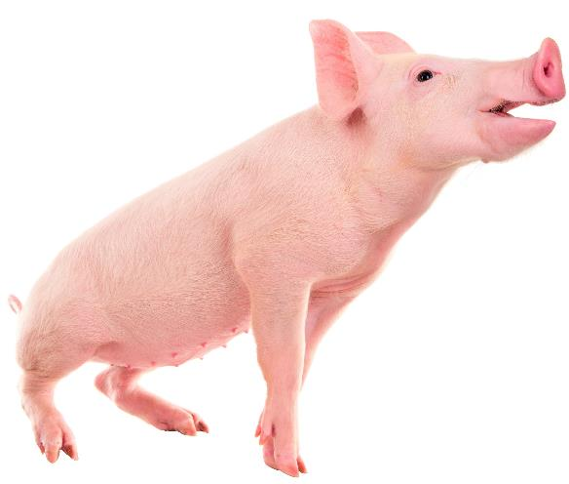
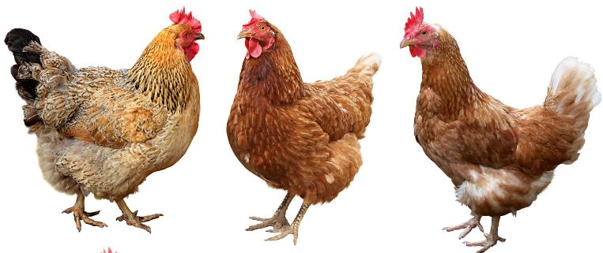
On Maree ‘s farm the ratio of pigs to sheep to chickens is 1:2:3.
Maree has 124 sheep.
How many of animals does she have in total?

Slide 4
Jessica Jones buys 60 animals at the market.
She only buys cows and pigs.
Cows are $120 each, three times the price of pigs.
The total cost is $4 800.
How many of each animal does she buy?

Slide 5
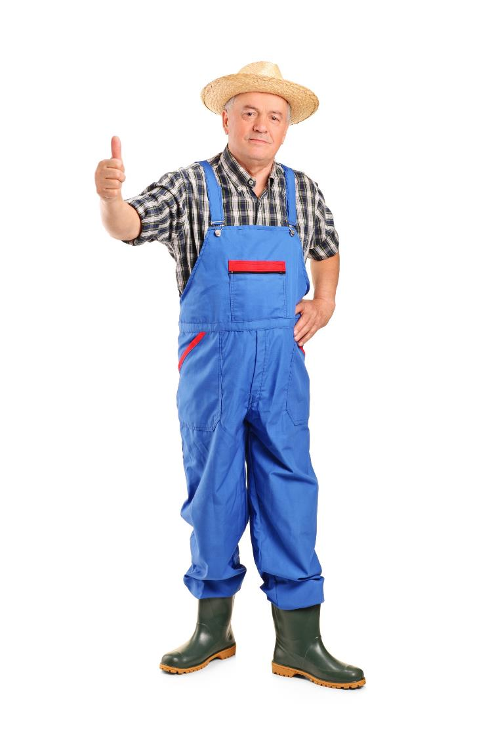
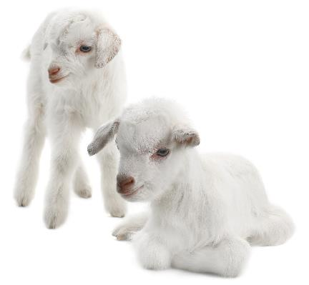
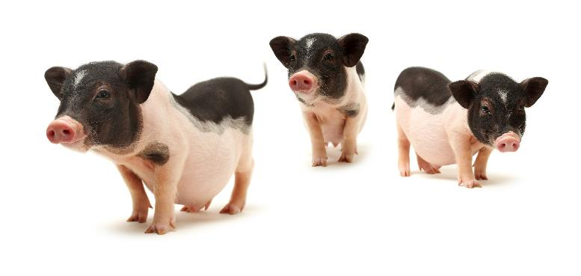
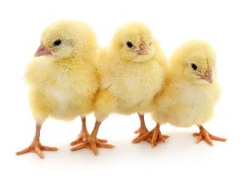
Farmer Fred goes to market.
He buys 100 animals for $100.
Lambs cost $10 each.
Piglets cost $3 each.
Chicks cost $0.50 each (50 cents).
How many of each animal does he buy?

Slide 6
The ratio of pigs to sheep is 1:2.
If p = number of pigs and s = number of sheep,
write an equation for this relationship.
Pigs
Sheep

Slide 7
The ratio of goats to cows is 1:5.
If g = number of goats and c = number of cows,
write an equation for this relationship.
Goats
Cows

Slide 8
The ratio of horses to llamas is 2:3.
If h = number of horses and L = number of llamas,
write an equation for this relationship.
Horses
Llamas

