Slide 1
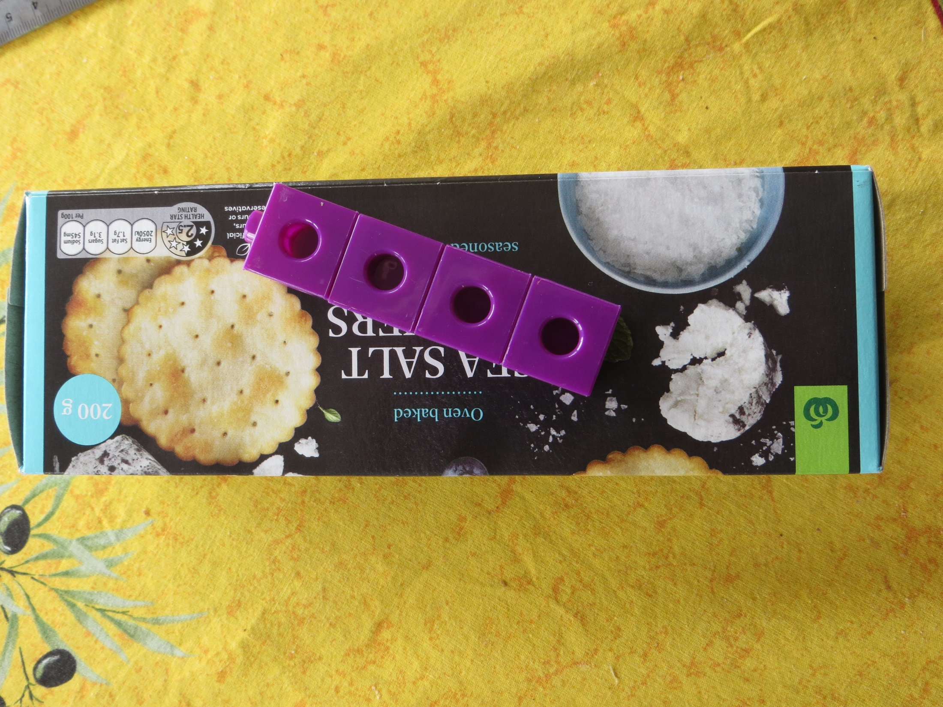
Suppose you wanted to find out how many cubes fit into the cracker box.
What would the number of cubes tell you about the box?

Slide 2
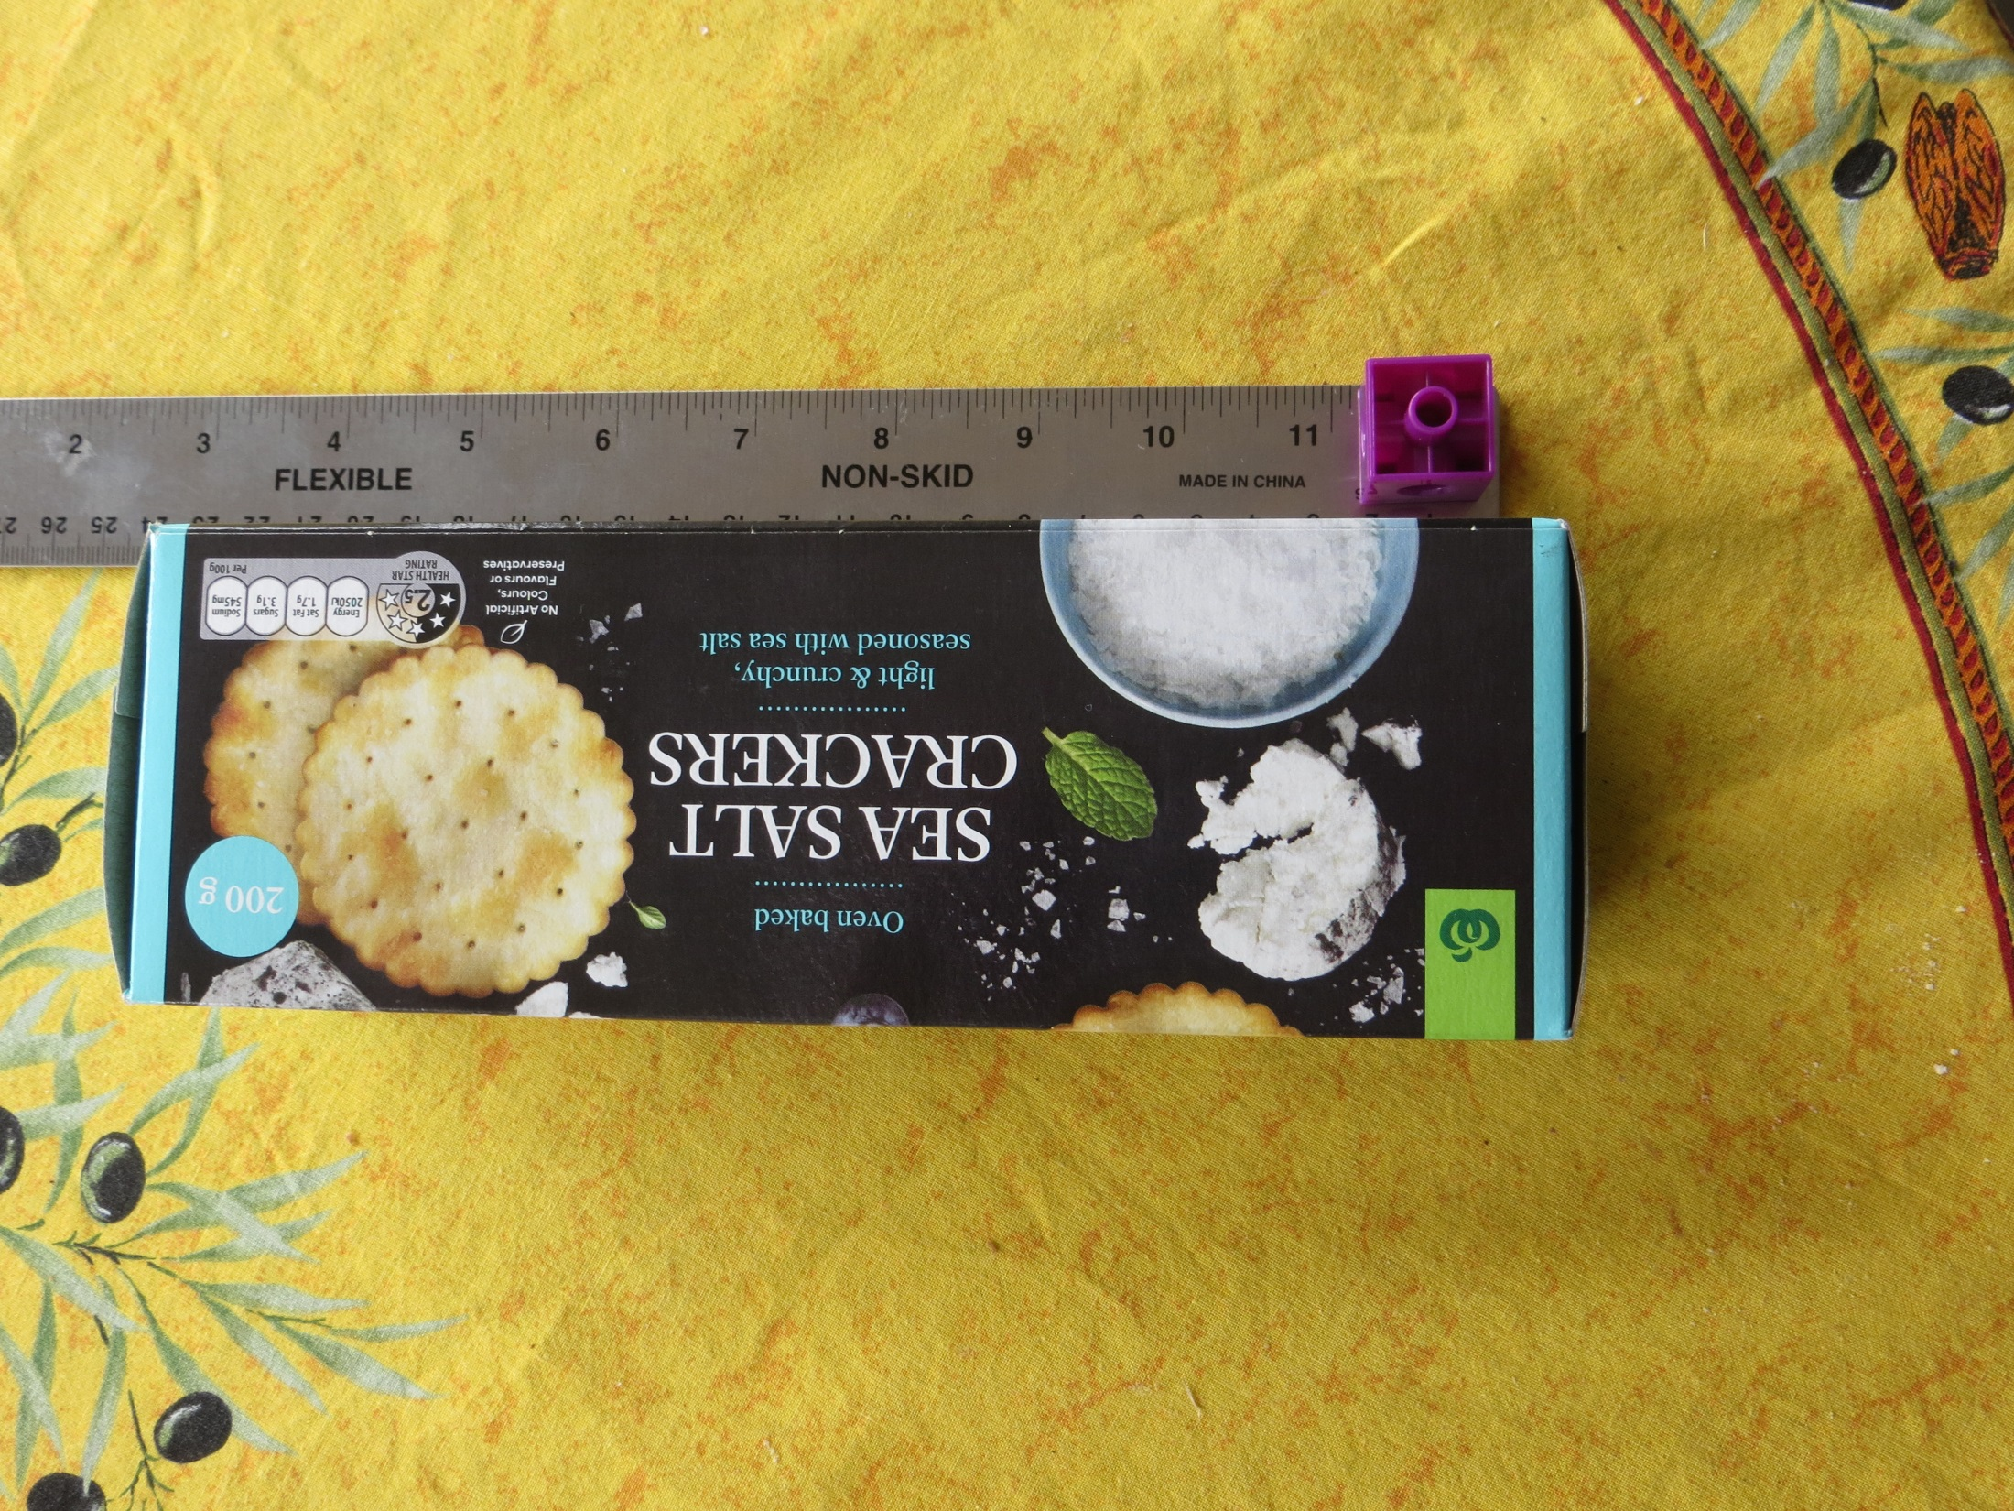
What information would be helpful to find the volume of the cracker box in cubes?

Slide 3
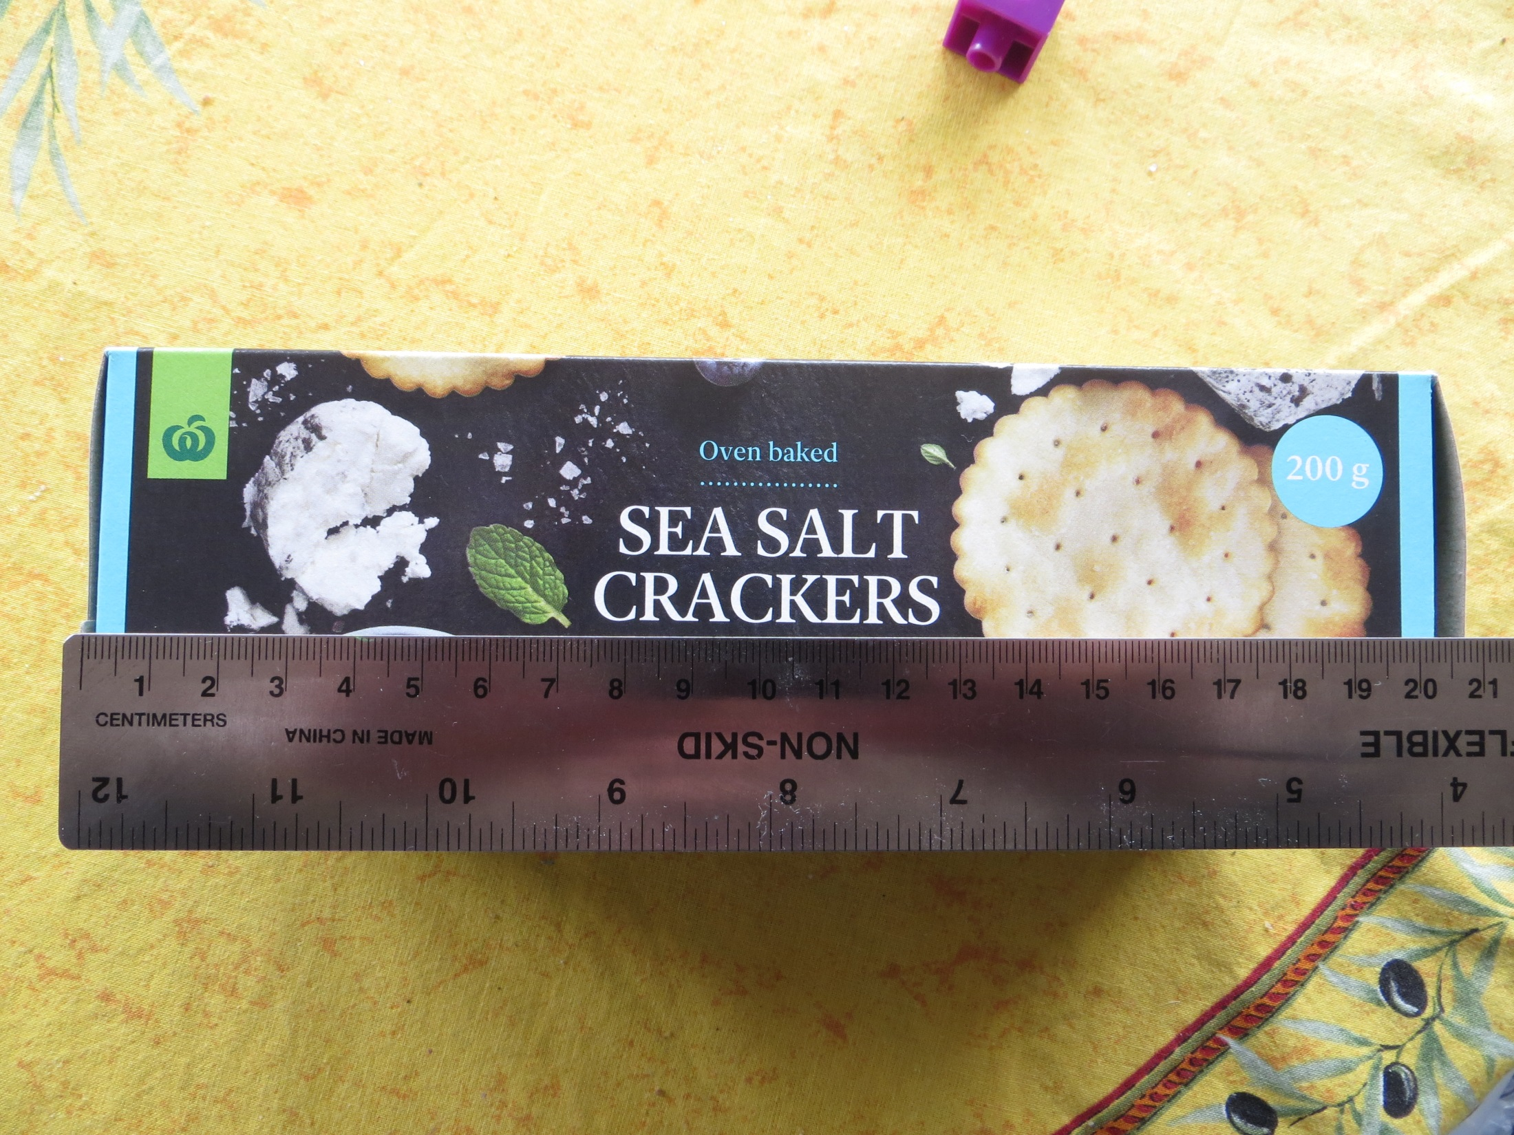
Does this view help? How?

Slide 4
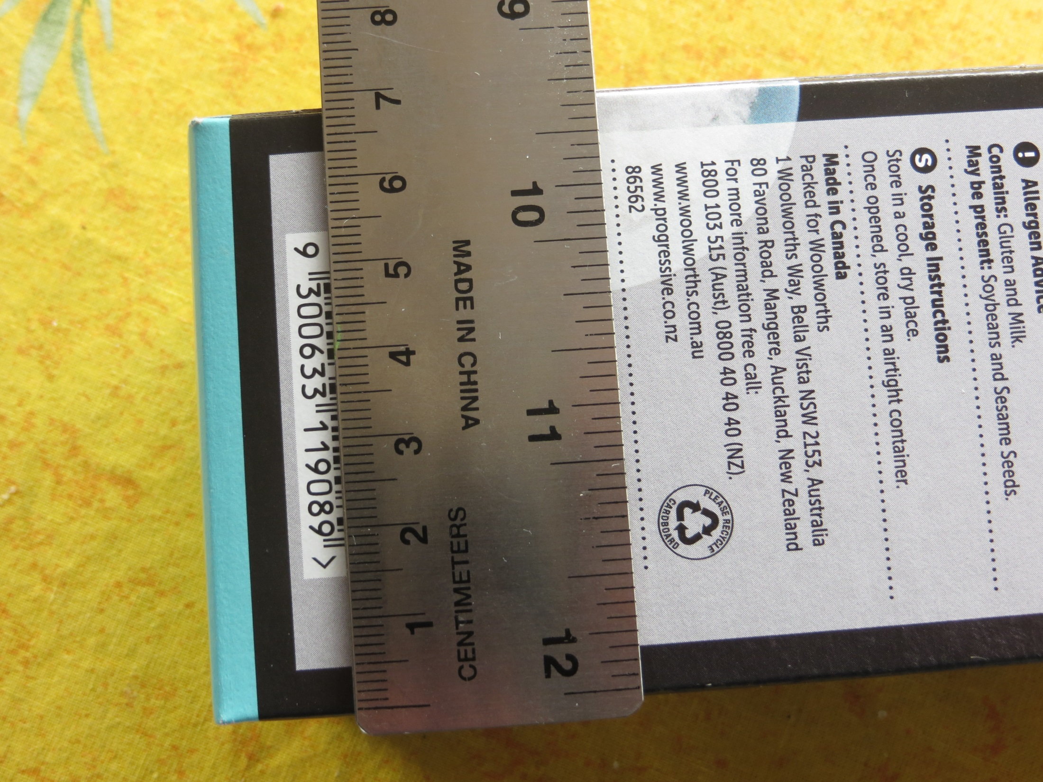
Do you foresee some complications? Why?

Slide 5
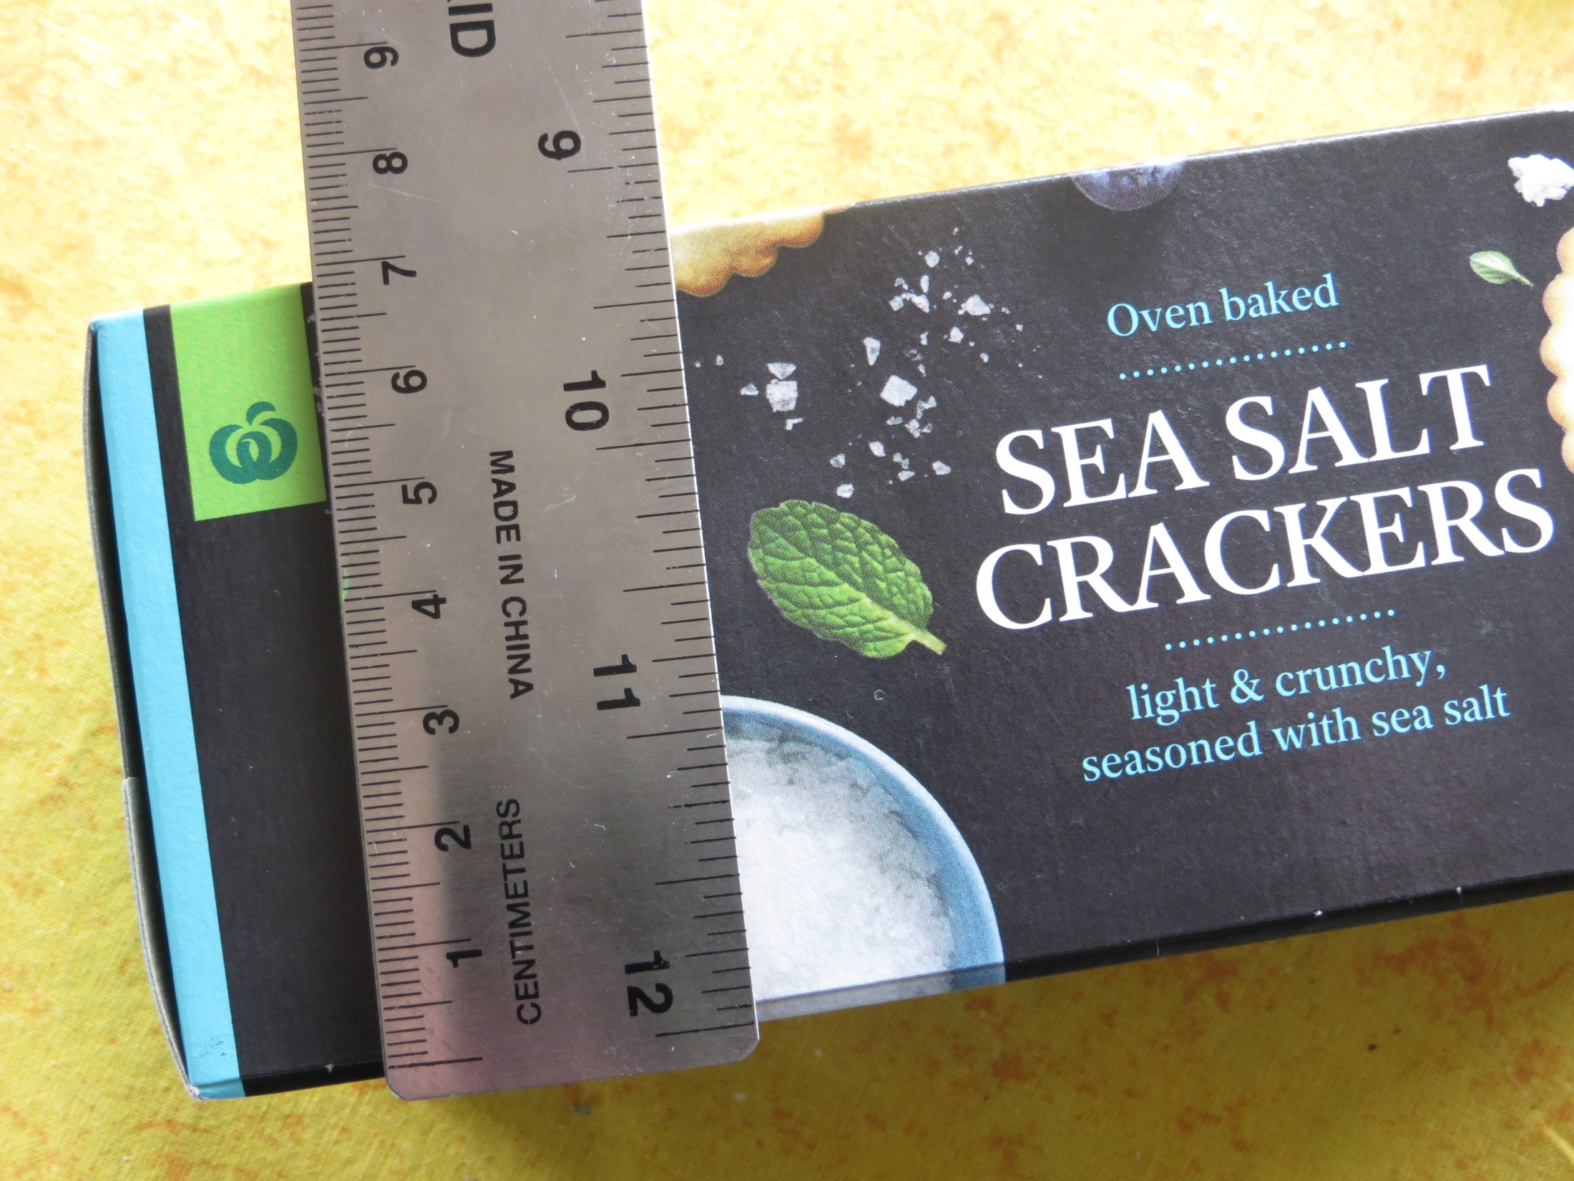
What will you do with part-cubes?

Slide 6
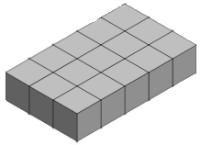
How could you calculate the volume of this box in cubes?

Slide 7
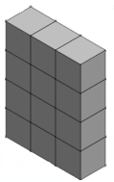
How could you calculate the volume of this box in cubes?

Slide 8
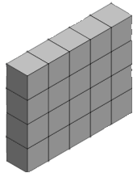
How could you calculate the volume of this box in cubes?

