Slide 2
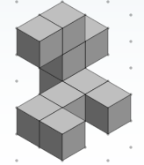
Make it
Draw it

