Slide 1
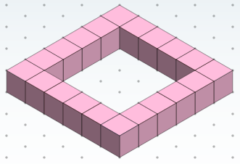
How many connecting cubes do you need to create this model?
Describe how you might group the cubes so you do not need to count each one.

Slide 2
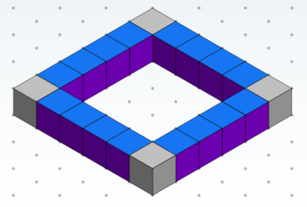
How would you calculate the number of cubes if you saw this?
What equation would you write?

Slide 3
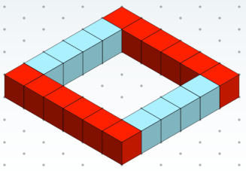
How would you calculate the number of cubes if you saw this?
What equation would you write?

Slide 4
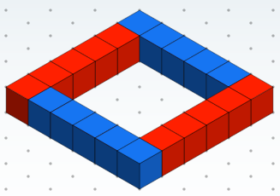
How would you calculate the number of cubes if you saw this?
What equation would you write?

Slide 5
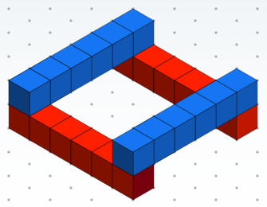
How would you calculate the number of cubes if you saw this?
What equation would you write?

Slide 6
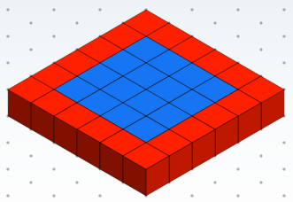
How would you calculate the number of cubes if you saw this?
What equation would you write?

Slide 7
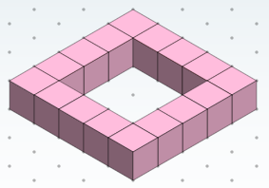
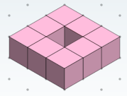
Here are three members of a growing pattern in sequence.
What do you notice about features that change and features that stay the same?
Imagine someone gave you 96 cubes to build a model in this pattern. How long would the side length of your model be in cubes?

Slide 8
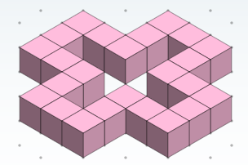
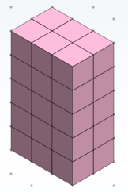
Here are some other models made from cubes.
They are also one member of a sequence of that grows.

Slide 9
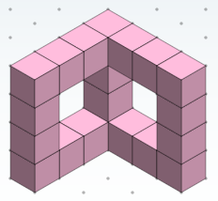
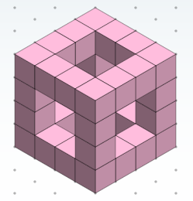

Slide 10
