Slide 1
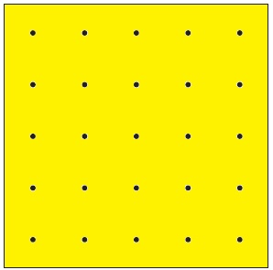
Here are three different rectangles than can be made using a rubber band on a 5 x 5 Geoboard.
What are the side lengths and area of each rectangle?
Note: A square is a type of rectangle.
This rectangle has an area of 3 square units

Slide 2
How many different sized rectangles are possible on a 5 x 5 geoboard?
What are the areas of these rectangles?

Slide 3
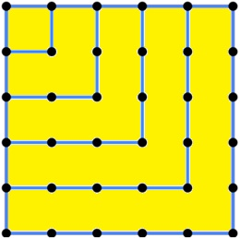
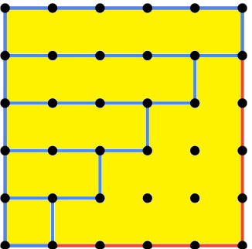
Did you get these squares with areas of 1, 4, 9, 16, and 25 square units?
Did you get all the rectangles with 1 as a side length?
1 x 1 is already counted but the areas are 2, 3, 4 ,and 5 square units.

Slide 4
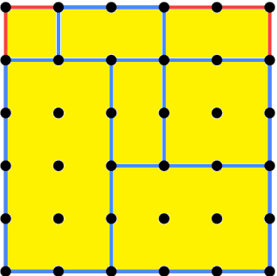
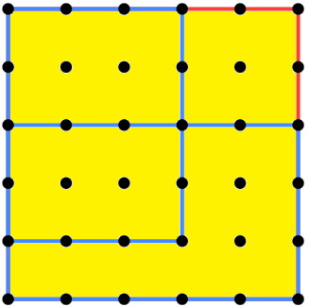
Did you get all the rectangles with 2 as a side length?
1 x 2 and 2 x 2 are already counted but other areas are
6, 8, and 10 square units.
Did you get all the rectangles with 3 as a side length?
1 x 3, 2 x 3 and 3 x 3 are already counted but other areas are
12 and 15 square units.
What rectangles with sides lengths of 4 and 5 are not counted yet?

Slide 5
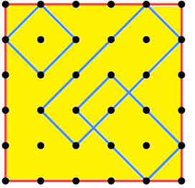
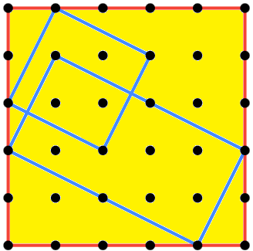
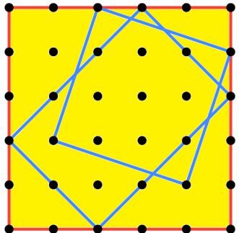
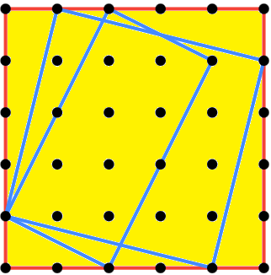
Did you get these tilted rectangles?
What are the side lengths and areas of these rectangles?
Are there other tilted rectangles that are missed?

Slide 6
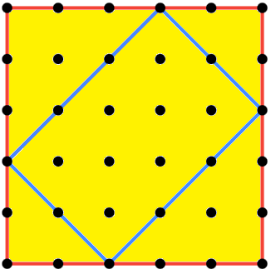
What are the side lengths of this rectangle?
$$d^{2}=3^{2}+3^{2}$$
4.24
3
$$d=\sqrt{3^{2}+3^{2}}$$
$$d=\sqrt{18}$$
3
$$d=4.24 (2dp)$$

Slide 7
What are the side lengths of this rectangle?
$$d^{2}=2^{2}+2^{2}$$
2.83
2
4.24
$$d=\sqrt{2^{2}+2^{2}}$$
2
$$d=\sqrt{8}$$
$$d=2.83 (2dp)$$

Slide 8
What is the area of this rectangle?
$$area=4.24×2.83$$
2.83
4.24
$$=12 sq units (2 dp)$$

Slide 9
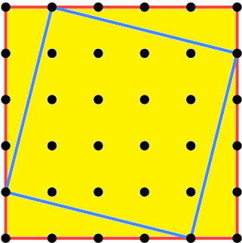
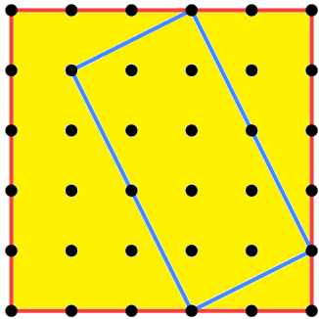
$$\sqrt{17}$$
$$\sqrt{5}$$
$$\sqrt{17}$$
$$\sqrt{20}$$
$$\sqrt{17 }×\sqrt{17}=17$$
$$\sqrt{5 }×\sqrt{20}=\sqrt{100}$$

Slide 10
2
1
$$c$$
$$\sqrt{5}$$
$$c^{2}=2^{2}+1^{2}$$
$$c=\sqrt{2^{2}+1^{2}}$$

Slide 11
The ladder just fits diagonally on the deck of a trailer. The deck measures 1.2 m x 2.4 m.
What is the maximum length the ladder can be?
Note: The legs of the ladder are 10 cm wide.
1.2 m
2.4 m

Slide 12
2
$$\sqrt{2}$$
2
$$\sqrt{2}$$
$$\sqrt{8}$$
1
1

Slide 13
1
1
$$1$$
1
$$\sqrt{3}$$
$$\sqrt{4}$$
$$\sqrt{5}$$
1
$$\sqrt{2}$$
$$\sqrt{6}$$
1
1
$$\sqrt{7}$$
$$\sqrt{8}$$
1
$$\sqrt{9}$$
$$\sqrt{10}$$
1
1

Slide 15
A Pythagorean Triple is a triple of natural numbers (a,b,c) such that a² + b² = c² The following is a list of all Pythagorean Triples where a, b, c are all no larger than 100; (3,4,5), (5,12,13), (6,8,10), (7,24,25), (8,15,17), (9,12,15), (9,40,41), (10,24,26), (11,60,61), (12,16,20), (12,35,37), (13,84,85), (14,48,50), (15,20,25), (15,36,39), (16,30,34), (16,63,65), (18,24,30), (18,80,82), (20,21,29), (20,48,52), (21,28,35), (21,72,75), (24,32,40), (24,45,51), (24,70,74), (25,60,65), (27,36,45), (28,45,53), (28,96,100), (30,40,50), (30,72,78), (32,60,68), (33,44,55), (33,56,65), (35,84,91), (36,48,60), (36,77,85), (39,52,65), (39,80,89), (40,42,58), (40,75,85), (42,56,70), (45,60,75), (48,55,73), (48,64,80), (51,68,85), (54,72,90), (57,76,95), (60,63,87), (60,80,100), (65,72,97).

Slide 16
Does $d^{2}=a^{2}+b^{2}$ $+c^{2}$?
$$d$$
$$c$$
$$a$$
$$b$$

