Slide 1
$$\begin{matrix}\begin{aligned}a+36=95 \\ a= \left[ \right] \end{aligned} \\ \end{matrix}$$
$$\begin{matrix}\begin{aligned}54+b=81 \\ b= \left[ \right] \end{aligned} \\ \end{matrix}$$
$$\begin{matrix}\begin{aligned}c^{2}=100 \\ c= \left[ \right] \end{aligned} \\ \end{matrix}$$
$$\begin{matrix}\begin{aligned}d^{2}=289 \\ d= \left[ \right] \end{aligned} \\ \end{matrix}$$
$$\begin{matrix}\begin{aligned}5^{2}{ −3}^{2}=g^{2} \\ g= \left[ \right] \end{aligned} \\ \end{matrix}$$
$$\begin{matrix}\begin{aligned}{13}^{2}{ −5}^{2}=h^{2} \\ h= \left[ \right] \end{aligned} \\ \end{matrix}$$

Slide 2
There is 13.4 metres of anchor chain in the sea.
The fishing boat’s drone shows the distance of the anchor from the ship is 7.6 metres.
How deep is the water?
13.4 m
?
55.5⁰
7.6 m

Slide 3
$$d^{2}+{7.6}^{2}={13.4}^{2}$$
Subtract 7.6² from both sides to leave only d ² on the left side.
$$d^{2}={13.4}^{2}−{7.6}^{2}$$
Find the square root of both sides to leave only d on the left side.
$$d=\sqrt{{13.4}^{2}−{7.6}^{2}}$$
Calculate out to find the value of d .
$$d=11.03 m$$

Slide 4
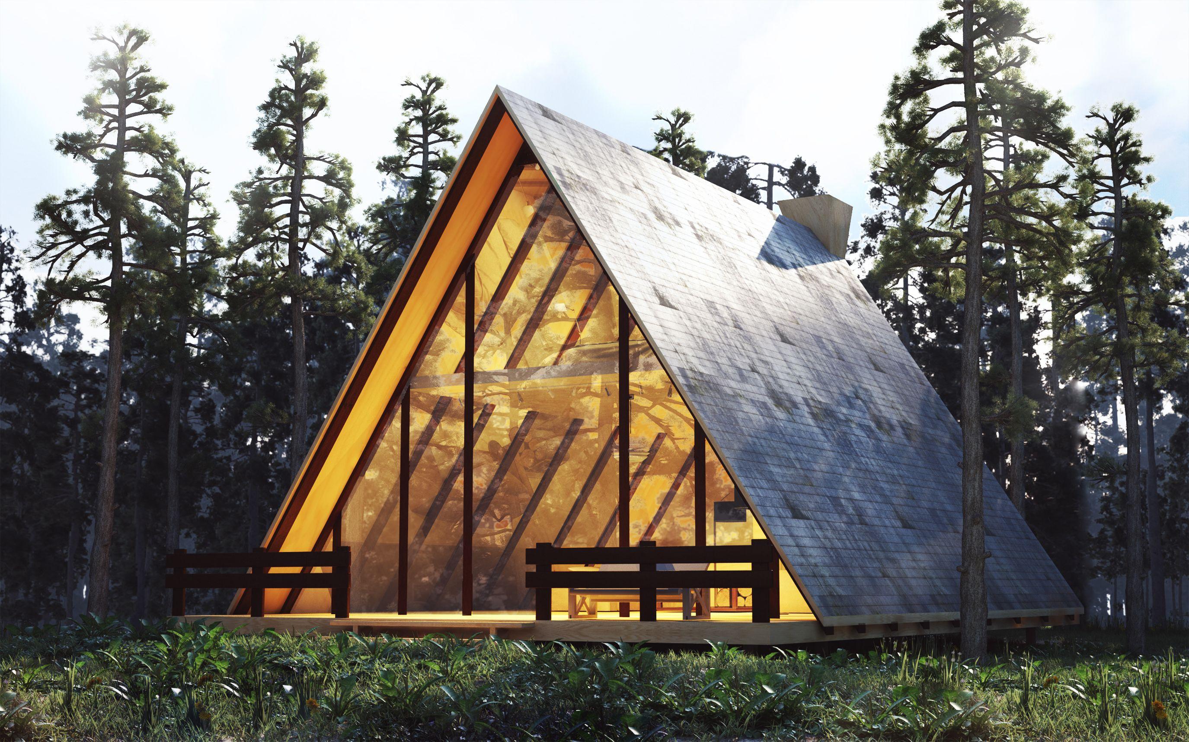
A-framed houses are ideal for mountain environments where there is a lot of snow.
Why are they ideal?
Use the measurements provided to find the missing height of the house, h.
7.32 m
h
7.32 m

Slide 5
A-framed houses are ideal for mountain environments where there is a lot of snow.
Why are they ideal?
Use the measurements provided to find the missing height of the house, h.
7.32 m
7.32 m
h
h
7.32 m
3.66 m

Slide 6
$$h^{2}+{3.66}^{2}={7.32}^{2}$$
Subtract 7.6² from both sides to leave only h ² on the left side.
$$h^{2}={7.32}^{2}−{3.66}^{2}$$
Find the square root of both sides to leave only h on the left side.
$$h=\sqrt{{7.32}^{2}−{3.66}^{2}}$$
Calculate out to find the value of h .
$$h=6.34 m$$

Slide 7
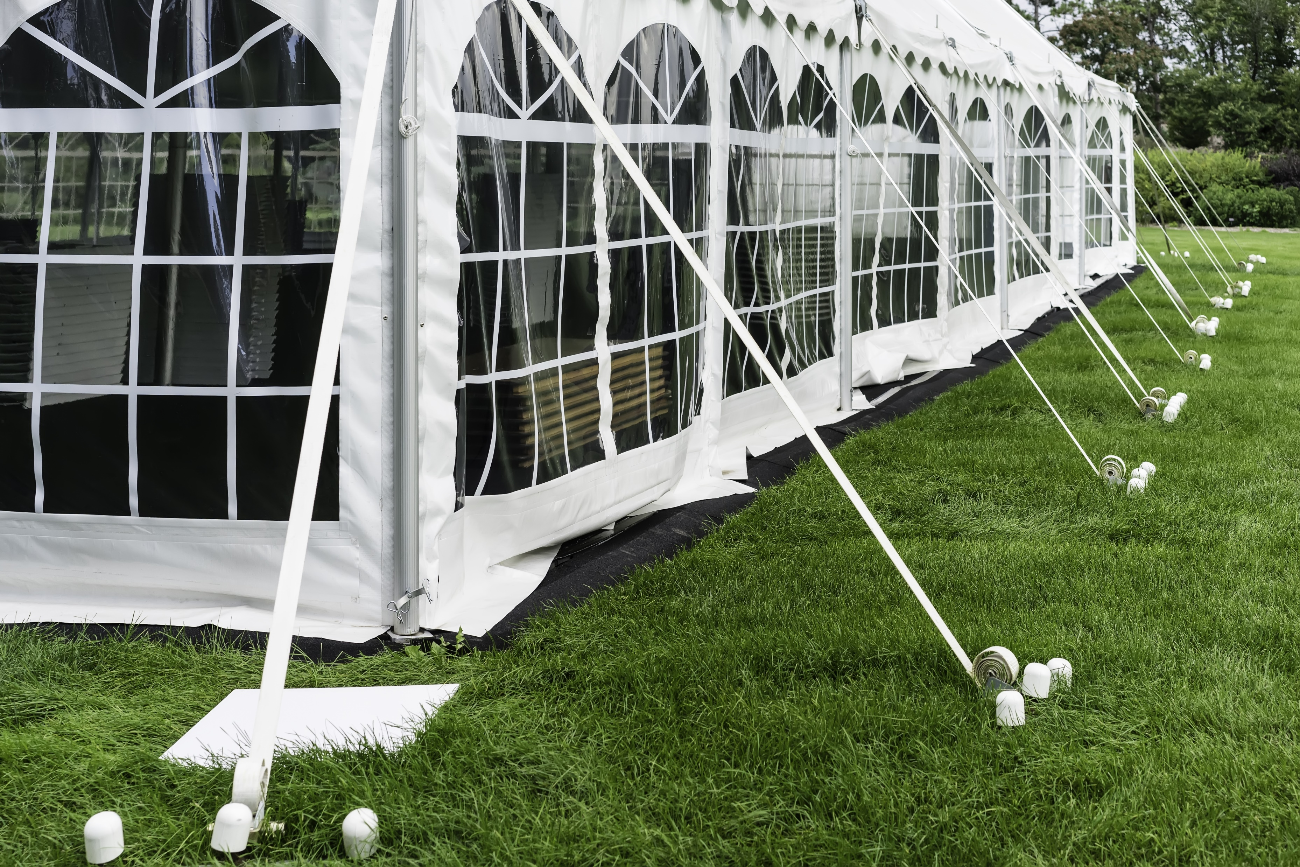
A marquee tent has been set up for a hui.
The guy ropes are all set at 2.8 metres long. The marquee walls are 2.4 metres high.
How far out from the tent are the pegs?
2.8 m
2.4 m
Peg

Slide 8
Rangimarie
Treaty Road
?
19.3 km
25.9 km
Henare Road
Uira Expressway
The road designer claims that the Uira Expressway is over 10 kilometres shorter than the old route from Rangimarie to Aroha.
Are they correct?
Use Pythagoras Theorem to check their claim.
Aroha

Slide 9
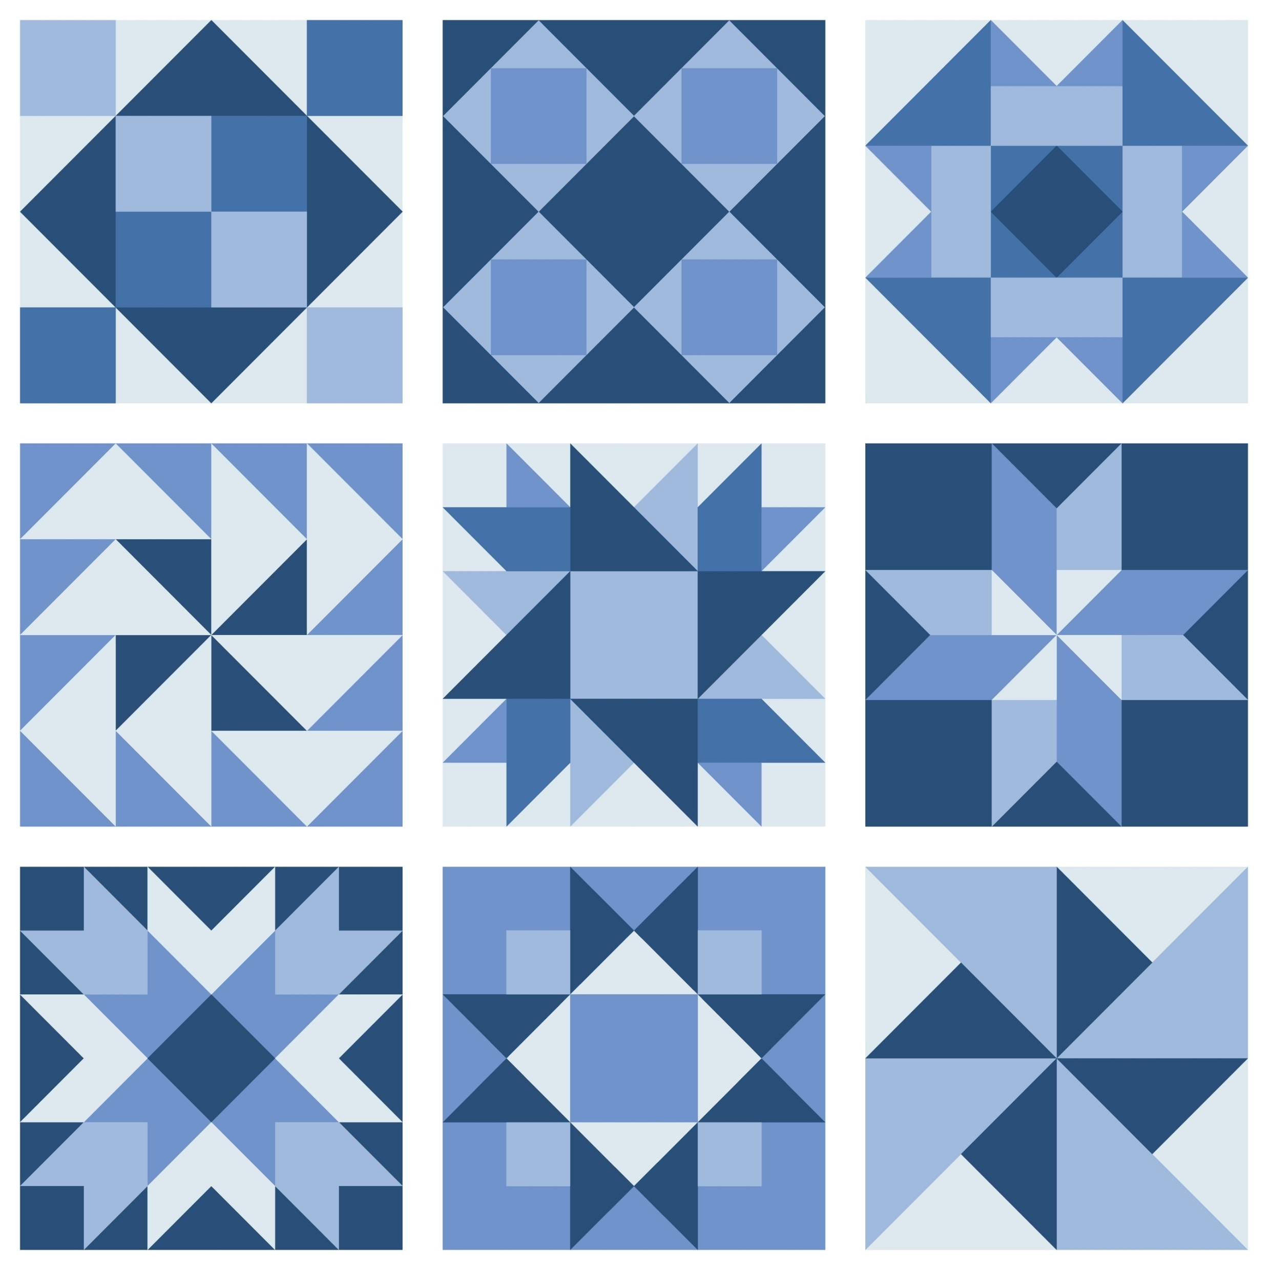
The side length of each square block measures 20 cm.
Find the side lengths of five different-sized right-angled triangles in the quilting pattern.
5
10
6$\frac{2}{3}$
5
$$\sqrt{50}$$
$$\sqrt{50}$$
$$\sqrt{50}$$
6$\frac{2}{3}$
$$\frac{\sqrt{800}}{3}$$
$$\sqrt{50}$$
5
20 cm
10
$$\sqrt{12.5 }$$
$$\sqrt{12.5 }$$
3$\frac{1}{3}$
$$\frac{\sqrt{200}}{3}$$
$$\sqrt{50}$$
3$\frac{1}{3}$

Slide 10
Poppa’s Pizzas come in a special box that has corners.
The pizza moves around less as it is delivered.
Use the measurements for the hypotenuse of each triangle to work out the length of side d.
Medium
Large
Small
$$d$$
$$d$$
$$d$$
8.28 cm
12.43cm
14.5cm

