Slide 1
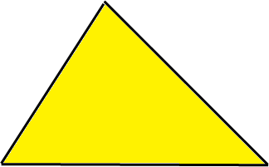
$$6^{2}=36$$
$$5^{2}=25$$
5
6
7
$$7^{2}=49$$

Slide 2
$$6^{2}=36$$
$$5^{2}=25$$
8
6
10

Slide 3
A biplane is 60 metres above the ground when it is 300 metres horizontally from the take-off point.
What distance, d, has the biplane flown to get to where it is?
$d$ = 305.94 m
d
60 m
300 m
$${60}^{2}+{300}^{2}=d^{2}$$
$$3600+90,000=d^{2}$$
$$93, 600=d^{2}$$
$$\sqrt{93,600}= d$$

Slide 4
A biplane is 140 metres above the ground when it is 500 metres horizontally from the take-off point.
What distance, d, has the biplane flown to get to where it is?
d
140 m
500 m
$${140}^{2}+{500}^{2}=d^{2}$$
$d$ = 519.23 m
$$19,600+250,000=d^{2}$$
$$269, 600=d^{2}$$
$$\sqrt{269,600}= d$$

Slide 5
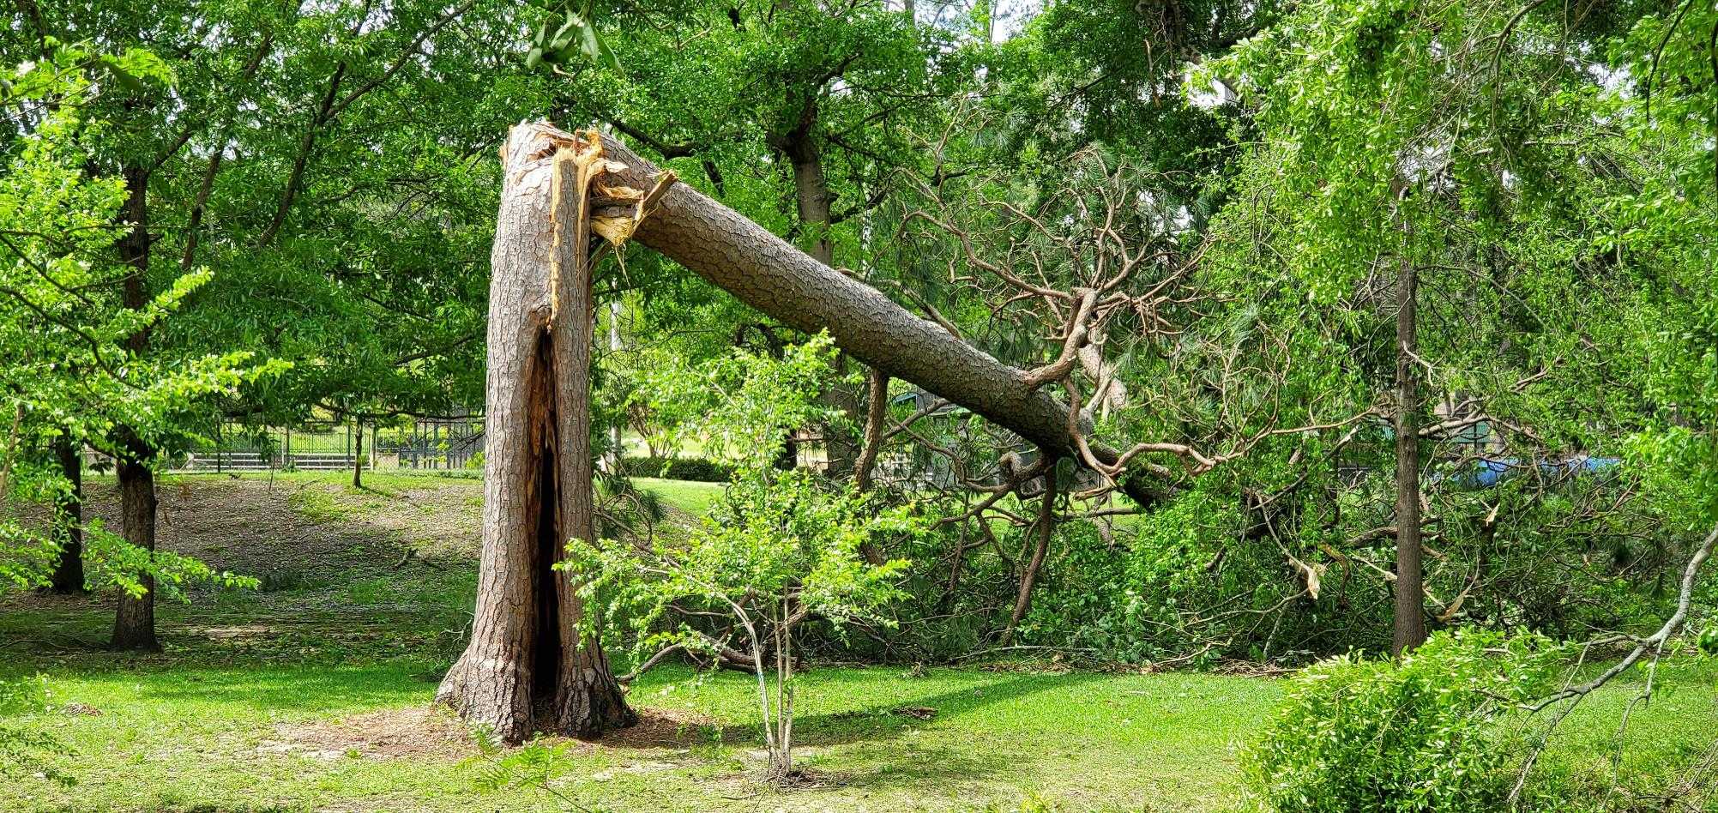
The pine tree was snapped in two during a cyclone.
Use the measurements to work out the full height of the tree before the cyclone.
2.3 m
5.9 m

Slide 6
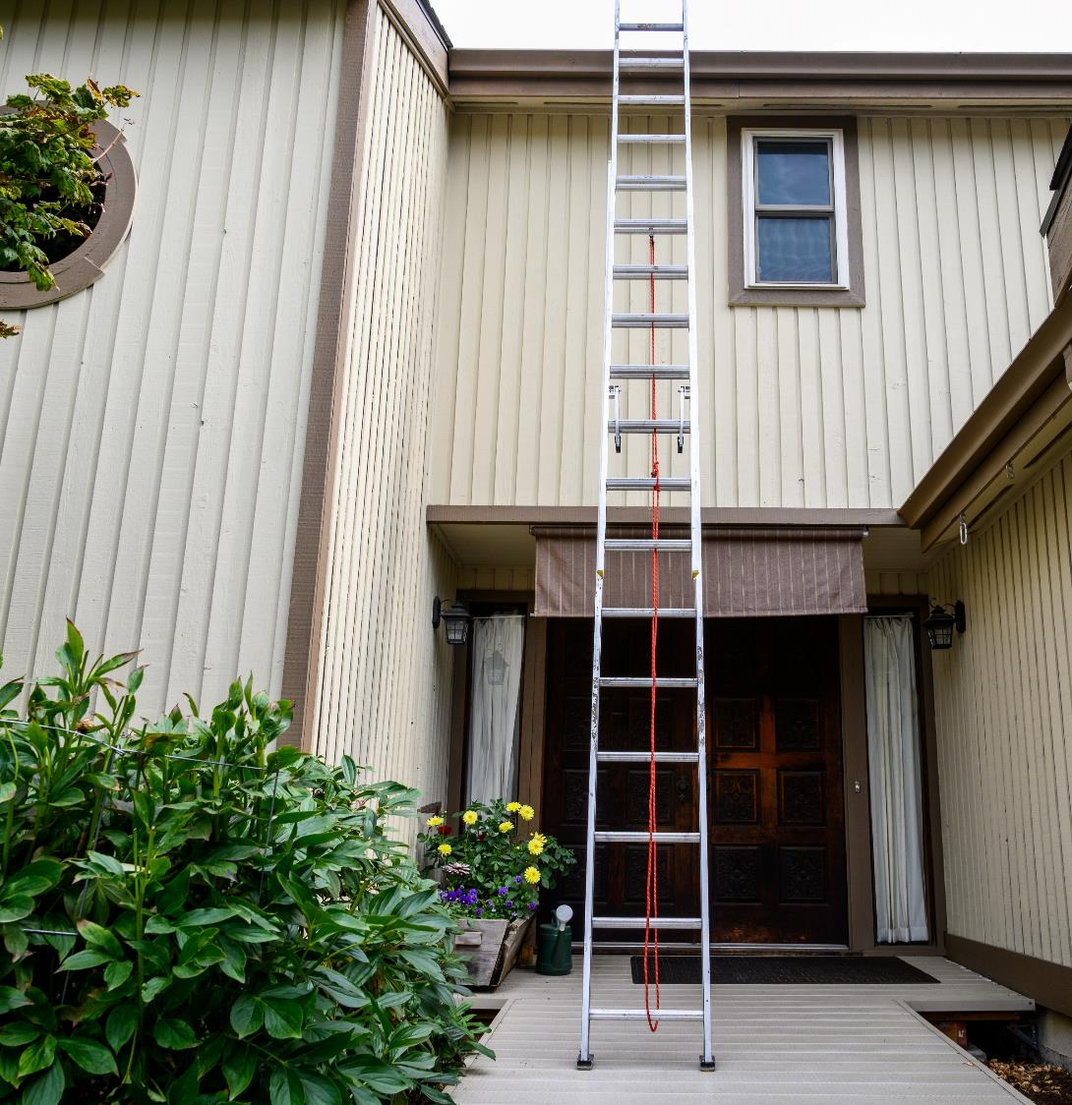
For safety reasons you should not use a ladder like this.
Use the measurements to calculate the length of the ladder.
Ladder
4.8 m
Wall
1.9 m

Slide 7
The size of a television screen is usually given in inches.
The measurement is the length of the diagonal.
Use the length and height of the screen to work out the length of its diagonal.
24.5 in
43.6 in

Slide 8
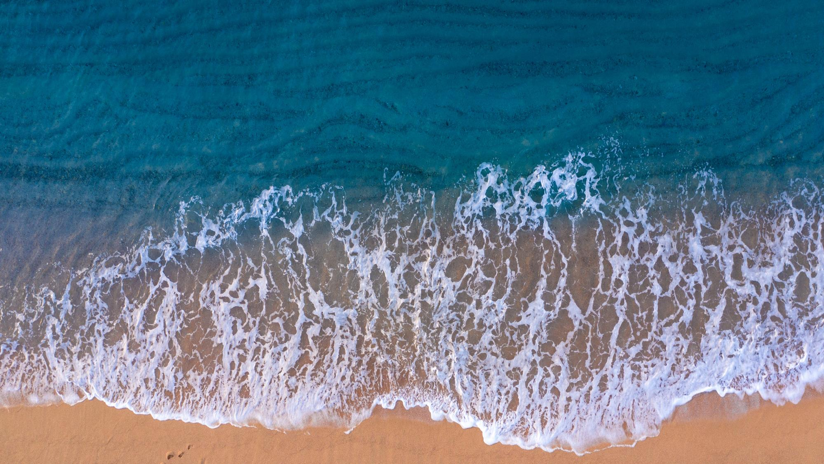
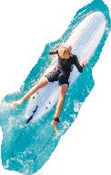
What is the shortest distance between the surf rescue boat and the surfer?
Surfer
75 m
150 m
Rescue boat

Slide 9
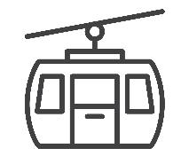
https://www.shutterstock.com/image-photo/rotorua-new-zealand-march-2nd-2016-452323771
The Rotorua Gondala ride takes you to the top of Mount Ngongataha. Your carriage rides on a long cable.
Use the measurements to find the length of the cable.
cable
179 m
882 m

Slide 10
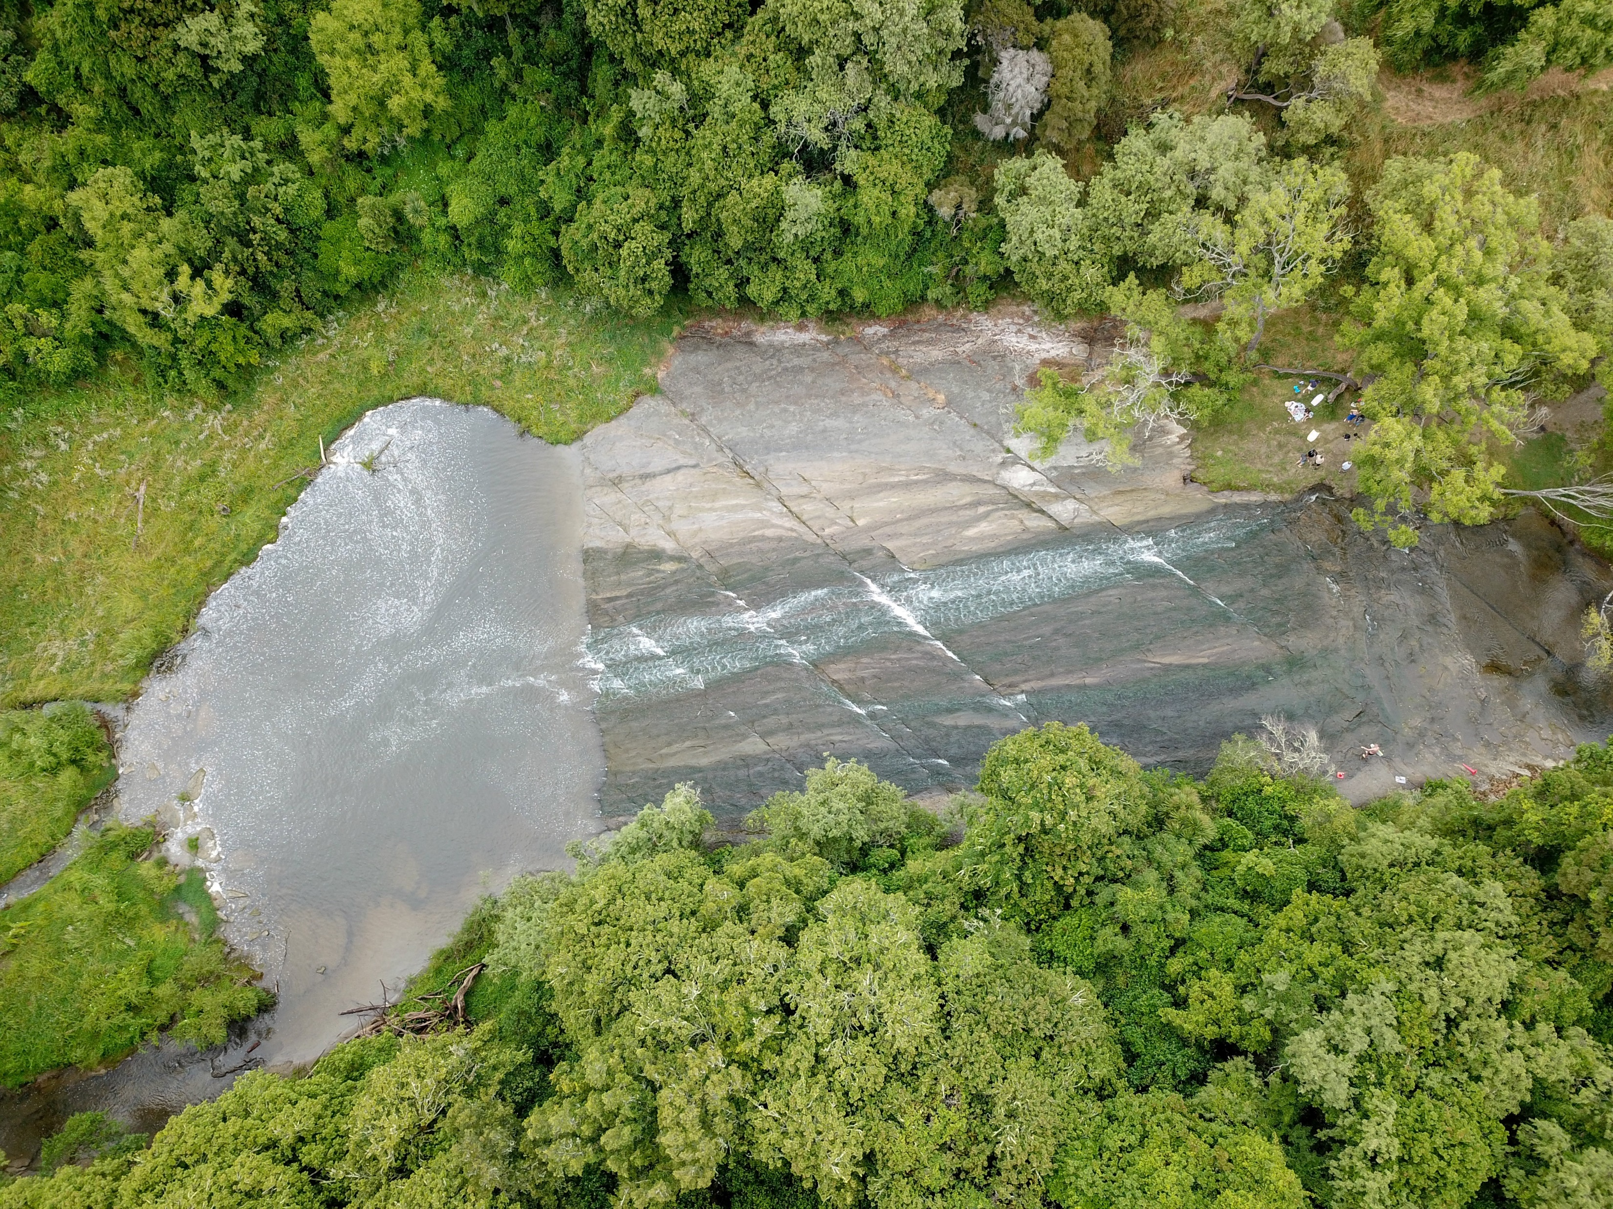
The Rere rockslide is a natural waterslide in the Tairawhiti (Gisborne) area.
How long is the slide?
10 m
59 m

Slide 11
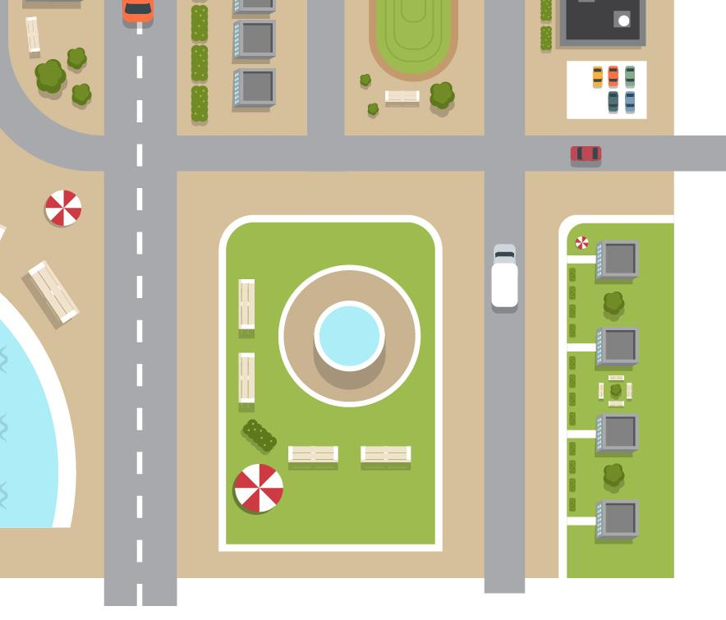
You could walk from A to B along Horizontal Street then turn left into Vertical Street.
You could also walk diagonally through the park.
How much shorter is the diagonal walk than the street walk?
Horizontal Street
A
Vertical Street
B

