Slide 1
True or false?
9² + 12² = 15²
81 + 144 = 225
7² + 10² = 13²
49 + 100 ≠ 169
8² + 15² = 17²
64 + 225 = 289

Slide 2
15 cm
?
9² + 12² = 15²
9 cm
12 cm
(9,12,15) is a Pythagorean triple!

Slide 3
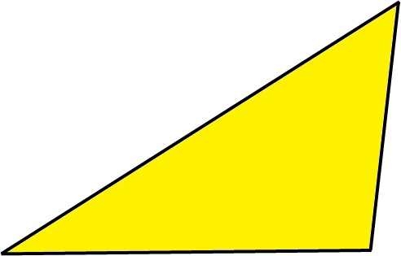
7² + 10² ≠ 13²
(7,10,13) is a not a Pythagorean triple!
13 cm
7 cm
10 cm

Slide 4
8² + 15² = 17²
(8,15,17) is a Pythagorean triple!
17 cm
?
8 cm
15 cm

Slide 5
156 mm
B
35 mm
117 mm
160 mm
51 mm
72 mm
C
A
68 mm
64 mm
118 mm
51 mm
77 mm
F
D
74 mm
E
74 mm
79 mm
142 mm
59 mm
63 mm
74 mm

Slide 6
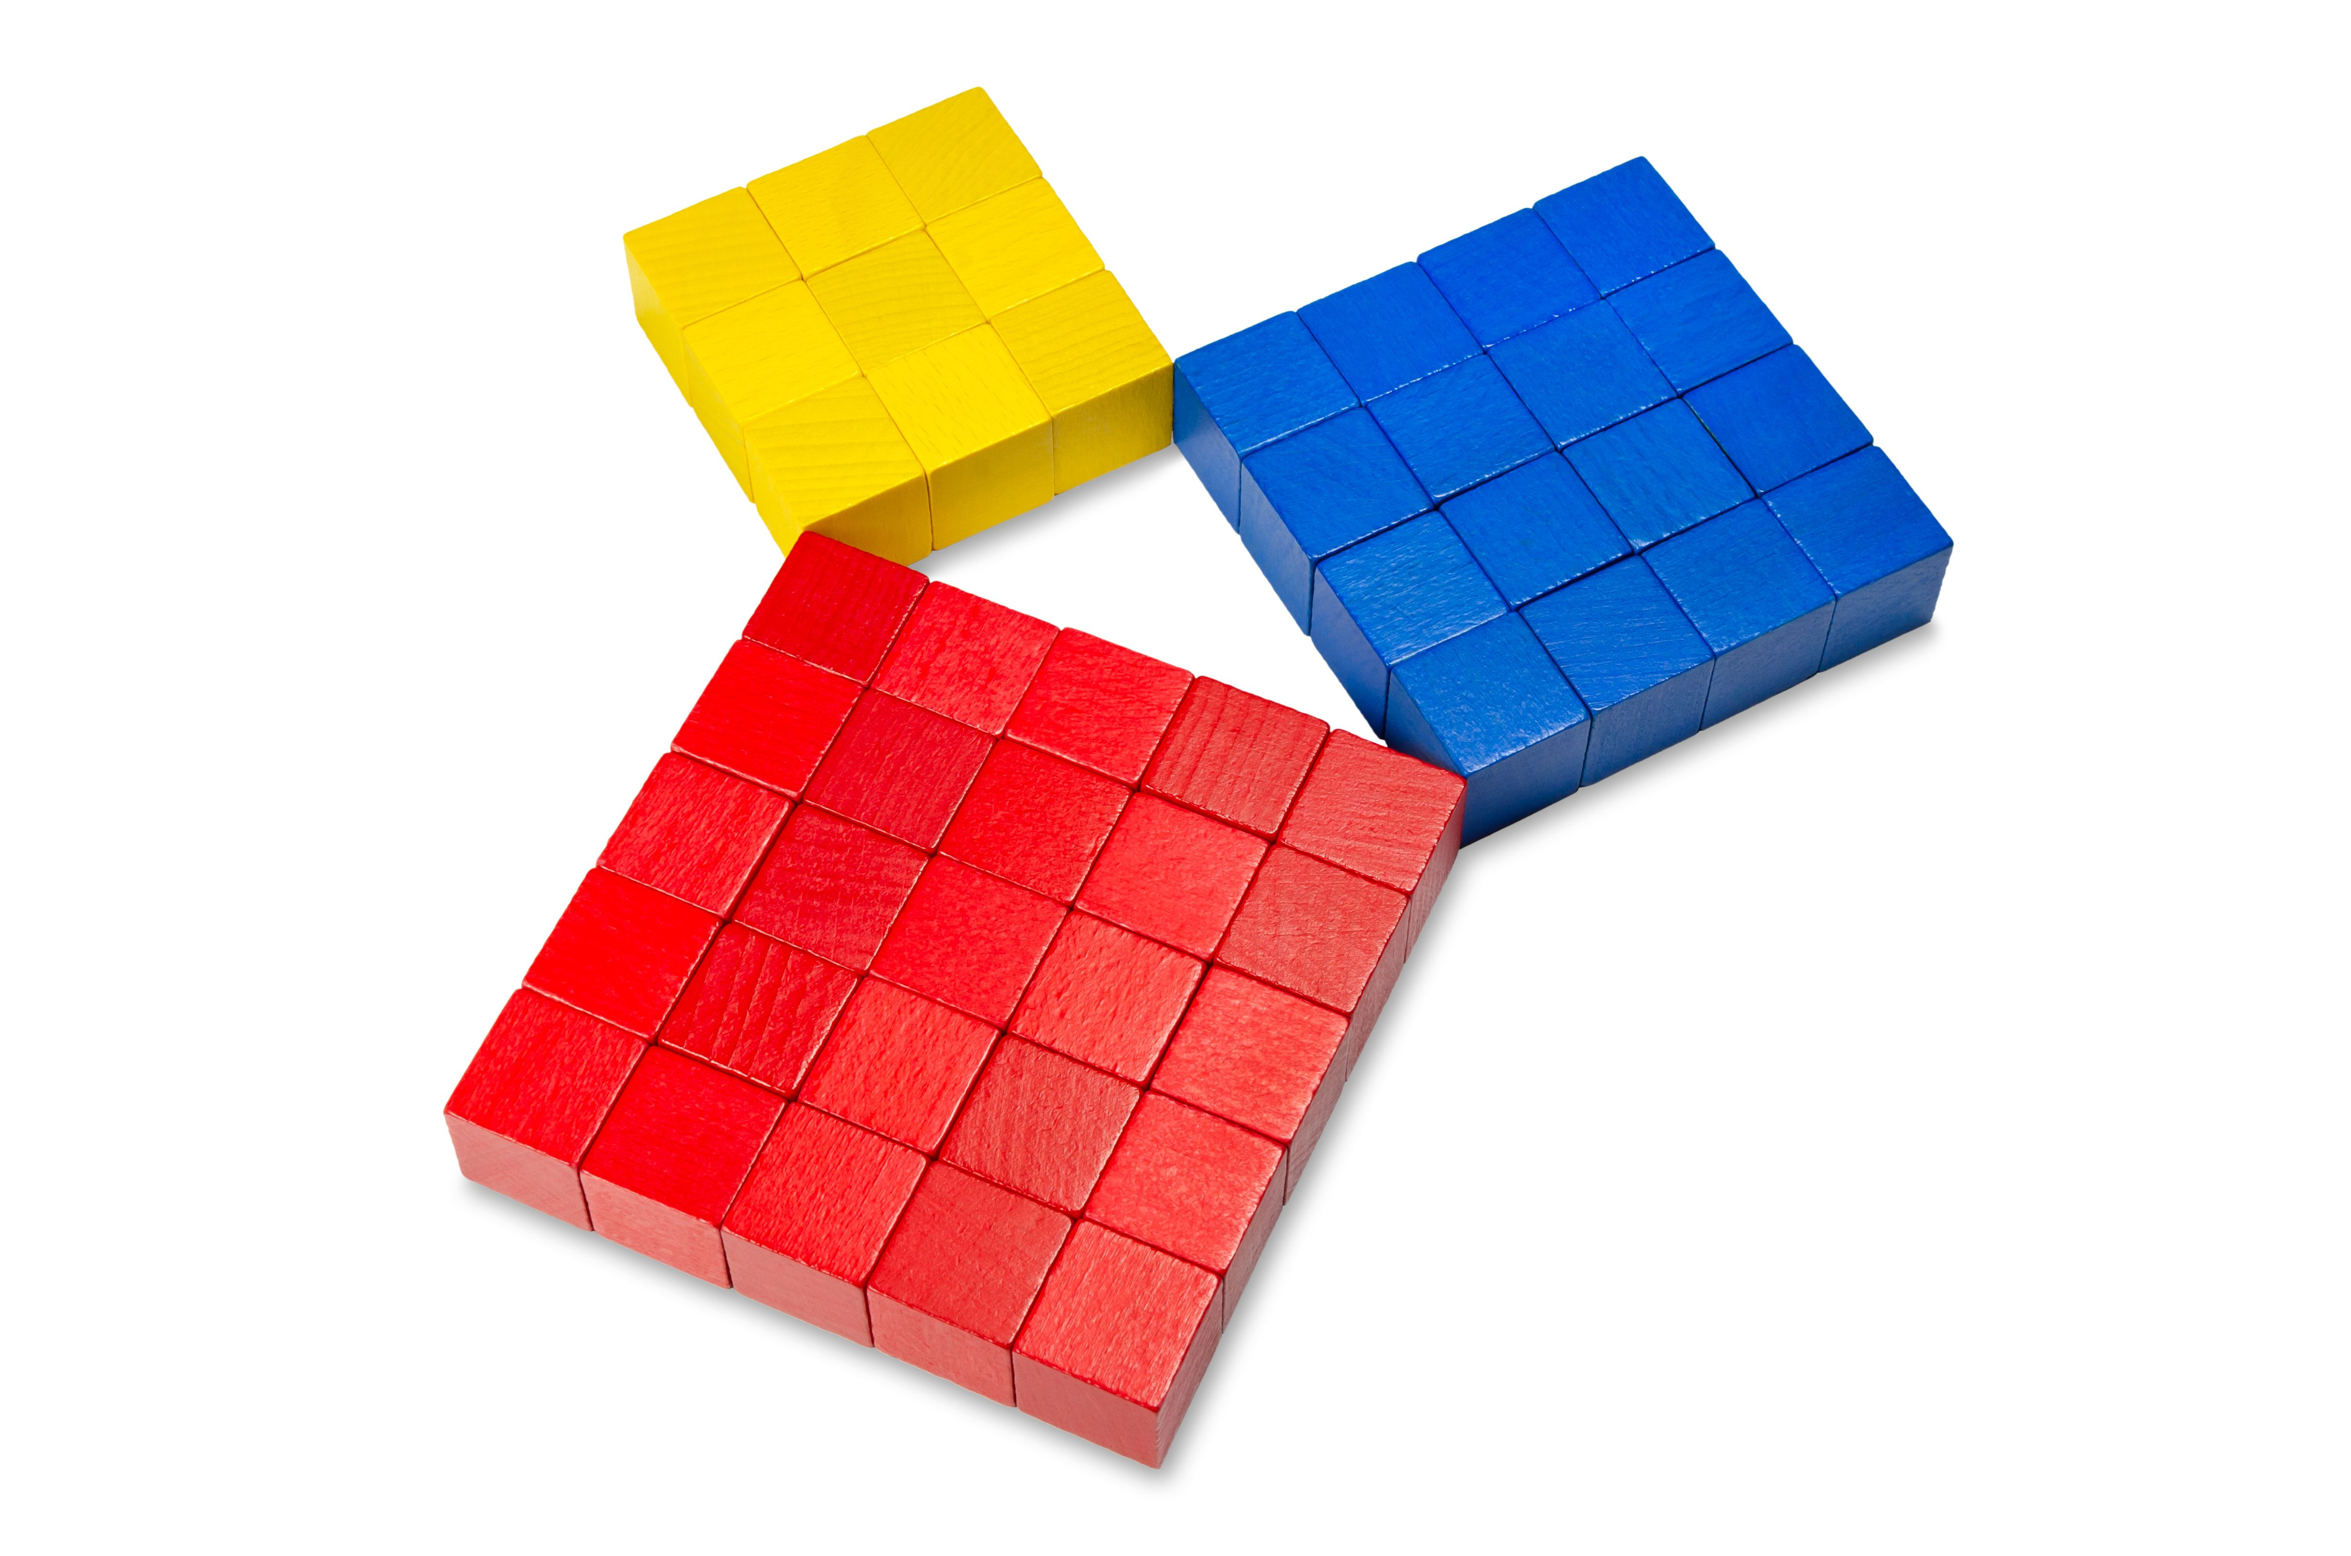

Slide 7
Pythagoras’ Theorem "For any right-angled triangle, the square of the hypotenuse is equal to the sum of the squares of the other two sides.” $$a^{2}+b^{2}=c^{2}$$
$$c$$
$$b$$
$$a$$

Slide 8
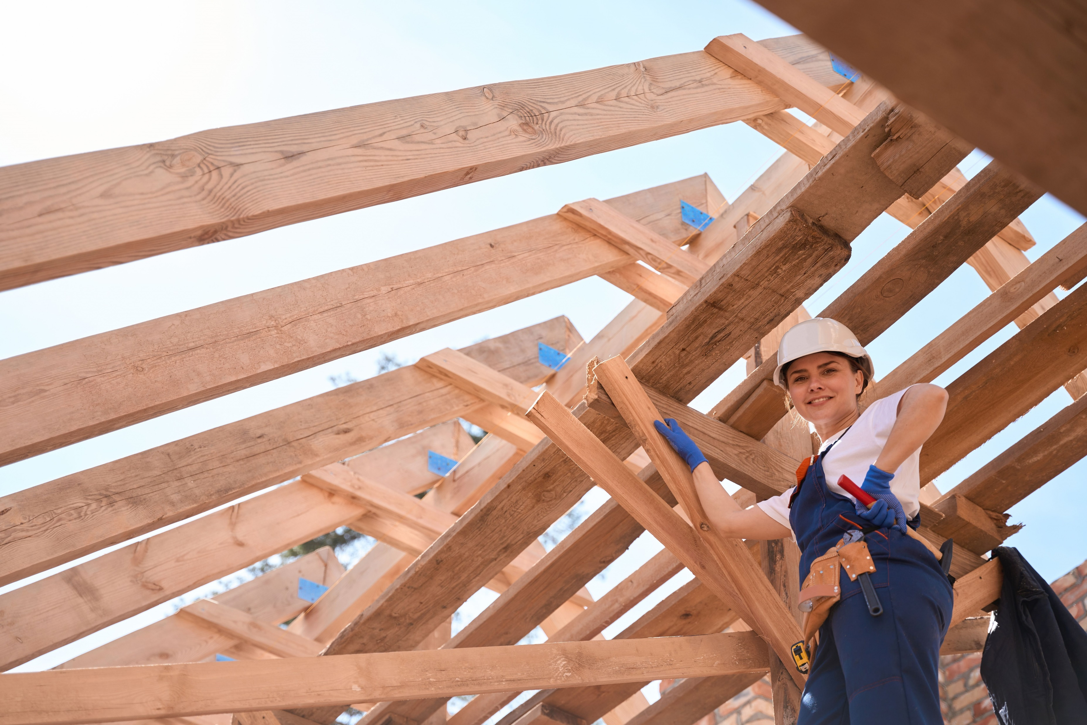
Michaela is a carpenter.
Her job might look physical, but she uses a lot of maths, as well.
Building this roof is a good example.

Slide 9
Here is a front on view of a roof truss.
The height of the roof is one-third of half the width of the roof.
The vertical pieces of timber are equally spaced.
width
12 m
Work out the lengths of all the pieces of roofing timber Michaela had to cut. Use Pythagoras’ Theorem as much as possible.

Slide 10
6² + 2² = C²
C²= 36 + 4 = 40
$$\frac{1}{3}×6$$
6.32 m
2 m
6 m
width
12 m

