Slide 1
Square numbers are the areas of squares that have whole number side lengths.
4
3
2
1
1
2
3
4
$$1^{2}=1$$
$$2^{2}=4$$
$$3^{2}=9$$
$$4^{2}=16$$
Use a calculator to work out and list the first 20 square numbers.

Slide 2
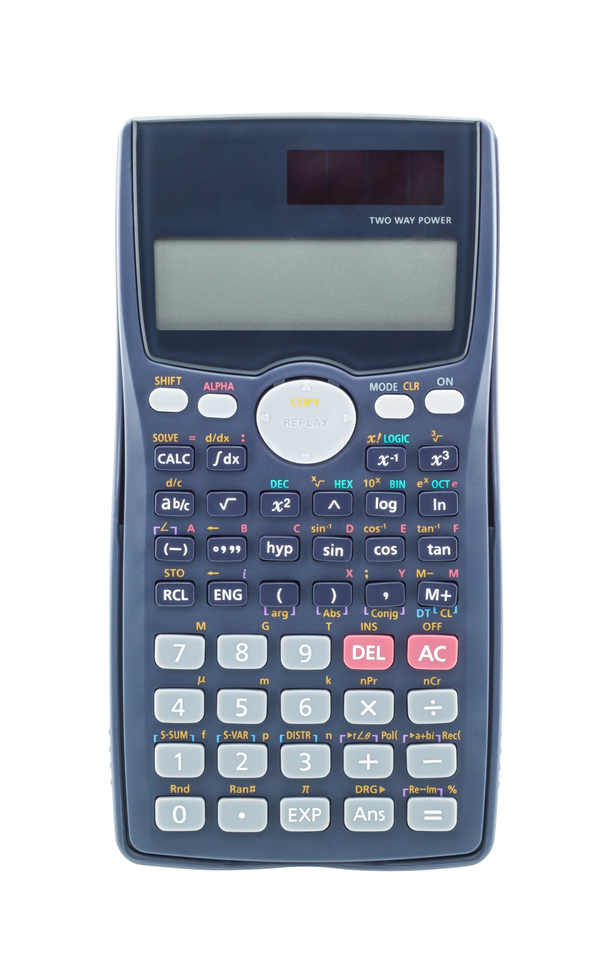
To find the square of 7, key in 7 x² =

Slide 3
$$1^{2}$$ | $$2^{2}$$ | $$3^{2}$$ | $$4^{2}$$ | $$5^{2}$$ | $$6^{2}$$ | $$7^{2}$$ | $$8^{2}$$ | $$9^{2}$$ | $${10}^{2}$$
1 | 4 | 9 | 16 | 25 | 36 | 49 | 64 | 81 | 100
$${11}^{2}$$ | $${12}^{2}$$ | $${13}^{2}$$ | $${14}^{2}$$ | $${15}^{2}$$ | $${16}^{2}$$ | 1$7^{2}$ | $${18}^{2}$$ | $${19}^{2}$$ | $${20}^{2}$$
121 | 154 | 169 | 196 | 225 | 256 | 289 | 324 | 361 | 400
Since 64 + 225 = 289,
you can write 8² + 15² = 17²
Can you find other examples where two square numbers add to a third square number?

Slide 4
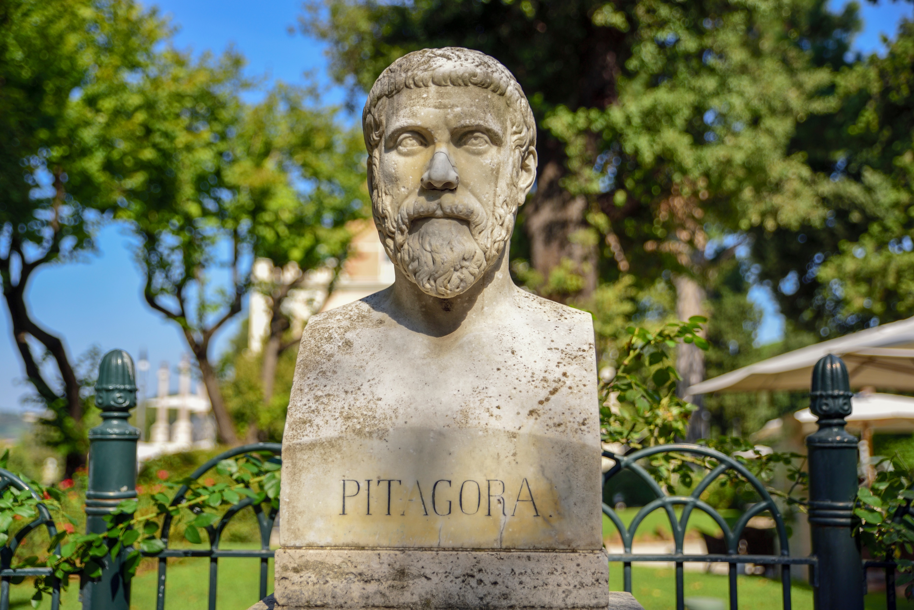
3² + 4² = 5²
5² + 12² = 13²
6² + 8² = 10²
8² + 15² = 17²
9² + 12² = 15²
12² + 16² = 20²

Slide 5
13
169

Slide 6
To find the side length of the square with area of 169, key in √ 169 =

Slide 7
All the shapes inside the boundary are squares.
Find the area of each square.
81 cm²
64 cm²

