Slide 1
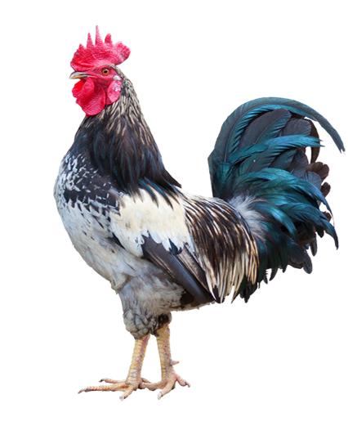
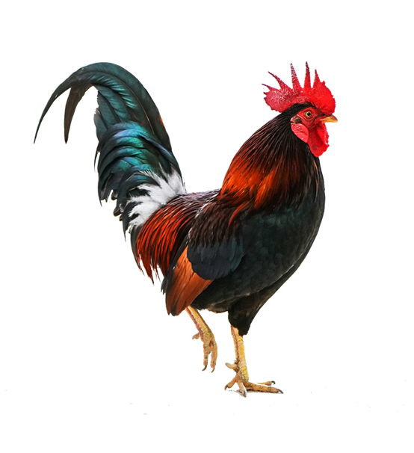
Speckles
Flame
11 metres
18 metres
8 metres
14 metres

Slide 2
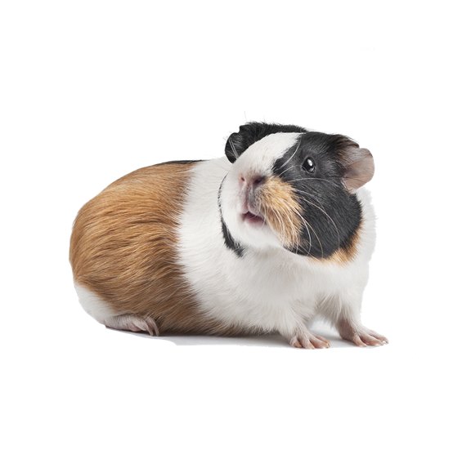
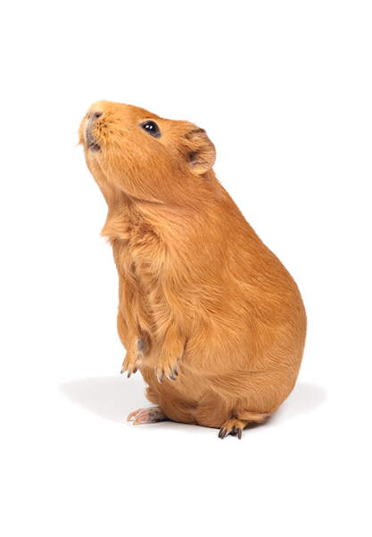
Stripe
Chocolate
16 metres
12 metres
15 metres
17 metres

Slide 3
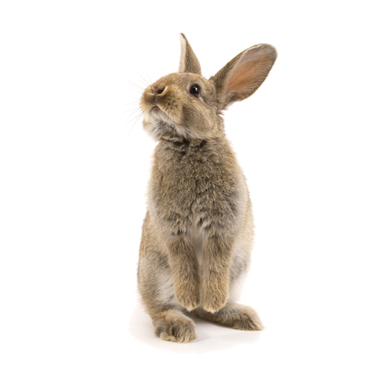
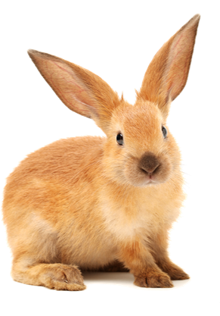
Fluff
Jumper
15 metres
14 metres
13 metres
14 metres

