Slide 1
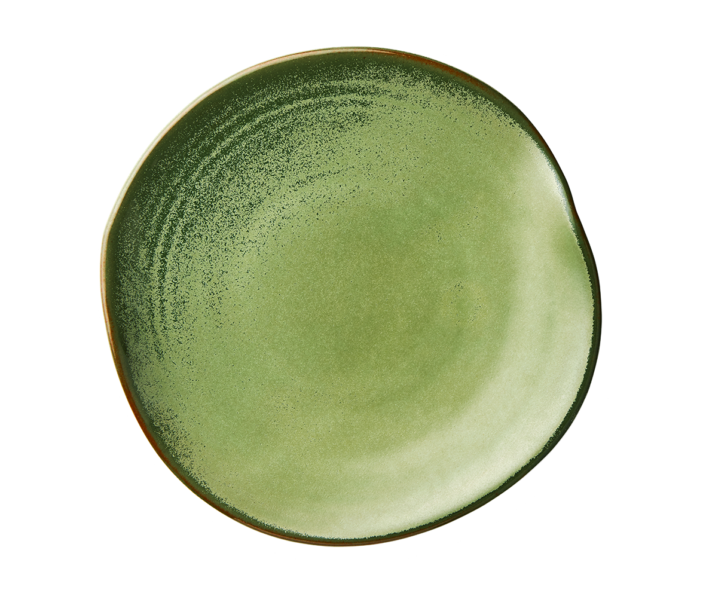
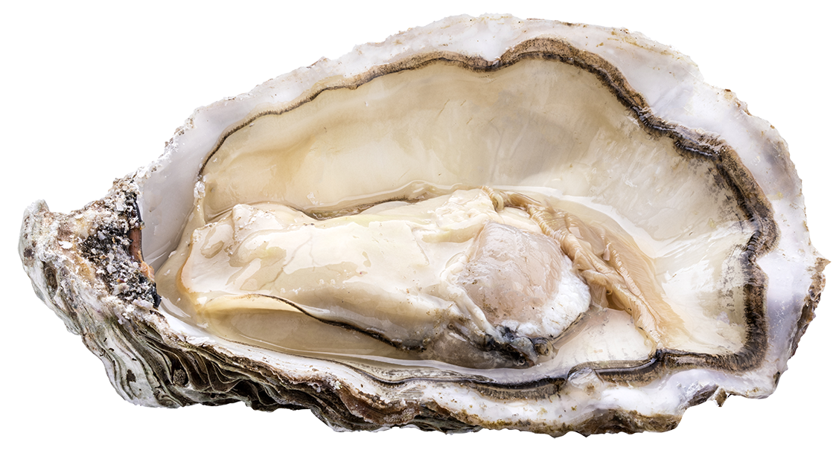
There are two plates of kaimoana.
One plate has 12 shellfish, and the other plate has 20 shellfish.

Slide 2
Each plate has the same fraction of mussels (kūtai) and the same fraction of oysters (tio).

Slide 3
One plate has ten more mussels than oysters.

Slide 4
If the plates are combined into one plate then one quarter of the shellfish are oysters (tio) and three quarters are mussels (kūtai).

Slide 5
Both plates have 15 shellfish on them.
The shellfish are either tio or kūtai.
There is one more oyster (tio) on the left plate than than the right plate.
There are five more mussels (kūtai) than oysters (tio) on the left plate.
Three fifths of the shellfish on the right plate are mussels (kūtai).

