Slide 1
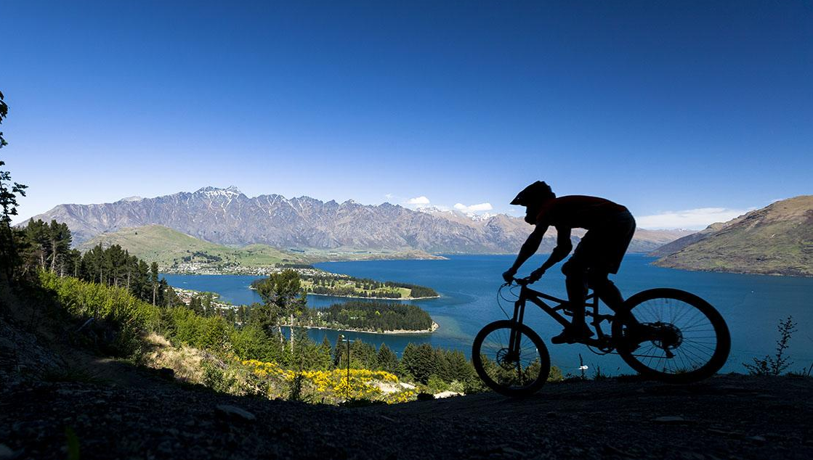
What sport is shown in this photograph?

Slide 4
Whole journey
Whole journey

