Slide 1
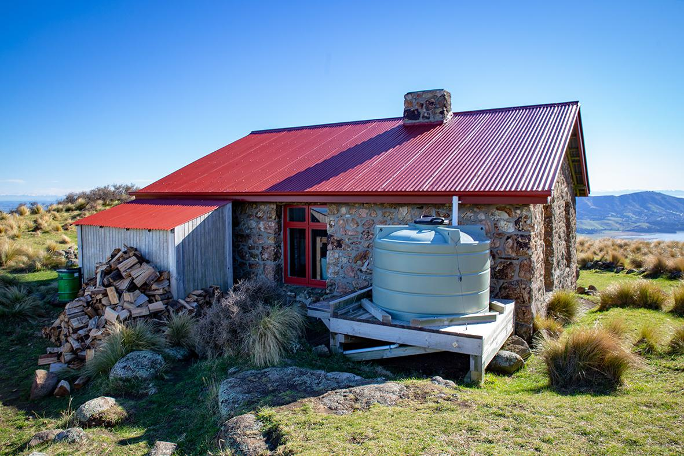

Slide 2
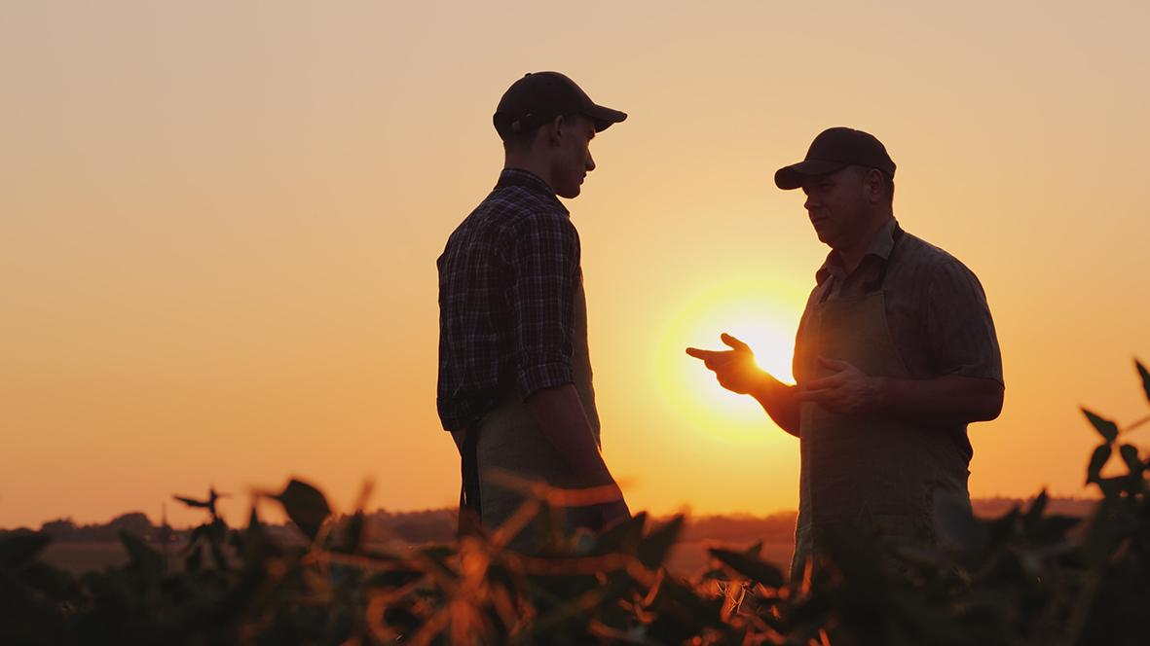
It’s been a bit dry lately, Bob. We need a good bit of rain.
I’ll say, Joe!
How are the water tanks holding up?

Slide 3
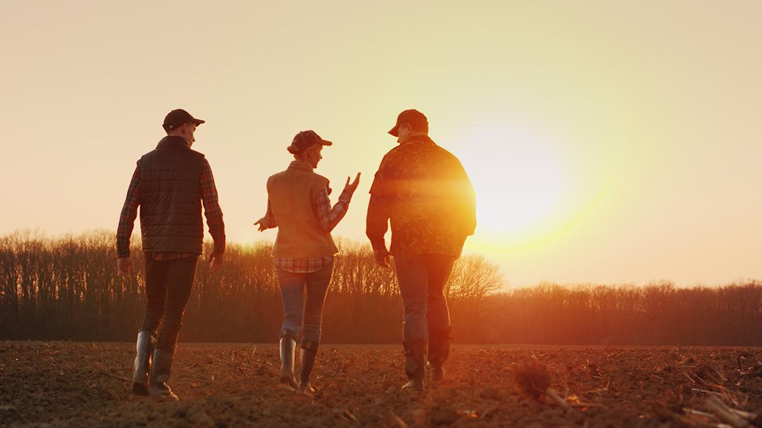
I checked today. Our tank is only one quarter full.
We’re better off, I think.
Our tank is three twelfths full.
Both tanks hold the same amount of water, right?

Slide 4
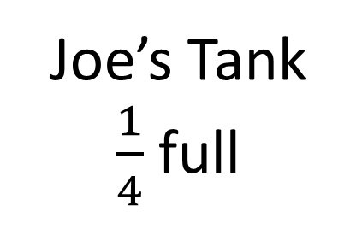

Slide 5
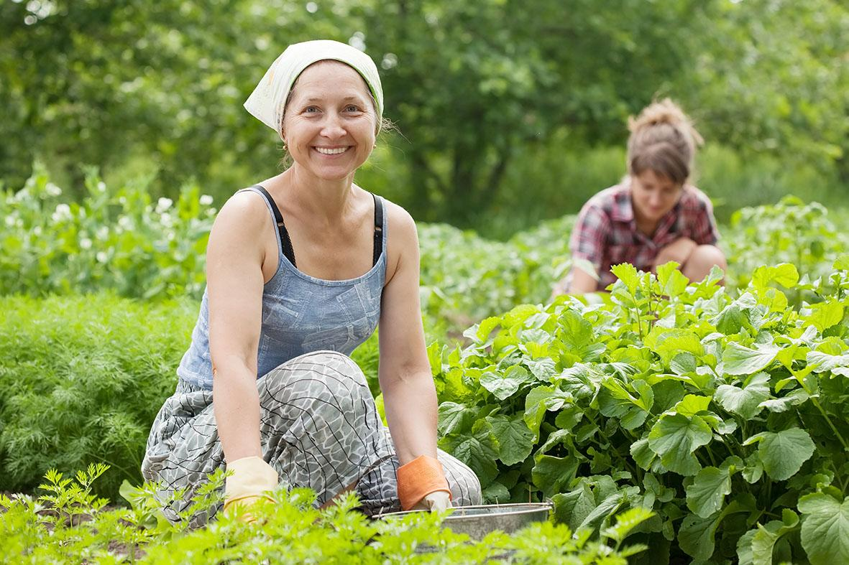
Hine
Mel

Slide 6
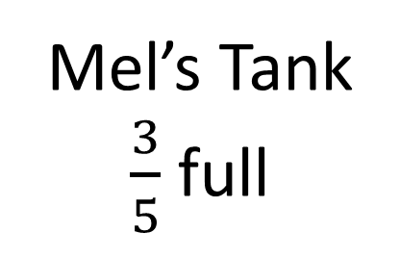

Slide 7
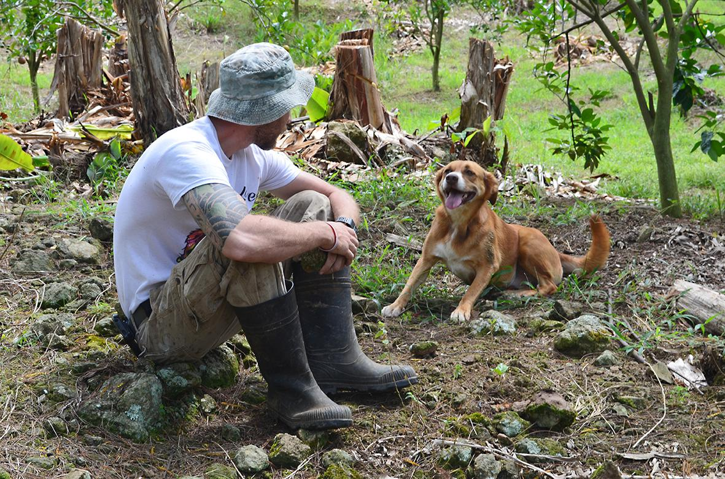
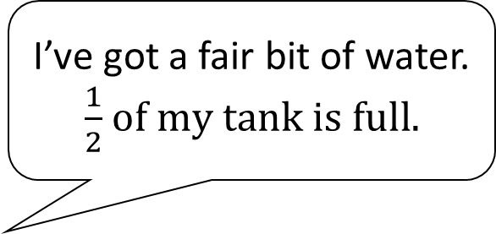
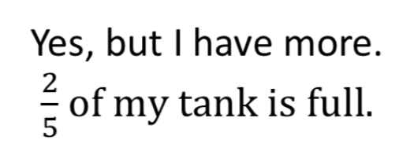

Slide 8
