Slide 1
Have you ever been in a car that runs out of fuel?
What did the driver do?
How are cars designed so this should not happen?

Slide 2
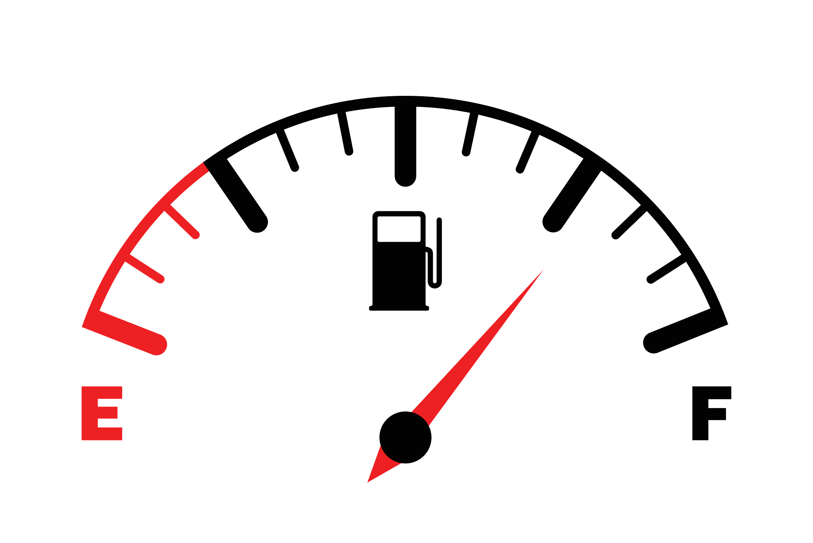
How much petrol is left in the tank?

Slide 3
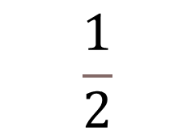
F
E

Slide 4
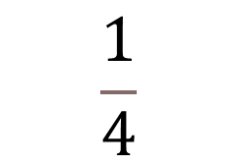
F
E

Slide 5
F
E

Slide 6
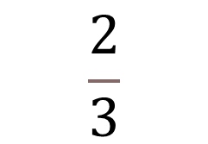
F
E

Slide 7
2
3
F
E
4

Slide 8
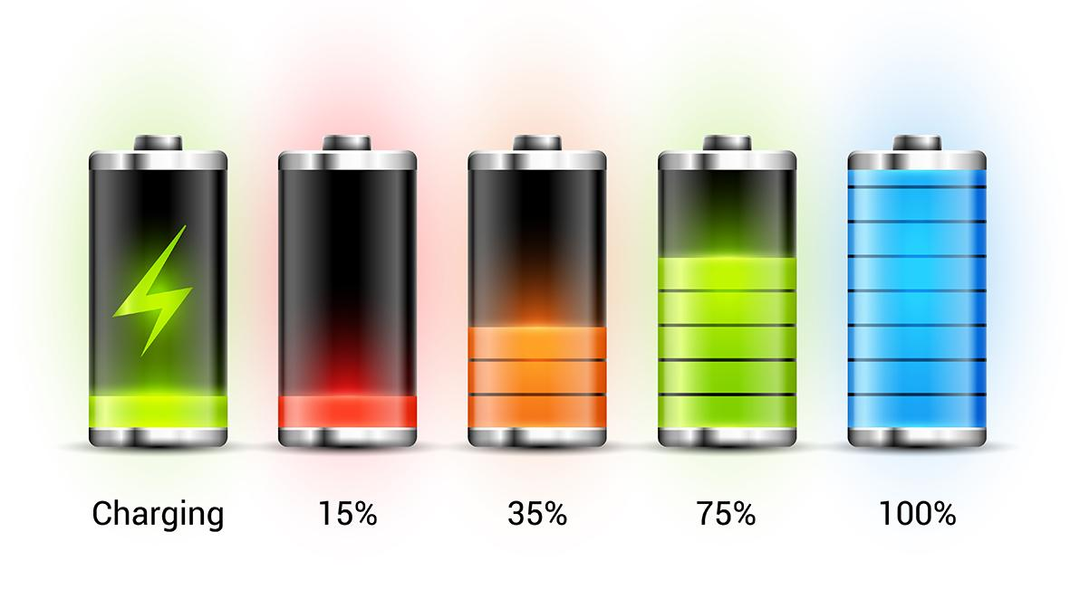
Electric powered devices like cars and mobile phones usually have a display like this. The icons show you how much charge the battery holds at the moment you look.

