Slide 1
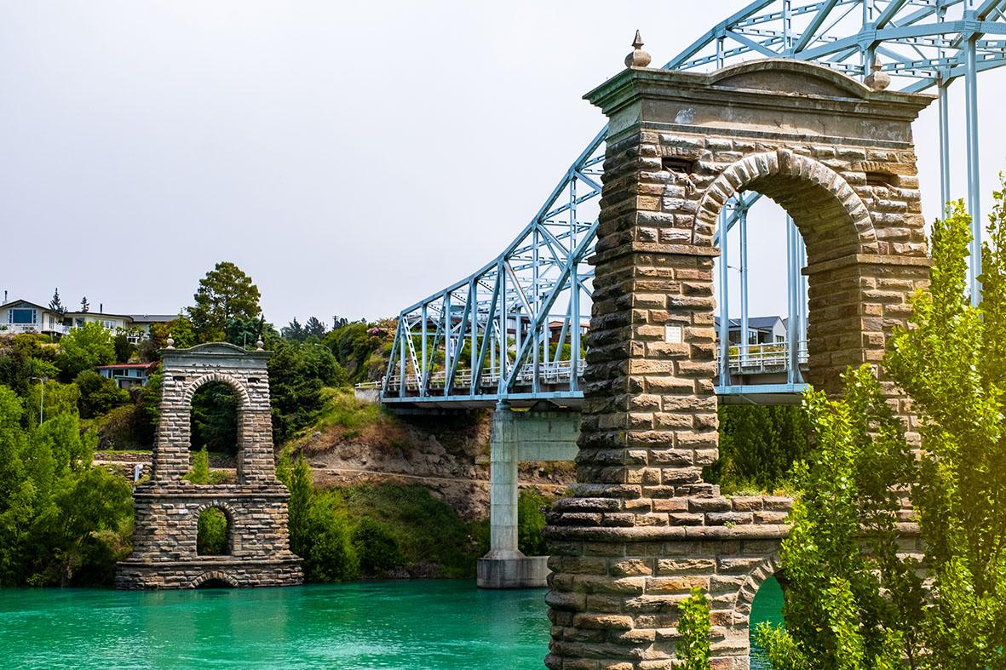
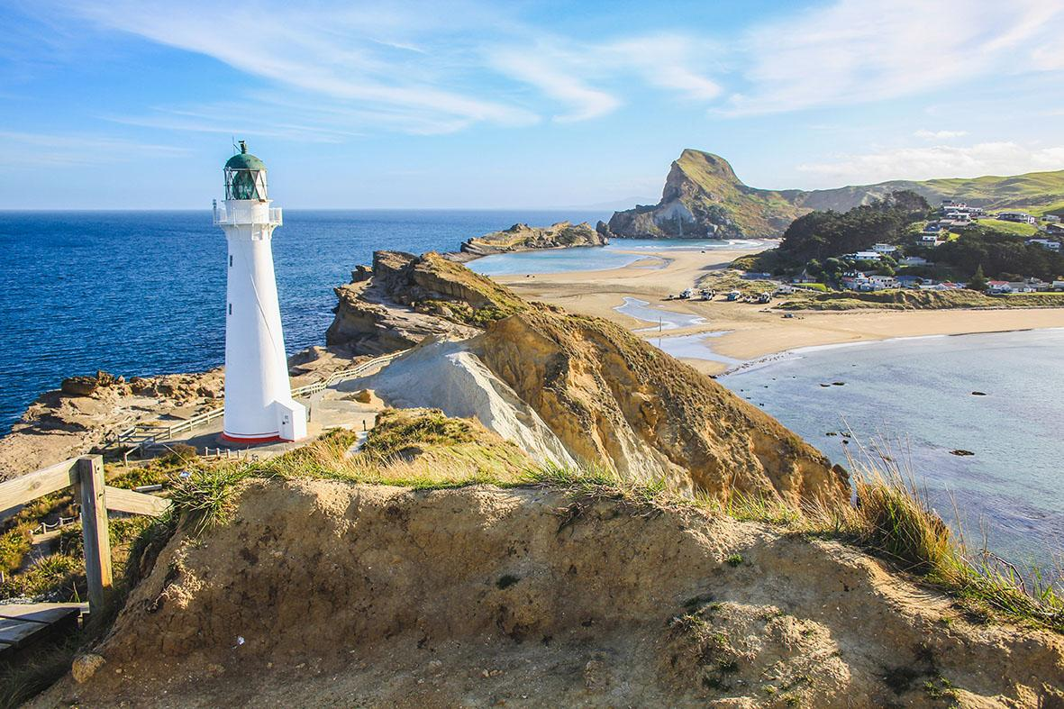
Alexandra 34.5⁰C
Castlepoint 19.8⁰C
What is the difference in temperature between these two places?

Slide 2
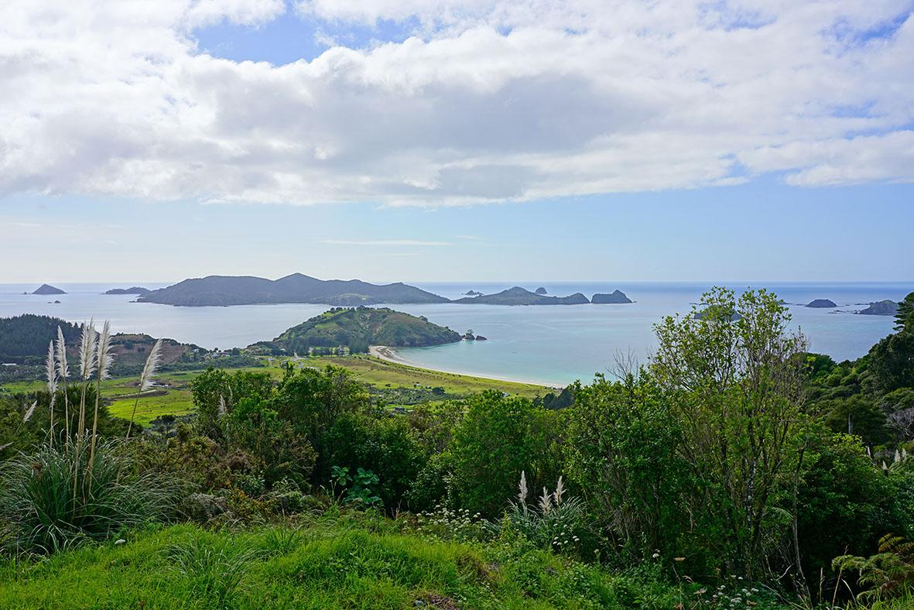
Kaitaia 28.6⁰C
Levin 19.2⁰C
What is the difference in temperature between these two places?

Slide 3
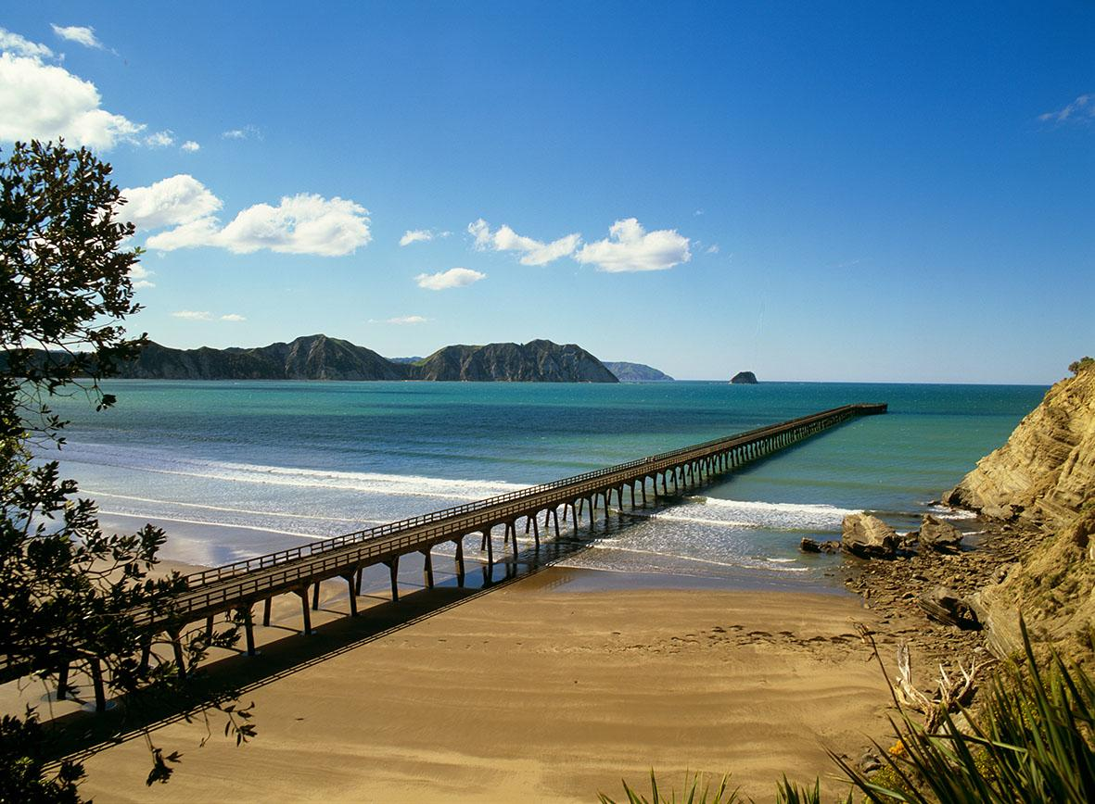
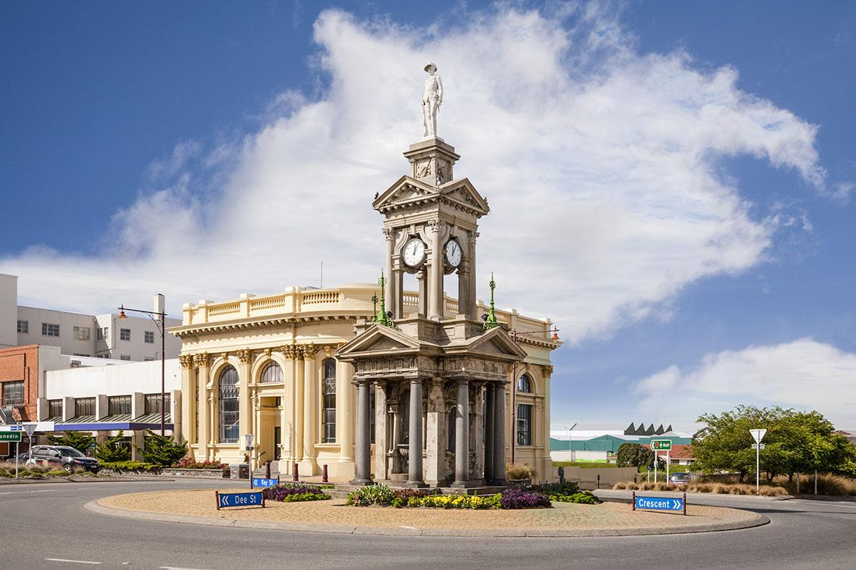
Tolaga Bay 31.6⁰C
Invercargill 12.7⁰C
What is the difference in temperature between these two places?

Slide 4
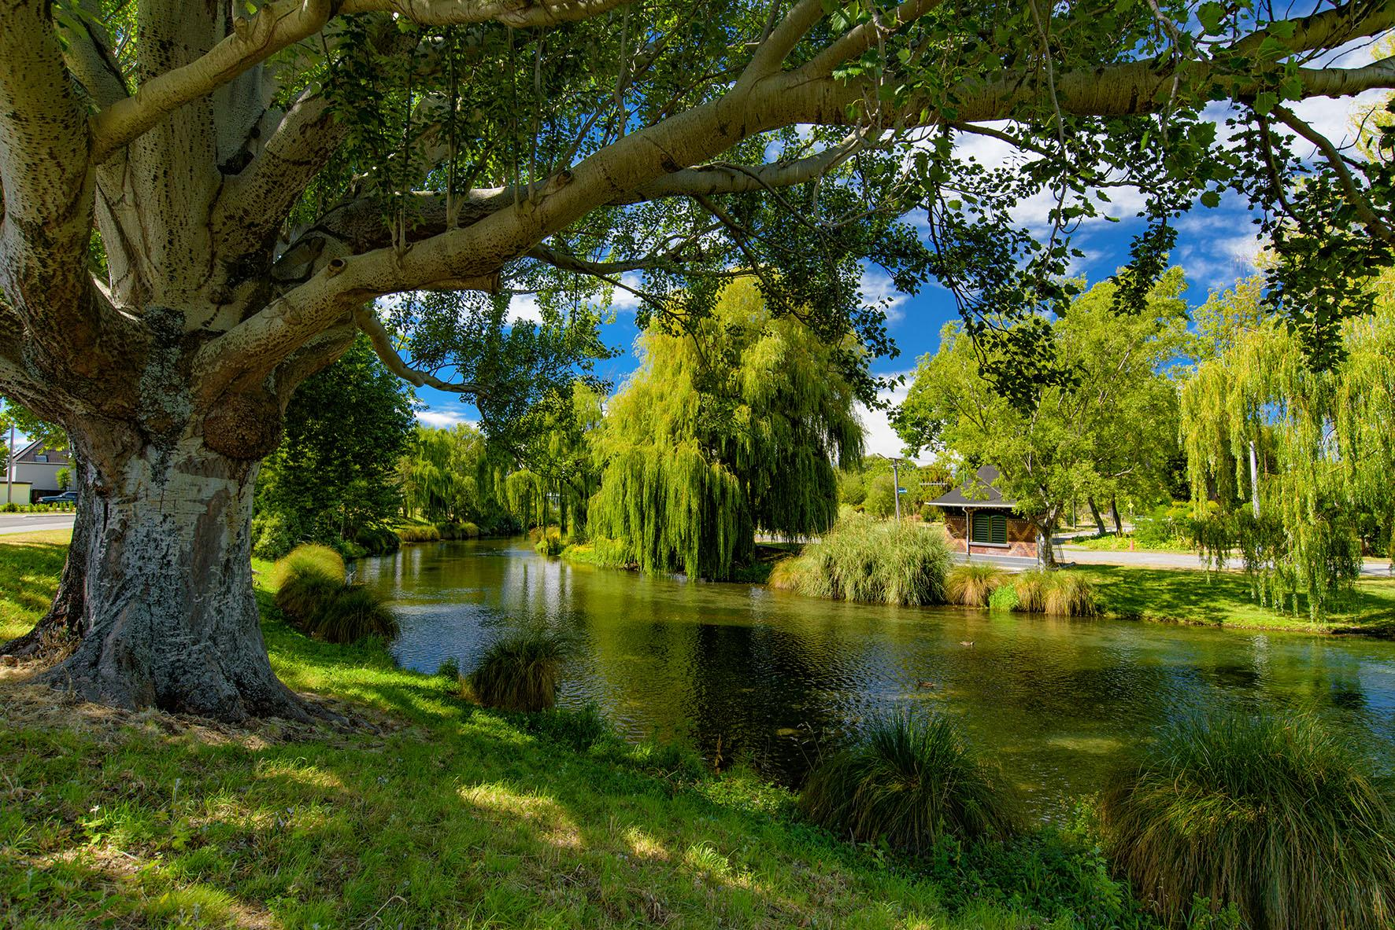
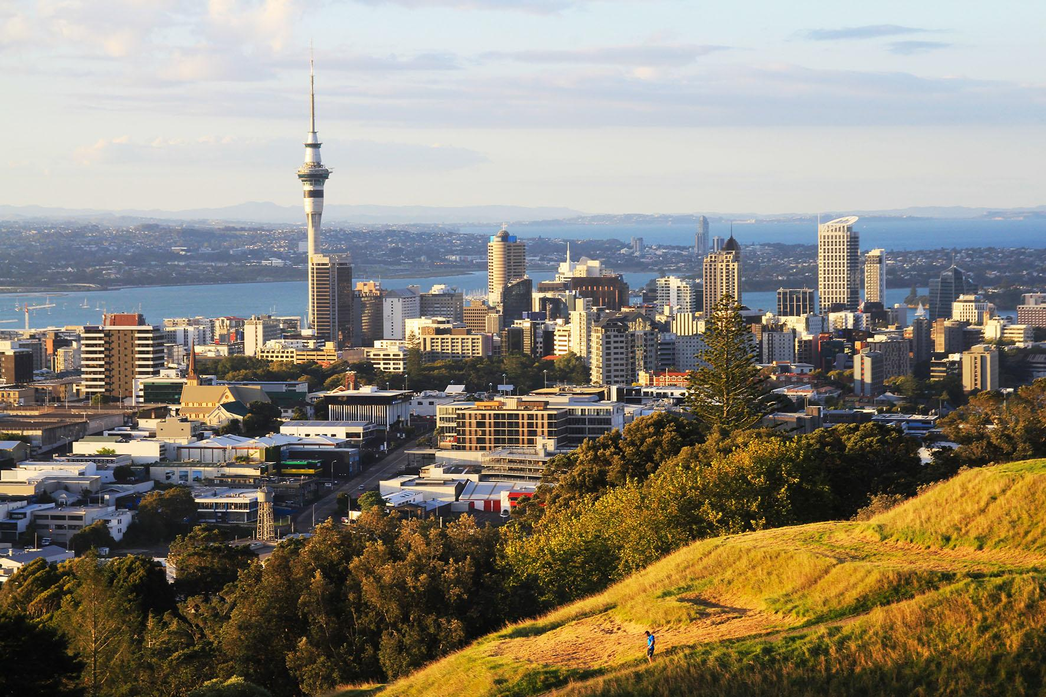
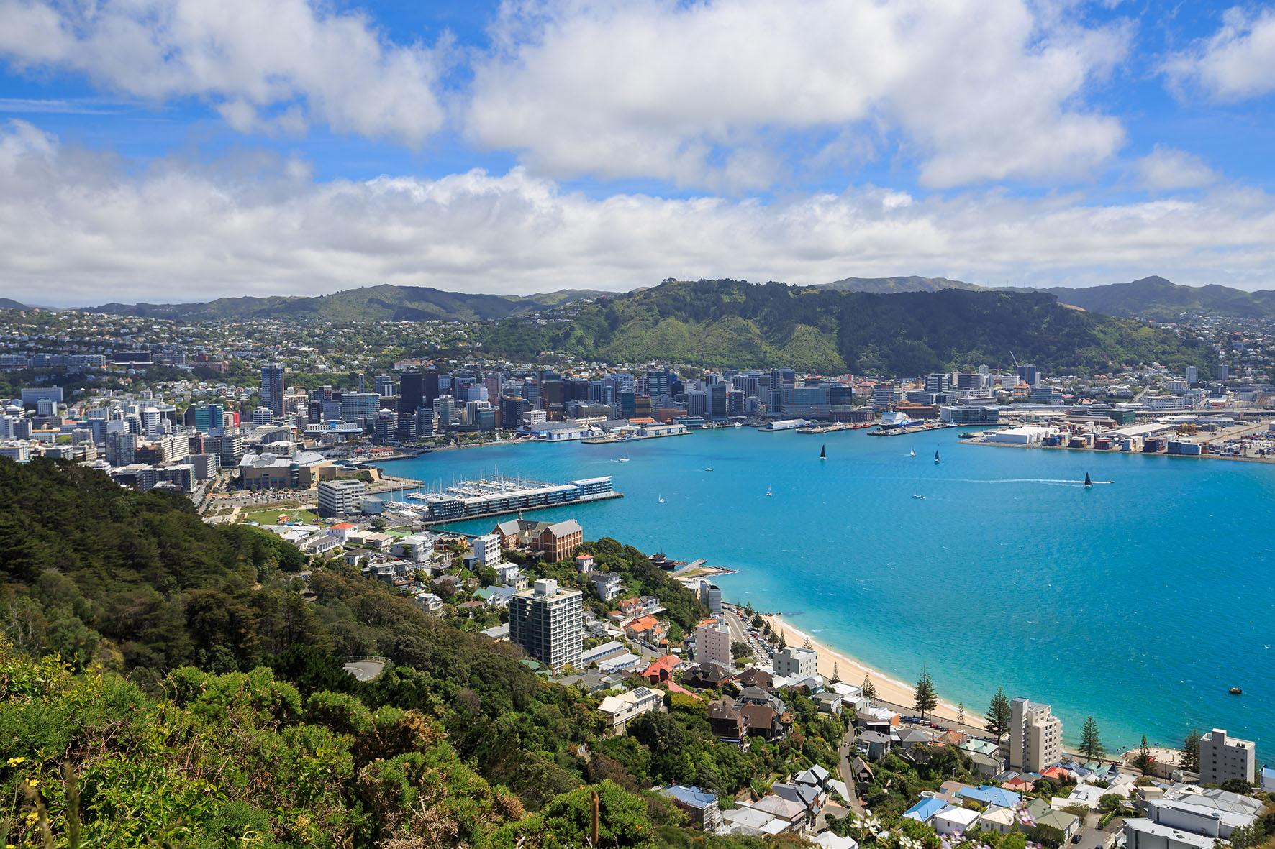
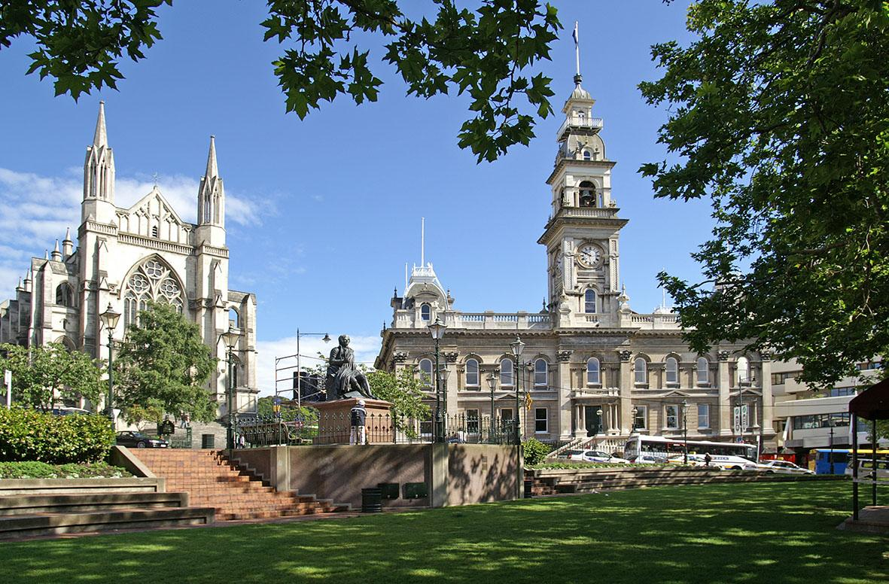
Sum of
31.1⁰C
Christchurch 10.6⁰C
Auckland 20.5⁰C
Sum of
34.3 ⁰C
Sum of
29.2 ⁰C
Wellington 13.8⁰C
Dunedin 8.7⁰C

Slide 5
Christchurch 10.6⁰C
Auckland 20.5⁰C
Difference of
1.9⁰C
Difference of
3.2 ⁰C
Difference of
5.1⁰C
Wellington 13.8⁰C
Dunedin 8.7⁰C

