Slide 1
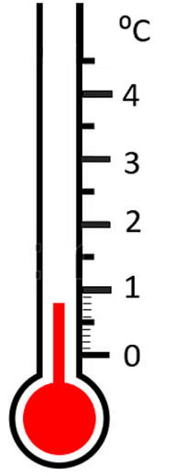
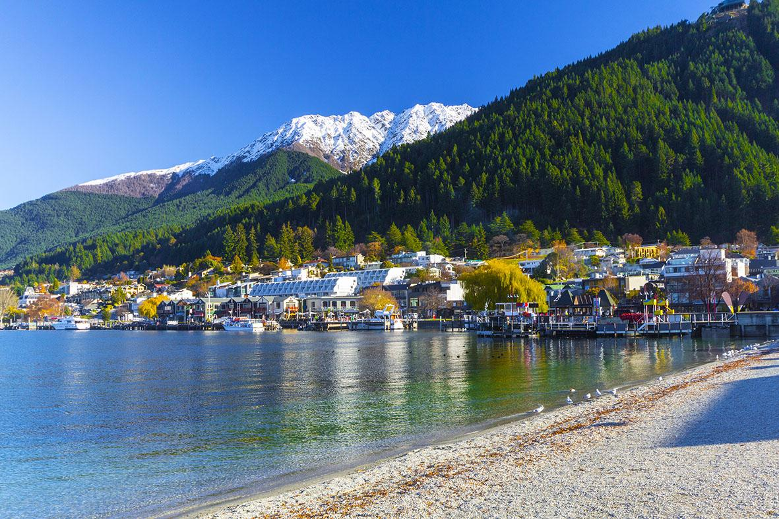
Queenstown
If the temperature increases by 3 degrees, what will the temperature be then?

Slide 2
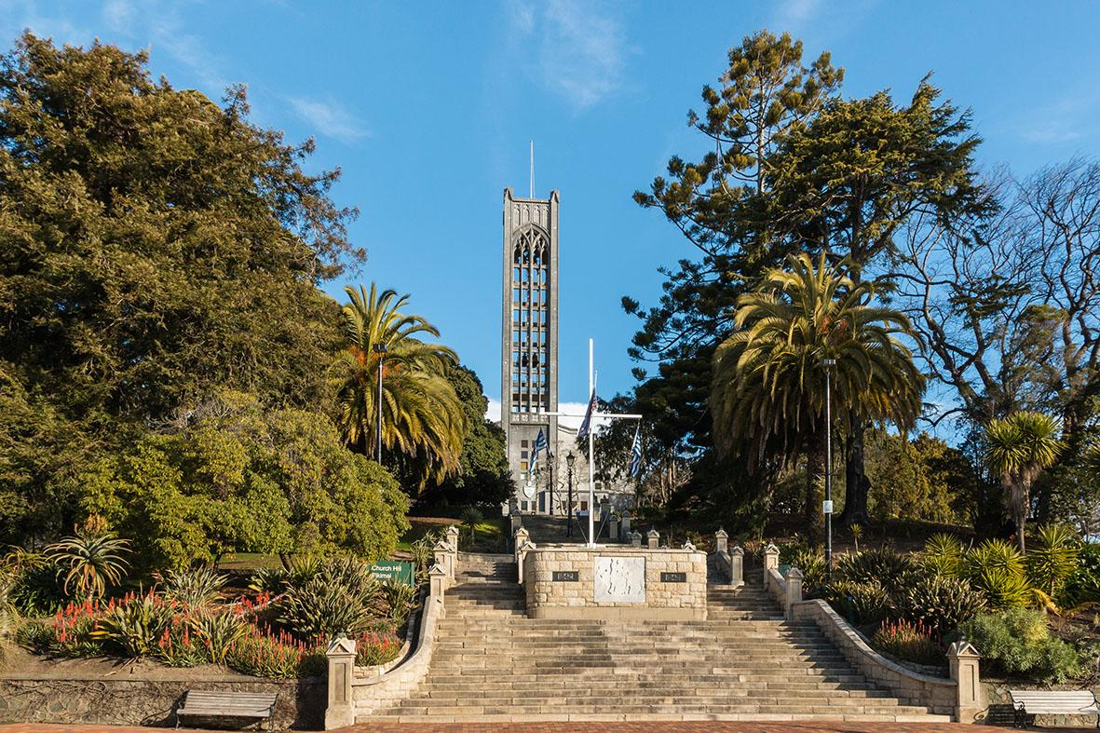
Nelson
If the temperature increases by 2.7 degrees, what will the temperature be then?

Slide 3
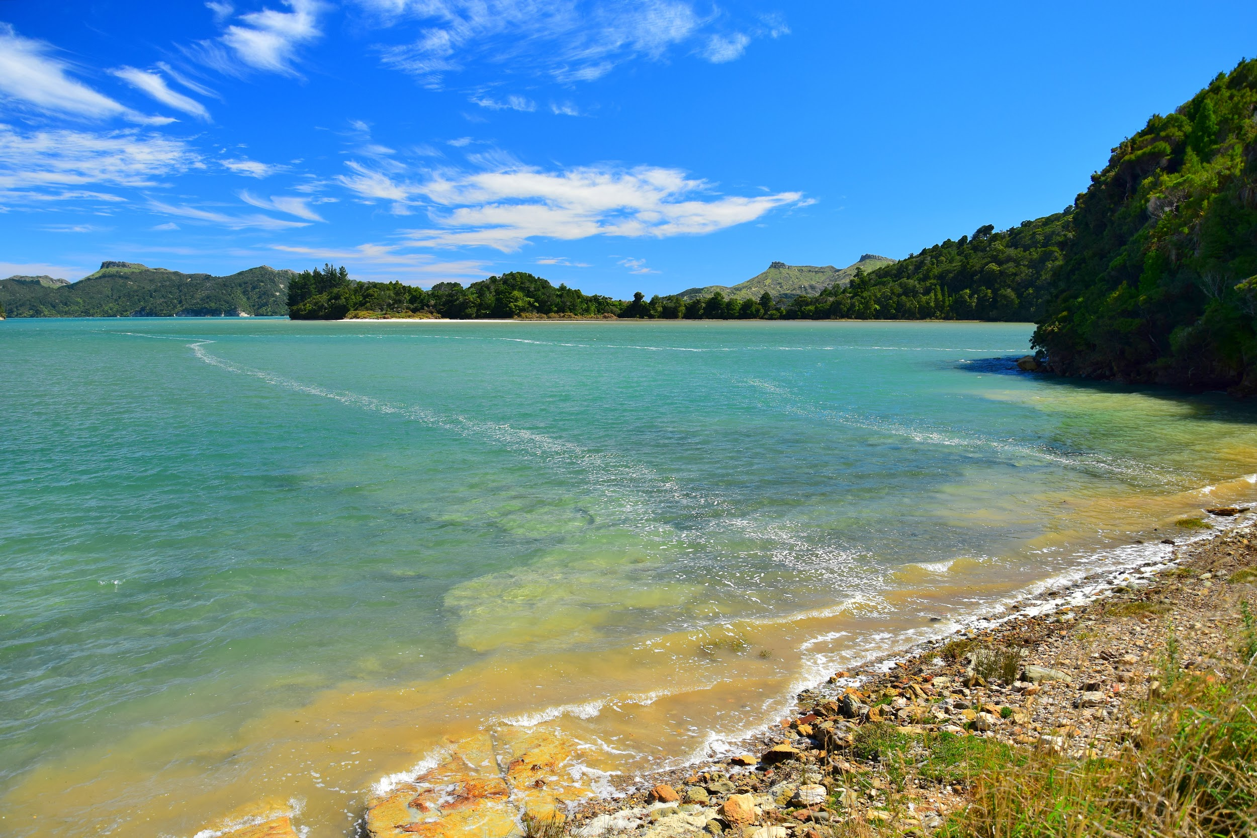
Whanganui
If the temperature increases by 1.5 degrees, what will the temperature be then?

