Slide 1
What are these devices used for?
What do the numbers mean?

Slide 2
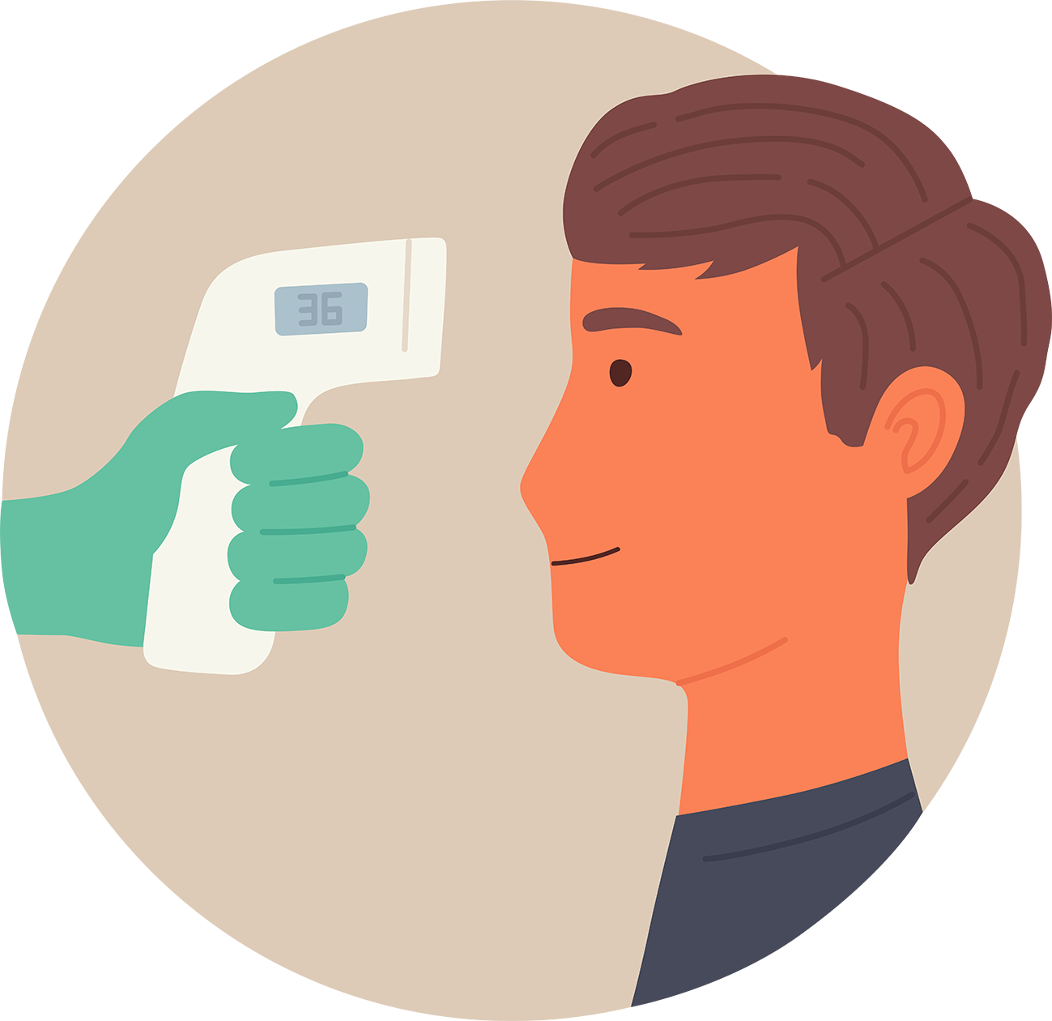
Body temperature is measured by putting the probe under your arm or in your ear.
Some thermometers scan your forehead. Those devices are used at airports to check for passengers who have “a temperature.”
What does “have a temperature” mean?

Slide 3
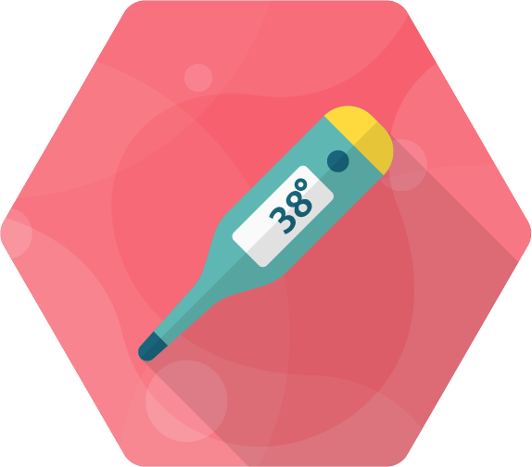
A measurement of 37.8⁰C or higher is a sign that your body is fighting an infection.
Your body may need some help.

Slide 4
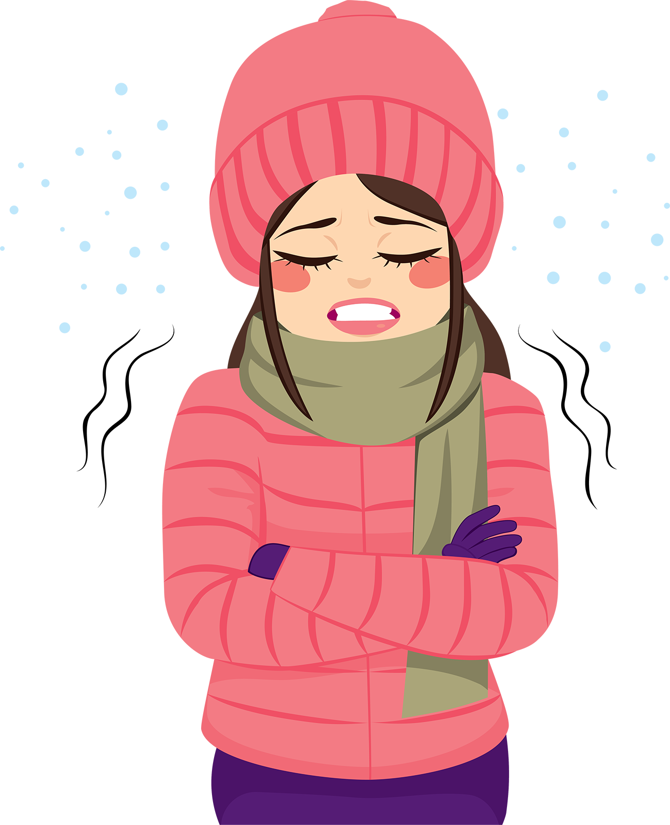
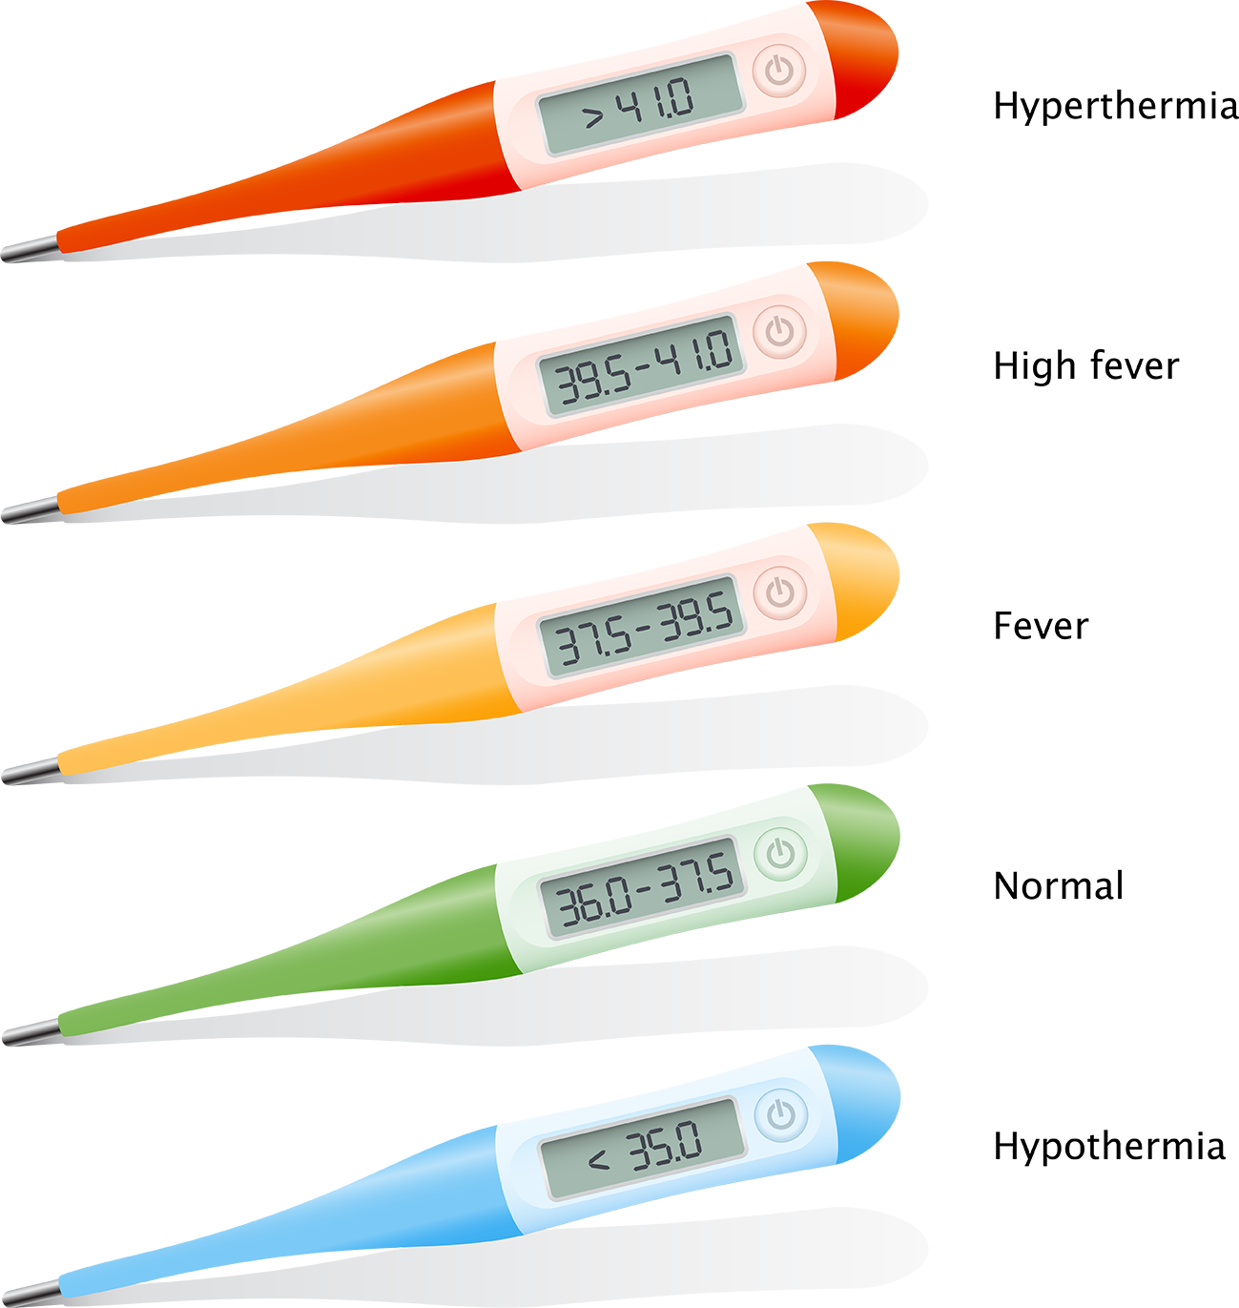
She looks cold! What do you think her body temperature might be?
What do the signs < and > mean?

Slide 5
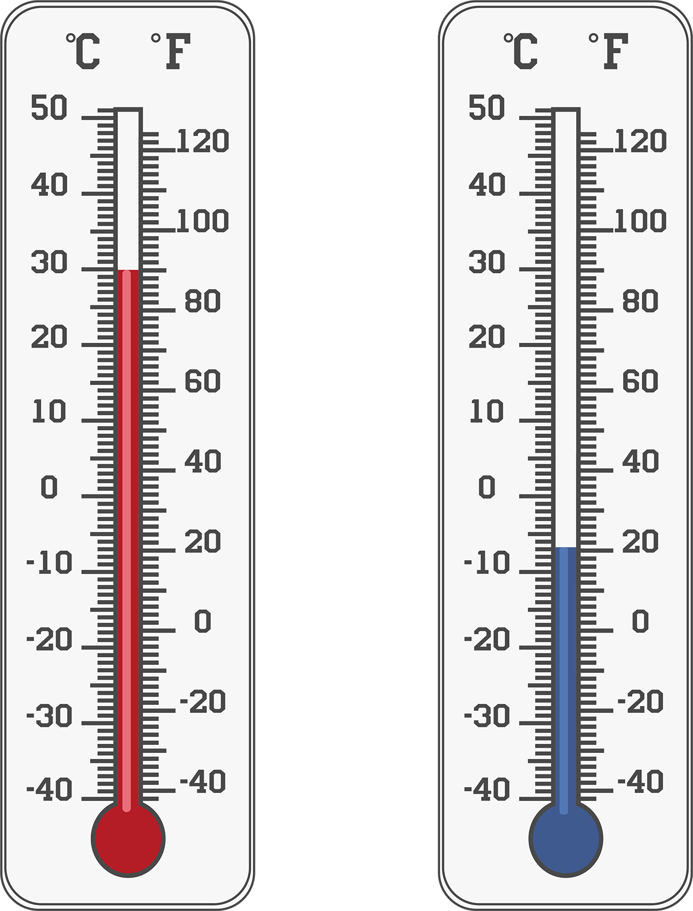

Slide 6
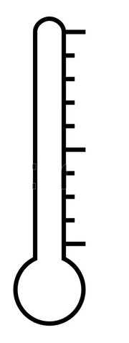
⁰C
40
30
20
10
0
Dunedin

Slide 7
⁰C
40
30
20
10
0
Whangārei

Slide 8
⁰C
40
30
20
10
0
Napier

Slide 9
⁰C
40
30
20
10
0
Kaikōura

Slide 10
⁰C
10
40
9
40
8
30
30
7
20
6
20
5
?
10
10
4
3
0
0
2
1
0

Slide 11
2
1
0

Slide 12
Why are ten tenths written as 1 and not as 0.10?
2
Why are ten tenths written as 1 and not as 0.10?
1
0.9
0.8
0.7
0.6
0.5
0.4
0.3
0.2
0
0.1

