Slide 1
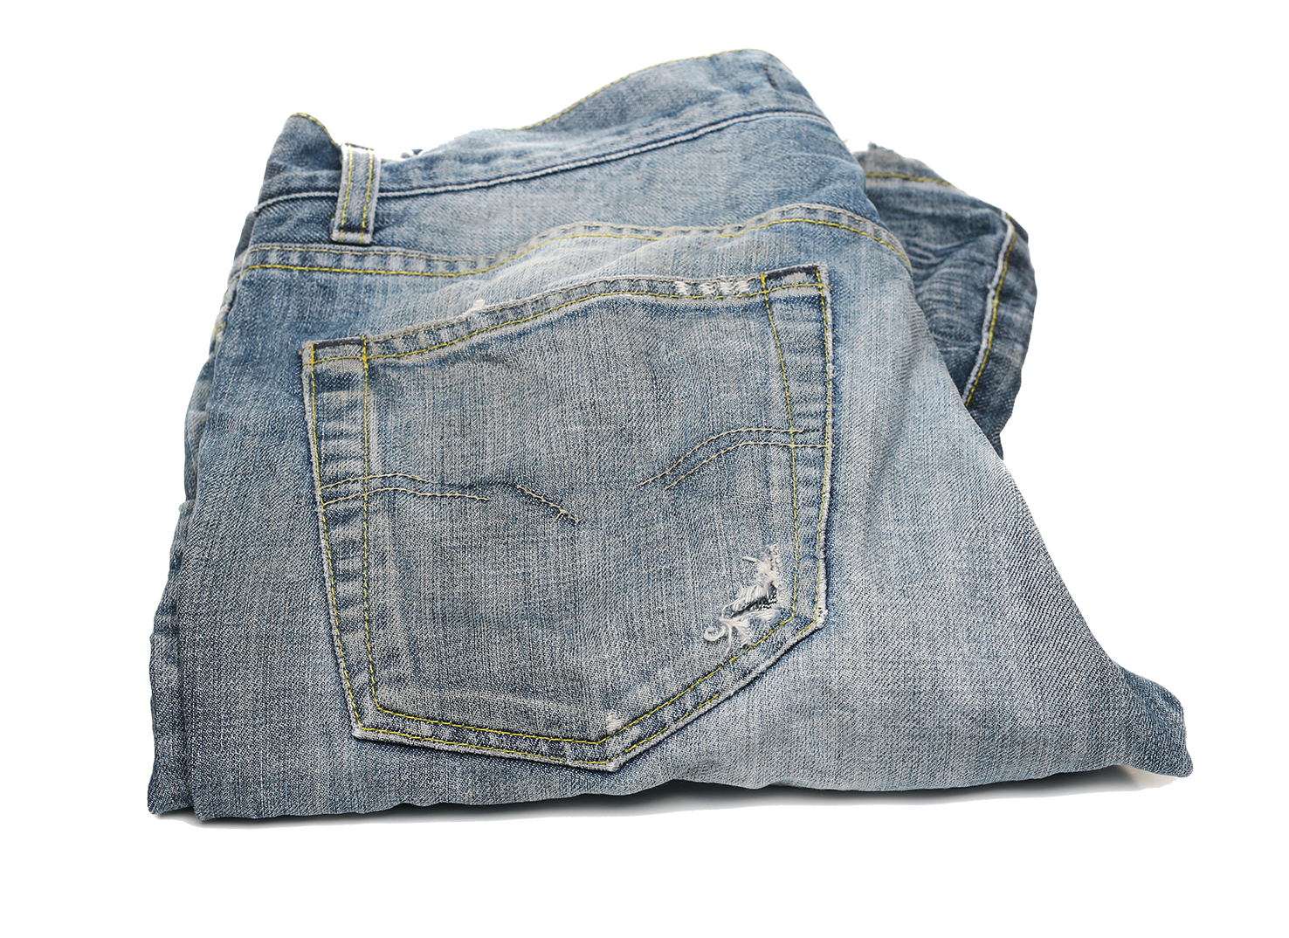
$20.00

Slide 2
Using a percentage bar for finding the price of jeans.
Percentage
10%
40%
60%
0%
100%
40% off
$0
$20.00
$2.00
$8.00
$12.00
Amount

Slide 3
Work out how much you would pay for the pair of jeans with these discounts.
50%
25%
20%
10%
30%
60%
15%
$20.00
Percentage
0%
100%
$0
$20.00
Amount

Slide 4
Percentage
50%
0%
100%
$10.00 off
$0
$20.00
$10.00
Amount
Percentage
50%
75%
0%
100%
$5.00 off
$0
$20.00
$10.00
$15.00
Amount

Slide 5
Percentage
90%
0%
100%
$2.00
off
$0
$20.00
$18.00
Amount
Percentage
70%
80%
90%
0%
100%
$6.00 off
$4.00 off
$0
$20.00
$14.00
$16.00
$18.00
Amount

Slide 6
Percentage
70%
0%
100%
$6.00 off
$0
$20.00
$14.00
Amount
Percentage
70%
85%
0%
100%
$3.00 off
$0
$20.00
$14.00
$17.00
Amount

