Slide 1
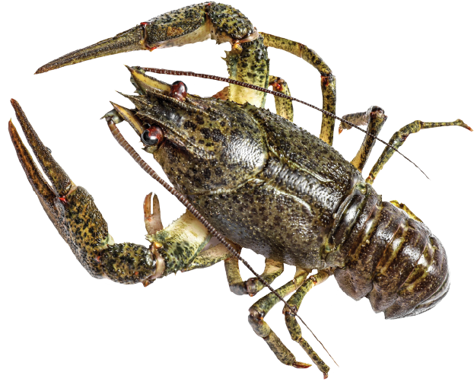
Kōura are freshwater crayfish.
They live in rivers, streams, and lakes all around New Zealand. Kōura were a food source for Māori people before Europeans arrived, and still are today.
Kōura are not very big.
South Island kōura grow to about 80 millimetres long, and North Island kōura are 10 millimetres shorter.
Get your ruler out to see how long a kōura is.

Slide 2
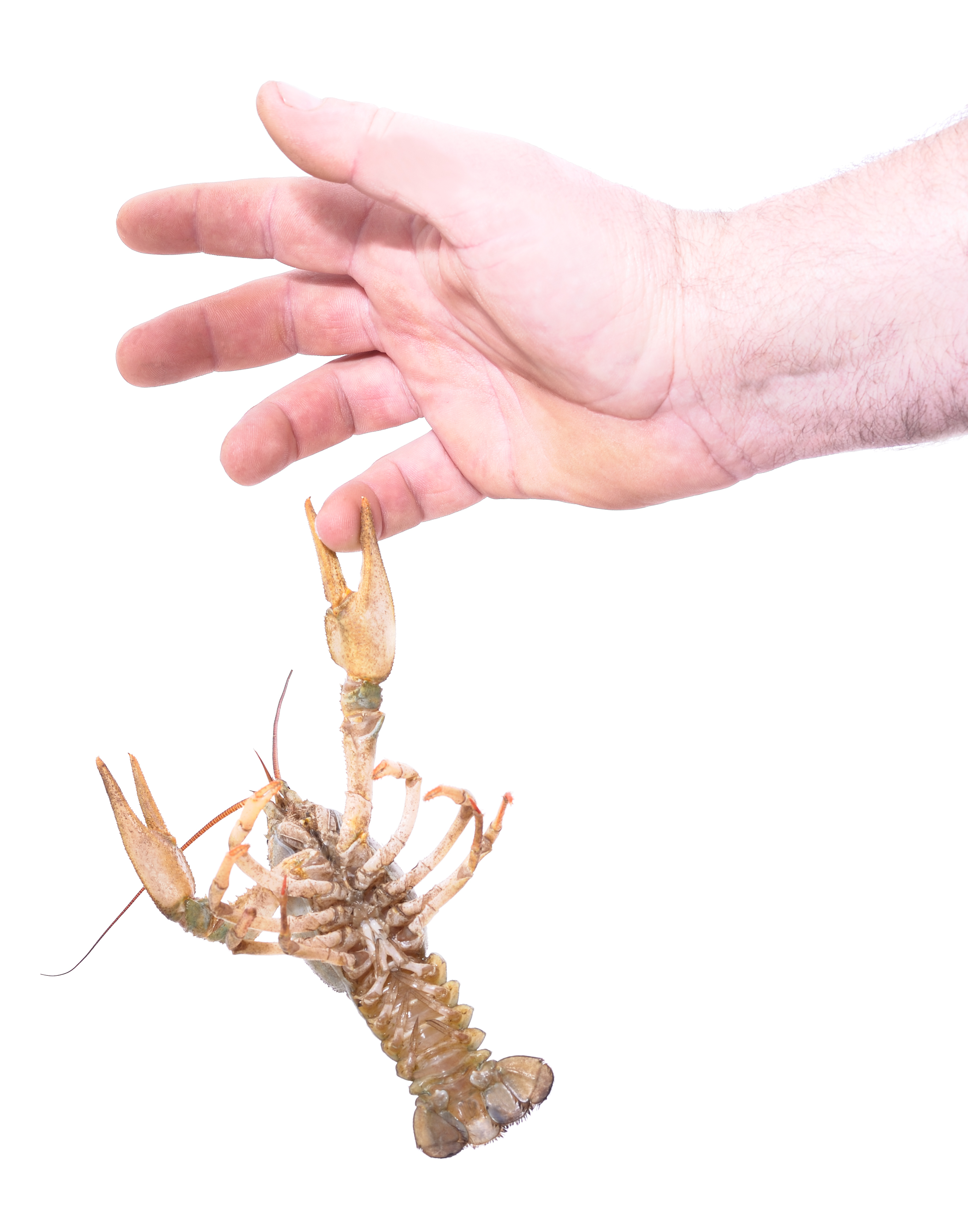
What do you think kōura like to eat?
It’s alright!
They are very shy and are scared of humans.
If you had a pet koura, would it be cheap to feed?

Slide 3
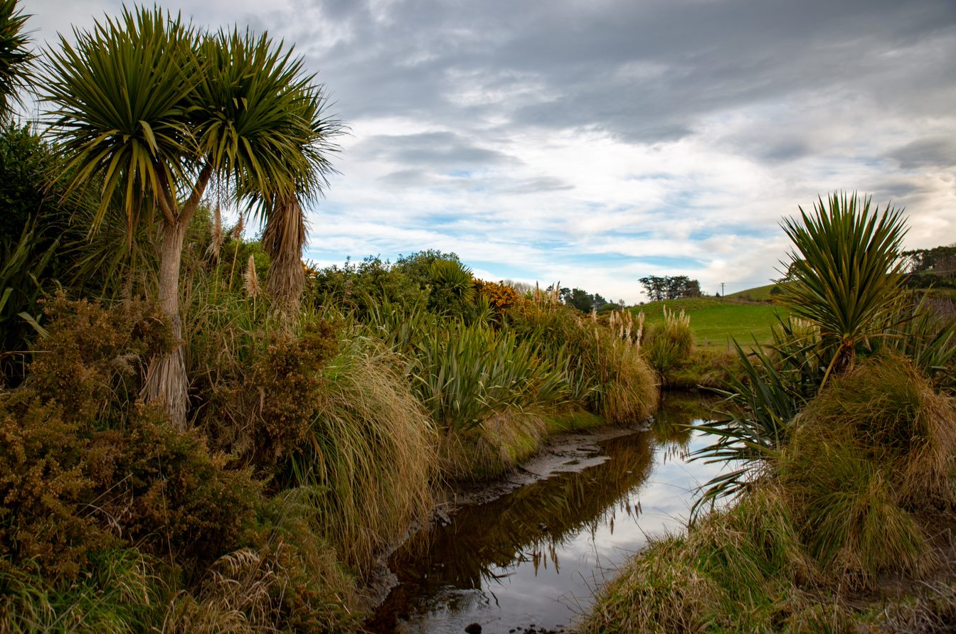
There are thousands of ponds on farms and in forests.
Kōura love fresh, clean water.
The ponds could become kōura farms.

Slide 4
Six ponds. Ten kōura in each pond.
How many kōura are there altogether?

Slide 5
Nine ponds. Two kōura in each pond.
How many kōura are there altogether?

Slide 6
Eight ponds. Five kōura in each pond.
How many kōura are there altogether?

Slide 7
Ten ponds. Three kōura in each pond.
How many kōura are there altogether?

Slide 8
It is night. That is the time when kōura come out to play.
It is a pity you can’t see them?
How many ponds are there?
How many kōura are in each pond?
How many kōura are there altogether?

Slide 9
