Slide 1
Statistics about bullying in New Zealand Schools
In the 2010/2011 Trends in International Mathematics and Science Study (TIMSS), 45% of Year 9 students, and 68% of Year 5 students, reported that they experience bullying weekly or monthly.

Slide 2
More recent surveys (ERO, 2018; OECD, 2017) have shown that nearly one half of New Zealand students, at both Primary and Secondary schools, report frequently being bullied.

Slide 3
In comparison to other countries in the OECD, New Zealand has the second worst rate of reported bullying of students.

Slide 4
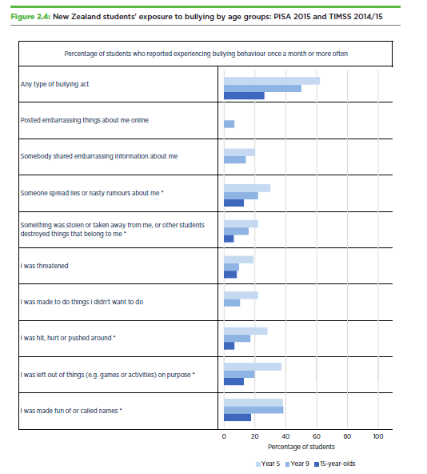
Source; OECD, 2017, p. 28

Slide 5
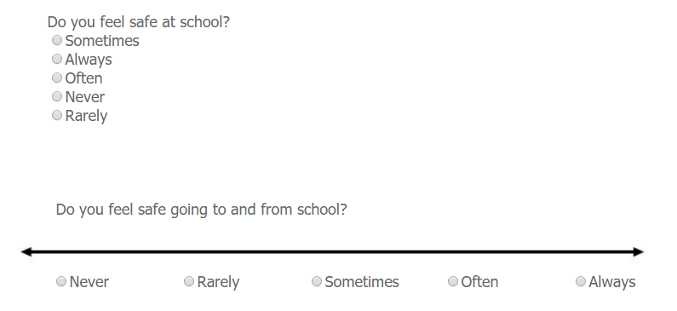

Slide 6
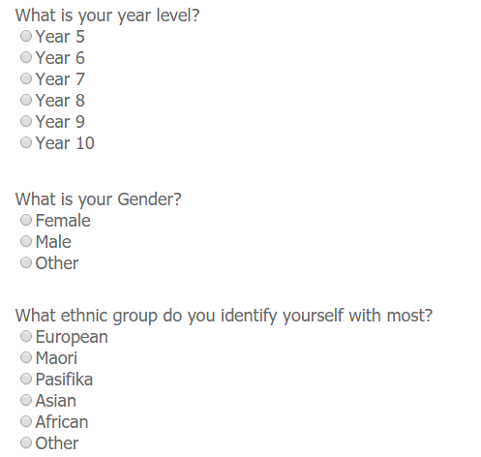

Slide 7
