Slide 1
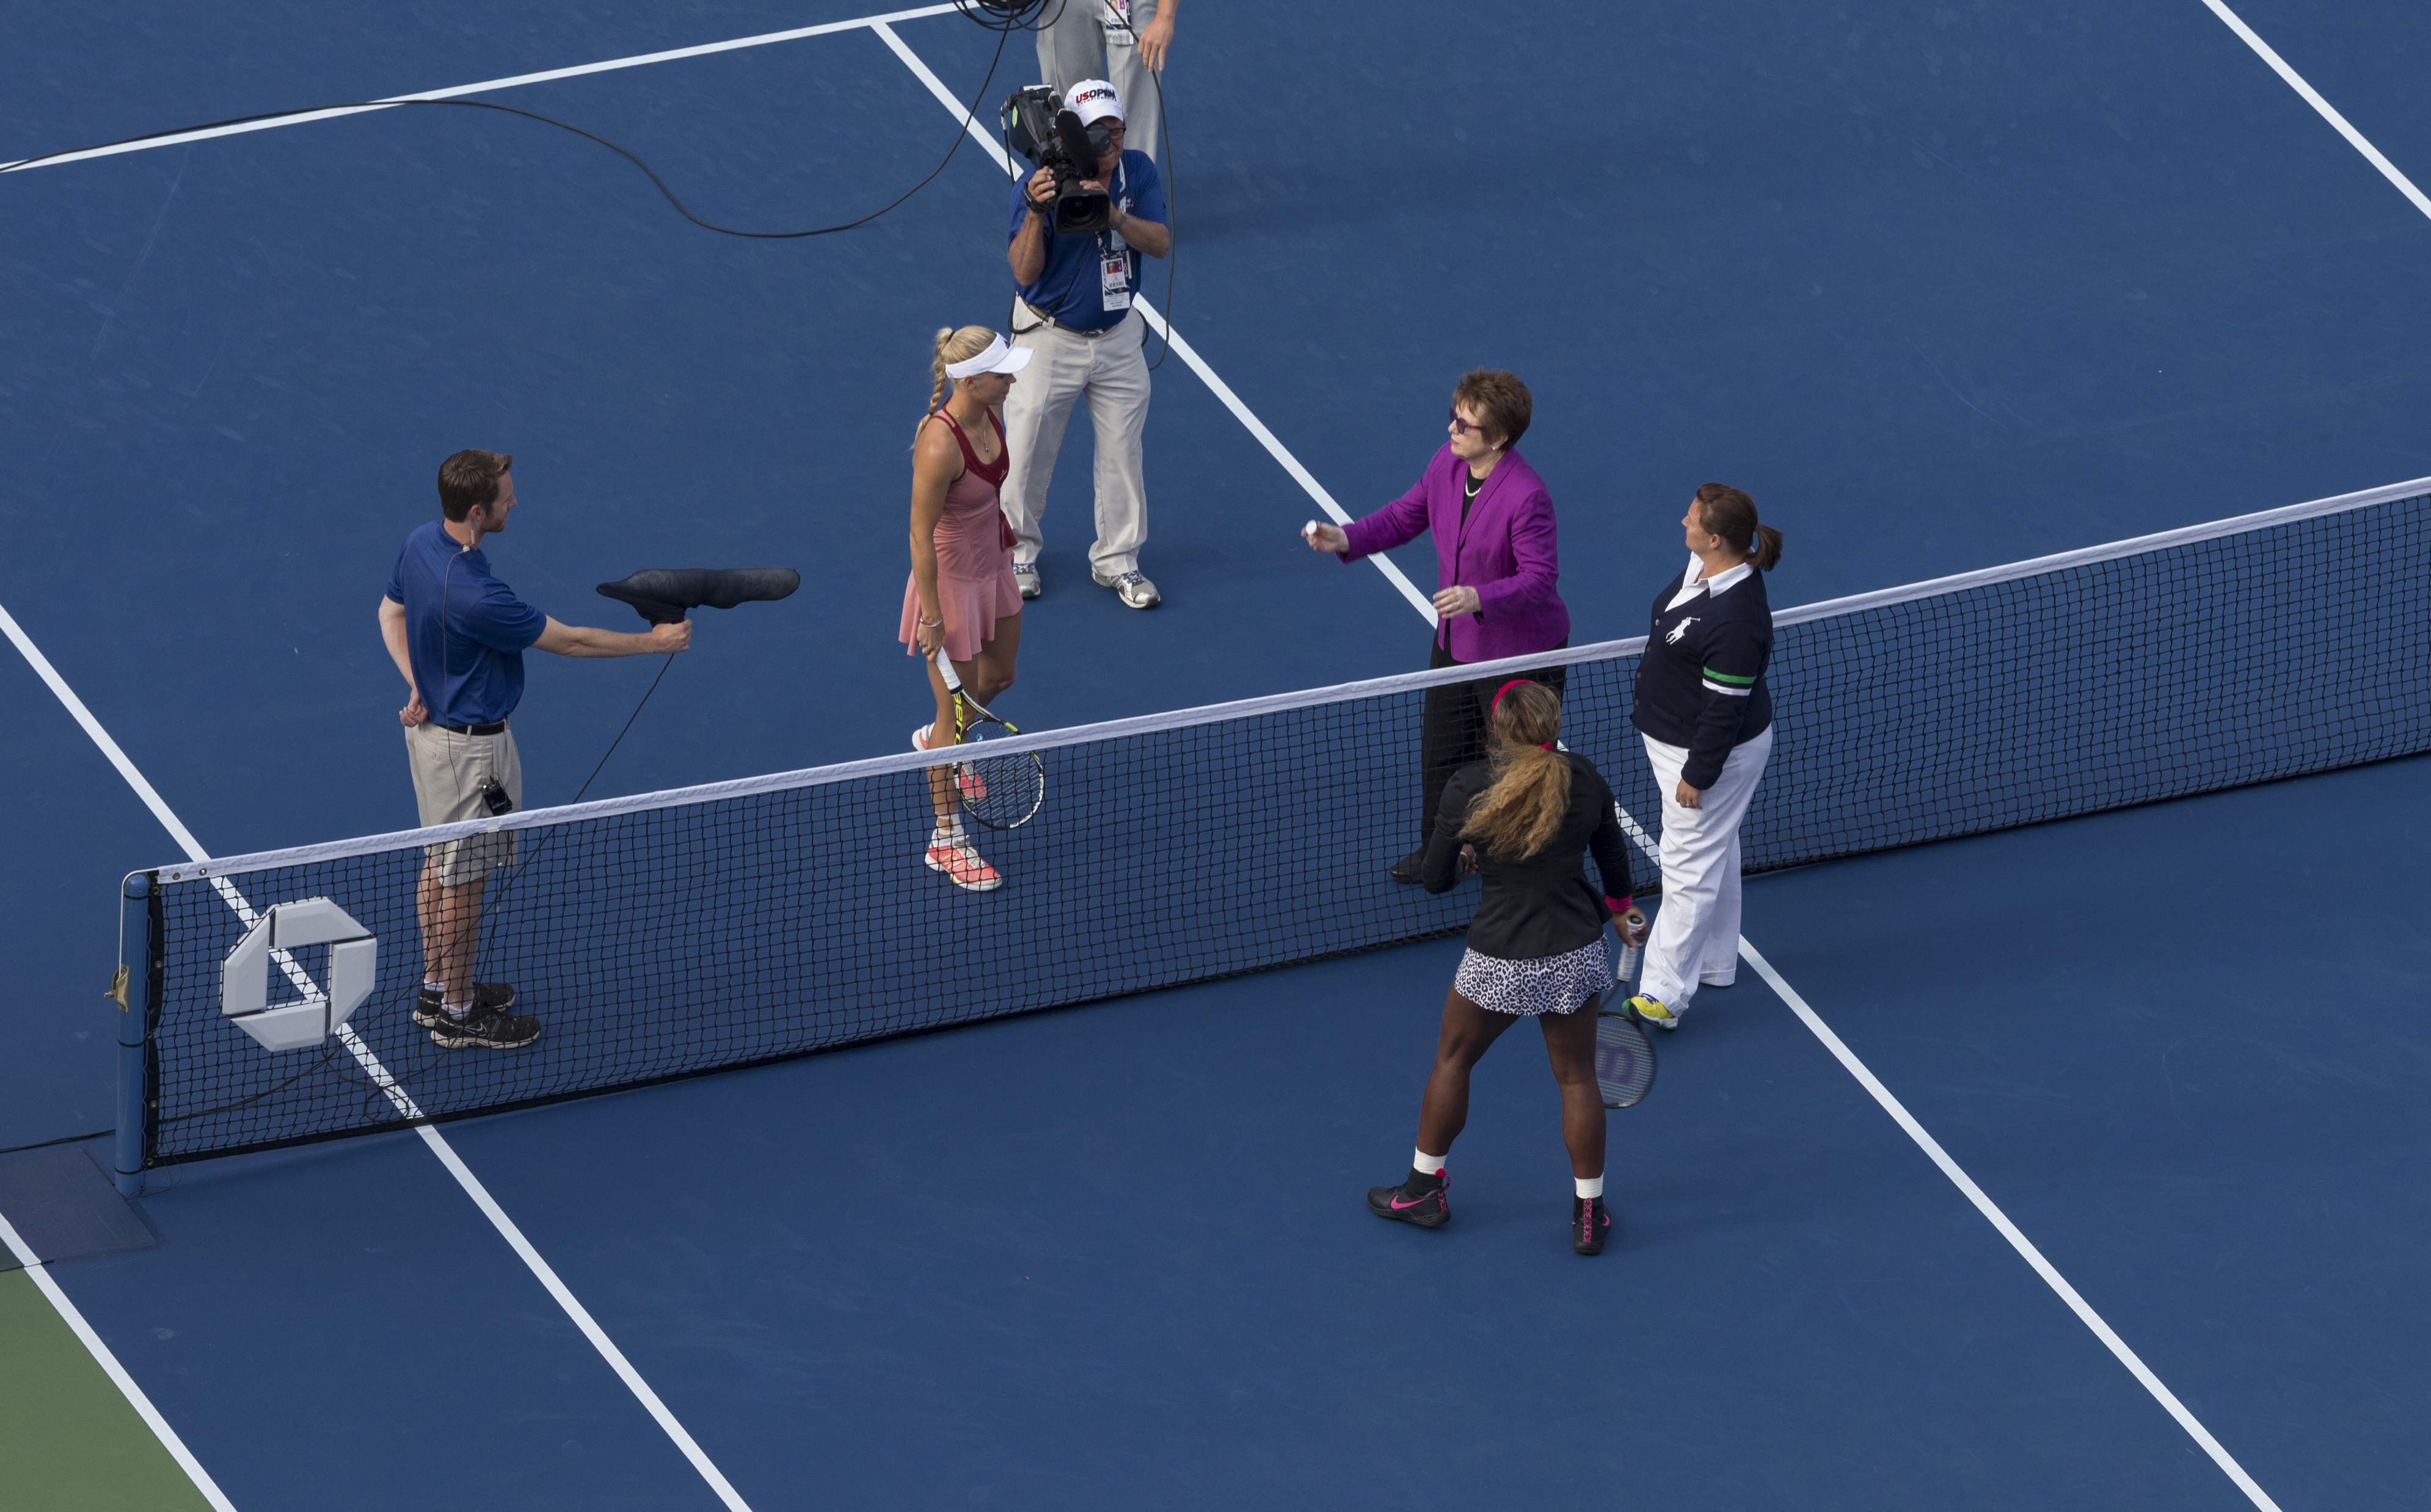
This is the women’s final of the US Tennis Open in New York.
What is happening?

Slide 2
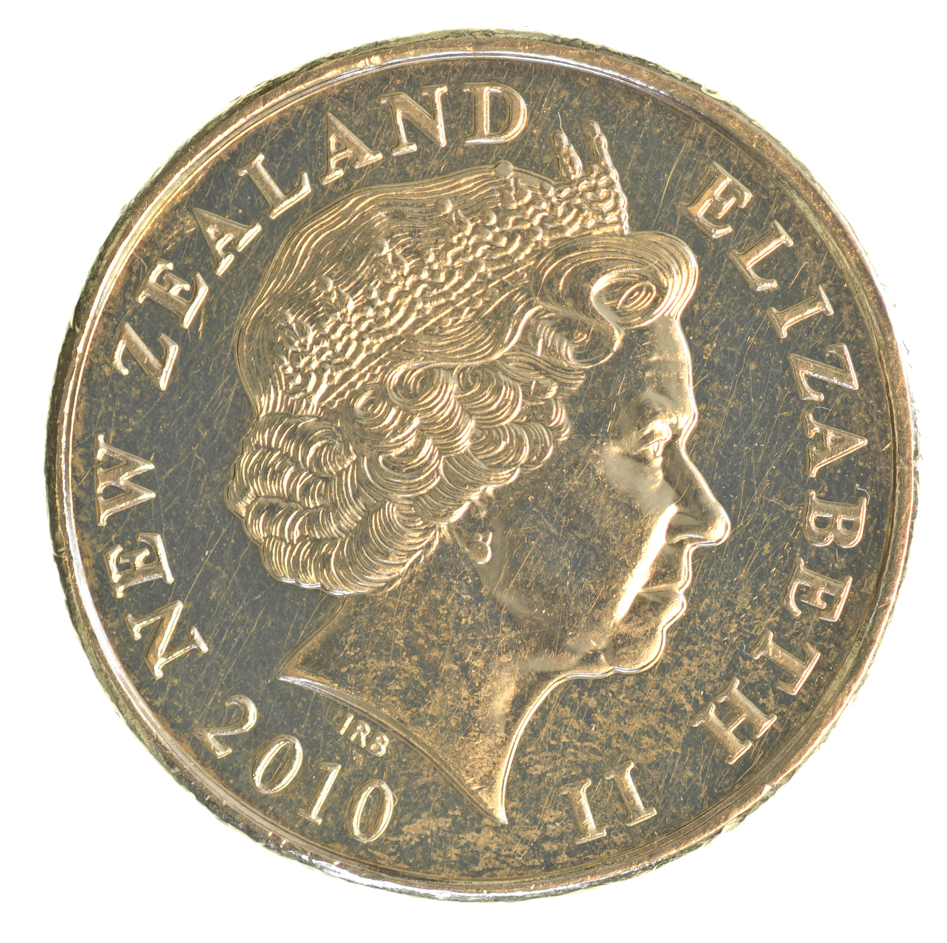
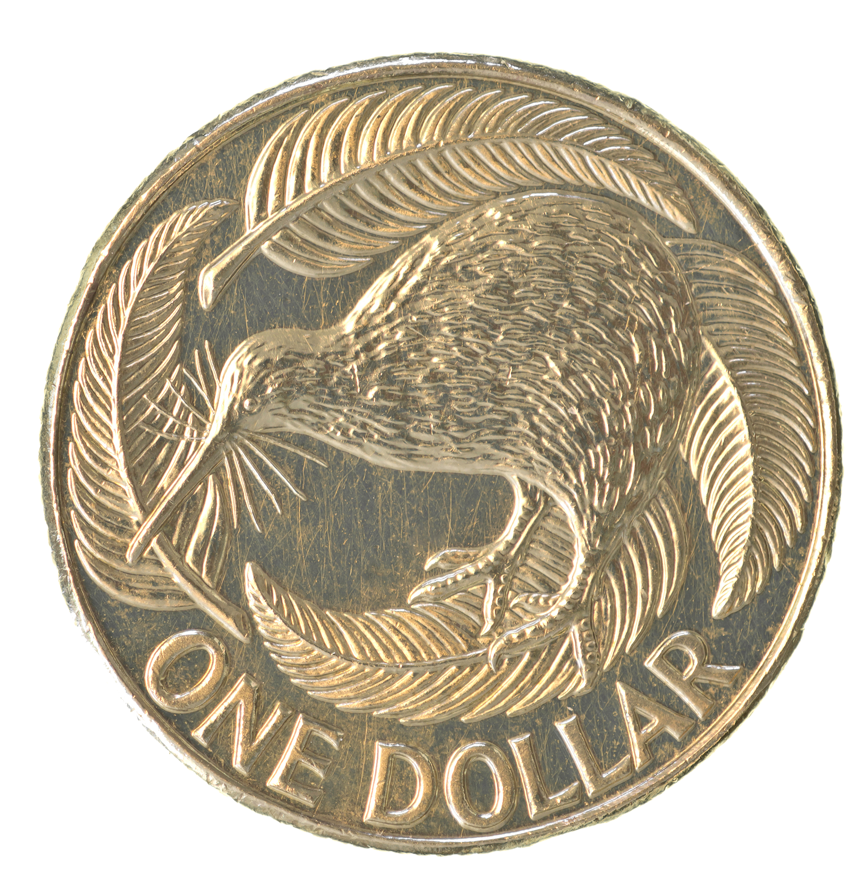
Toss the same coin three times, one after the other.
If the result is two heads and one tail:
You win!
If the result is not two heads and one tail:
You lose!

Slide 3
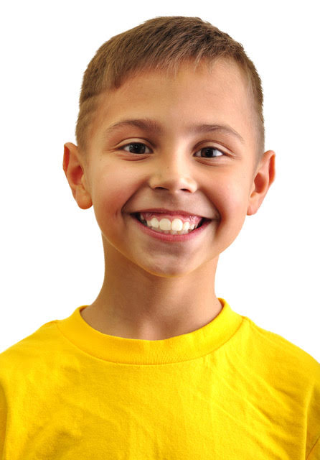
There are four things that can happen:
3 heads, 3 tails, 2 tails and 1 head, 2 heads and 1 tail.
The chance of winning must be 25%.
I agree that there are four things that can happen but I don’t think they are equally likely.
Brian
Jo

Slide 4
First Toss
Second Toss
Third Toss
H
H
T
H
H
T
T
H
H
T
T
H
T
T

Slide 5
First Toss
Second Toss
Third Toss
Fourth Toss
H
H
T
H
H
T
T
H
H
H
T
H
T
T
T
H
H
H
T
T
H
T
T
H
H
T
T
H
T
T

Slide 6
Imagine you counted the first twenty students who went through the school gate at the end of school. How many of the students would you expect to be females?

Slide 7
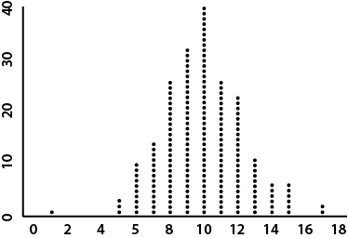
Number of trials
Number of heads

Slide 8
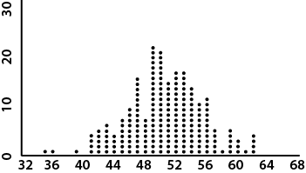
Number of trials
Number of trials
Number of heads
Number of heads

Slide 9
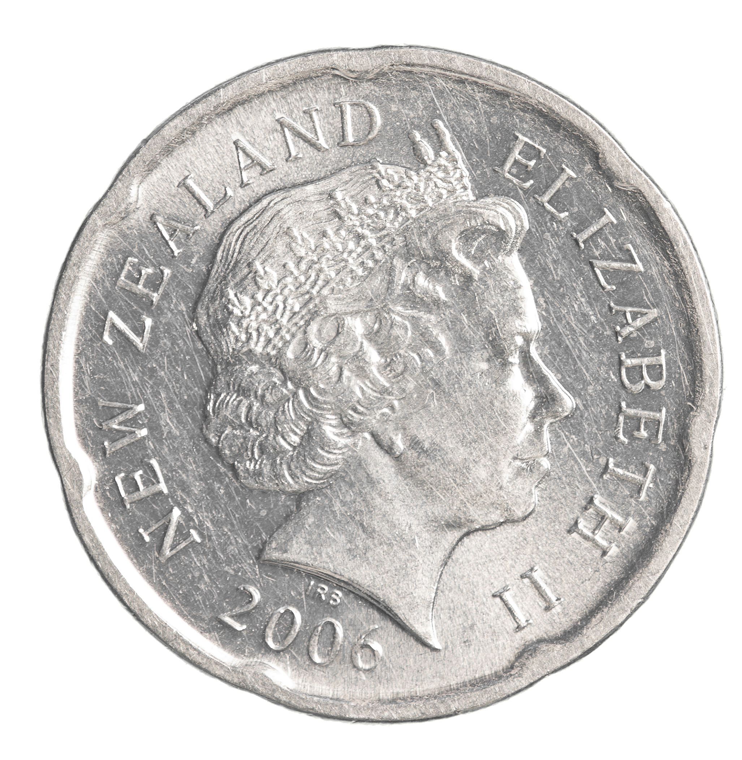
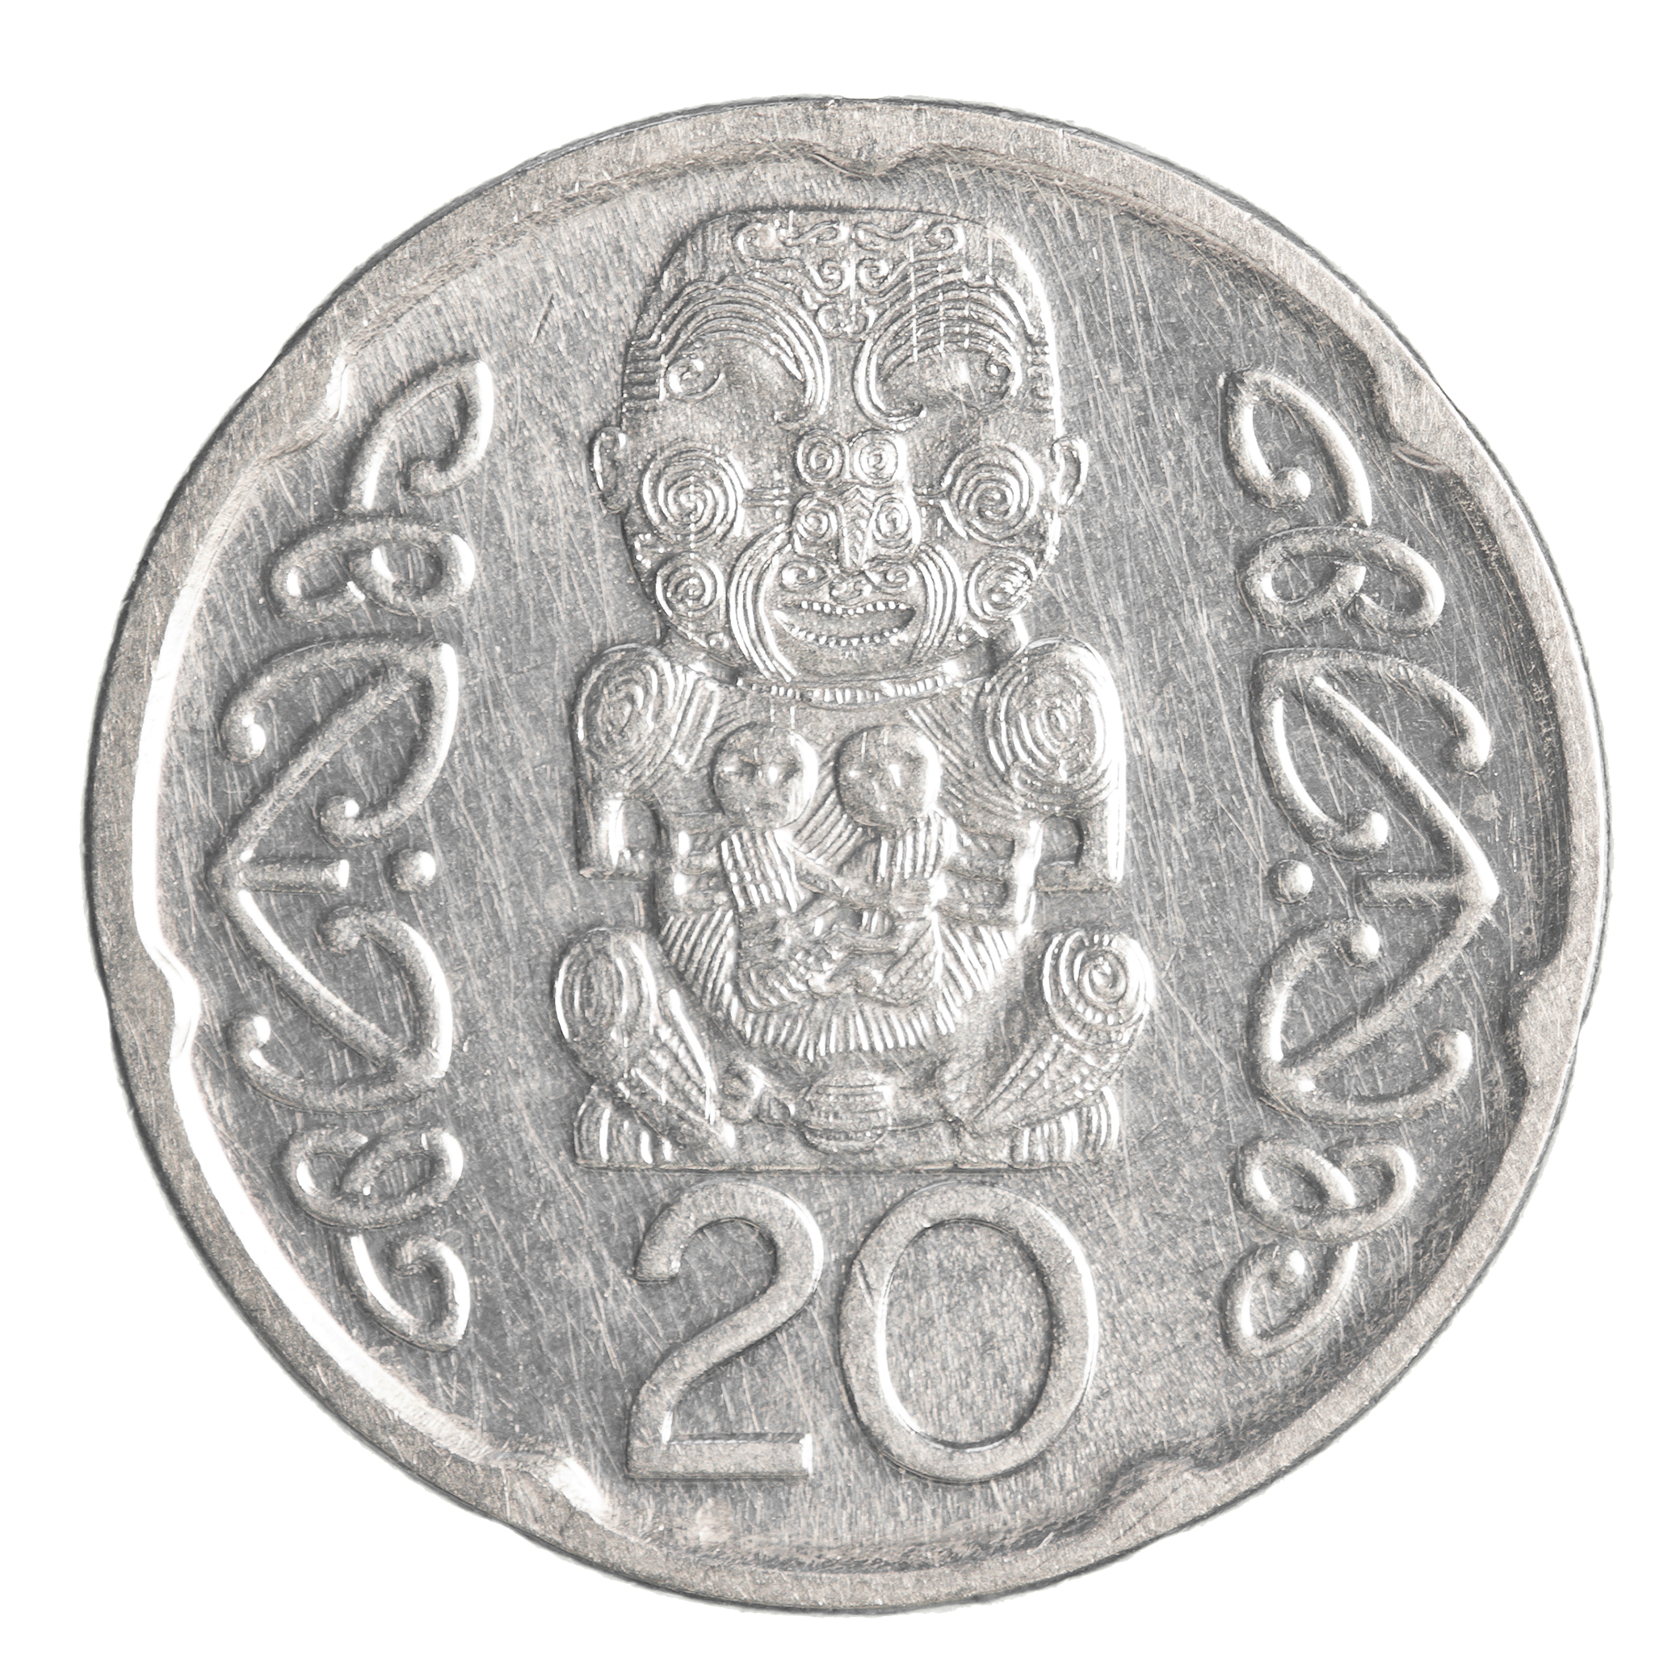

Slide 10
22mm
44mm

Slide 11
Player One
Player Two
Paper
Paper
Scissors
Rock
Paper
Scissors
Scissors
Rock
Paper
Rock
Scissors
Rock

Slide 12
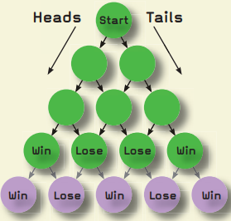
HHT
TTH
TTT

Slide 13
HHH
HHT
TTH
TTT
HTH
THT
THH
HTT

Slide 14
HHHH
TTTT
HHHT
HHTT
TTTH
HHTH
HTHT
TTHT
HTHH
THHT
THTT
THHH
TTHH
HTTT
THTH
HTTH

