Slide 1
$$\frac{2}{3}$$
$$\frac{2}{3}$$
Jamal cycles two thirds of a kilometre in one minute.
How long does he take to cycle one kilometre?

Slide 2
$$\frac{2}{5}$$
$$\frac{2}{5}$$
$$\frac{2}{5}$$
Arohia cycles two fifths of a kilometre in one minute.
How long does she take to cycle one kilometre?

Slide 3
$$\frac{3}{8}$$
$$\frac{3}{8}$$
$$\frac{3}{8}$$
Mere cycles three eighths of a kilometre in one minute.
How long does she take to cycle one kilometre?

Slide 4
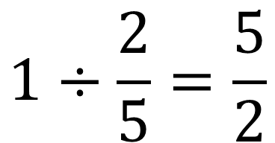
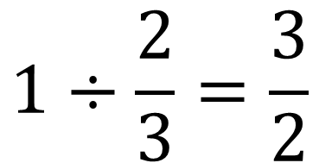
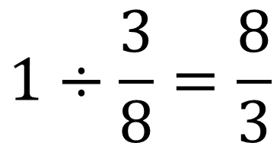
$$1÷\frac{2}{3}=\frac{3}{2}$$
$$1÷\frac{2}{5}=\frac{5}{2}$$
$$1÷\frac{3}{8}=\frac{8}{3}$$

