Slide 1
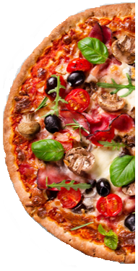
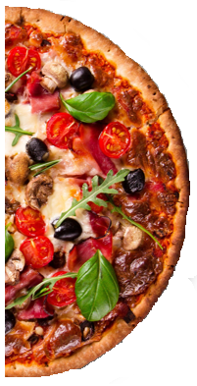
I have this much pizza.
I want to share pizza equally among the three people at my party.
How much pizza should each person get?

Slide 3
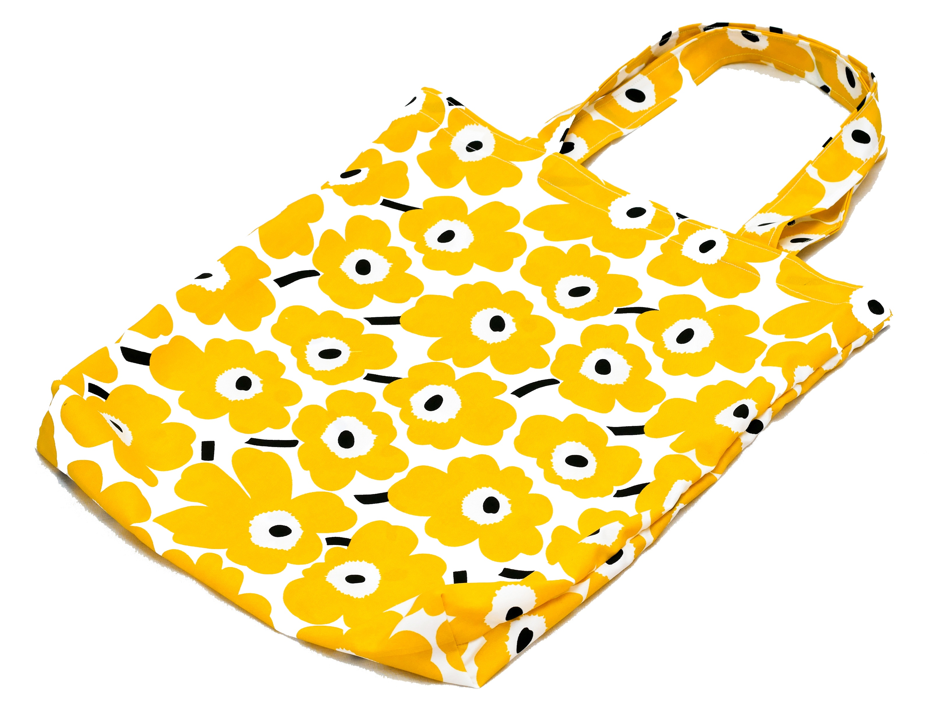
I have 4½ metres of cloth.
Each bag is made from ¾ of one metre of cloth.
How many bags can I make?

Slide 4
1
1
1
1
½
¾
¾
¾
¾
¾
¾
¾
¾
¾
¾
¾
¾
¾
¾
¾
¾
¾
¾

