Slide 1
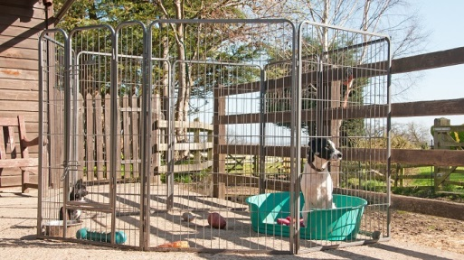
Here is Yap’s cousin Yip in her run.
That size of run may be suitable for a small city dog but Yap needs space to roam.

Slide 2
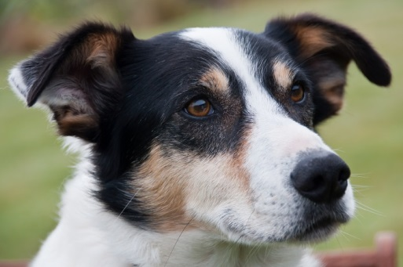
I checked the Federated Farmers Handbook and I need a run of 54 square metres. That way I can stretch my legs and won’t wake up my owner by howling in the morning.

Slide 3
Here are three designs for Yap’s new run.
Do all the designs have an area of 54 m²?

Slide 4
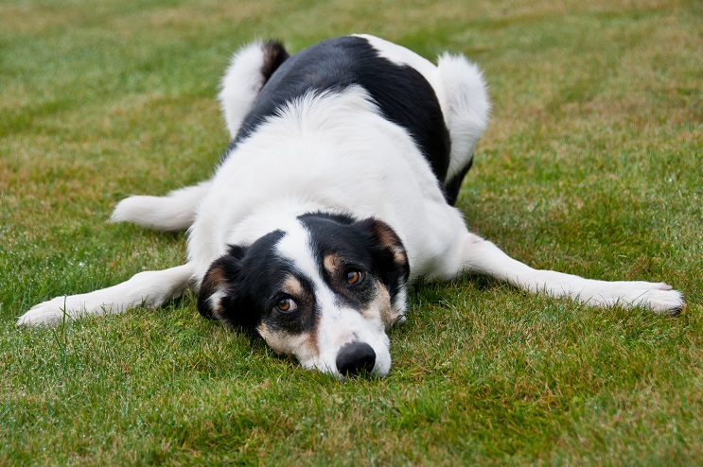
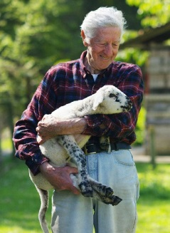
My last run was a boring rectangle.
I’d prefer a shape that is a bit more interesting.
The outside fencing is very costly.
My farm is a business Yap. Money matters.
You can have a maximum perimeter of 45 metres.
I am sure you can make some interesting designs with that.

Slide 5
2m
5m
40m²
4m
Is the perimeter within the maximum of 45 metres?

