Slide 1
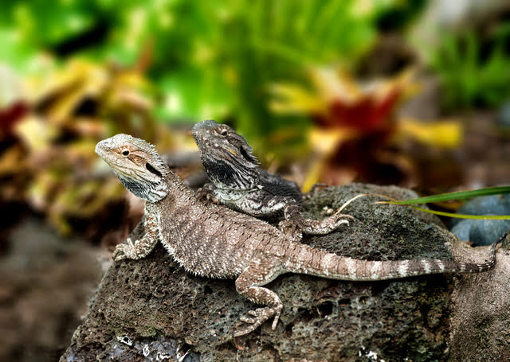
Tuati and Tera are tuatara lizards. They are small reminders of a time when dinosaurs ruled the Earth.
Nowadays scientists measure tuatara to check that they are growing well, as they are an endangered species.
In 2000 Tuati was 10 centimetres long and Tera was 16 centimetres long.
This year Tuati is 30 centimetres long and Tera is 40 centimetres long.
Which tuatara grew the most between 2000 and today, Tuati or Tera?

Slide 2
Tuati
2000
10cm
Today
30cm
Tera

Slide 3
2000
Tera
16cm
Today
40cm

