Slide 1
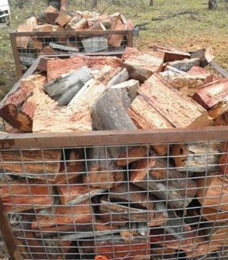
A ‘thrown’ cubic metre (m³) of firewood is loose, not stacked.
You actually get between 0.67 and 0.8 of a cubic metre of solid wood.

Slide 2
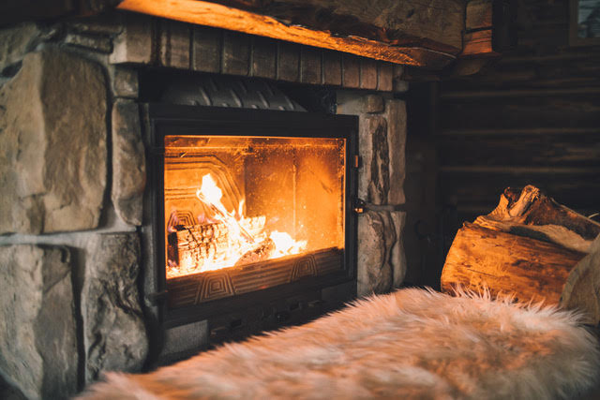
Some firewoods are better than others.
Wood that is dense tends to burn hotter.
What does dense mean? Density is the noun.

Slide 3
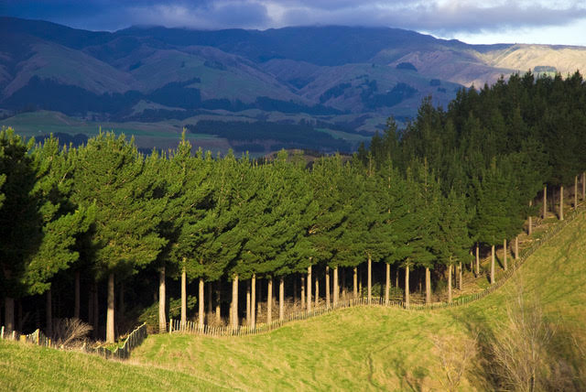
Pinus radiata is the most common firewood burned in New Zealand.
A solid cubic metre of pine has a mass of 0.480 tonnes or 480 kilograms.
So the density of pine is 0.480 tonnes per cubic metre.

Slide 4
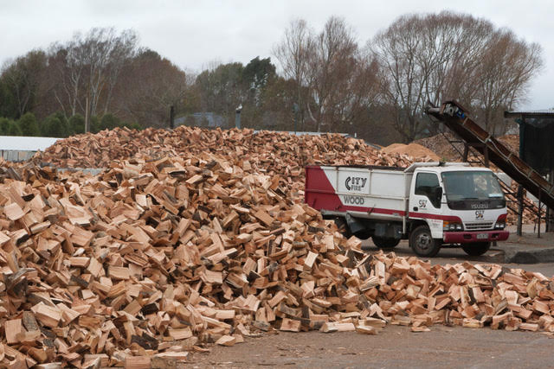
Pinus Radiata is a firewood that burns quickly.
It has a density of 0.48 tonne per cubic metre.
What does a thrown cubic metre (0.7 m³) of pine weigh?

Slide 5

If 7 x 48 = 336, what is 0.7 x 0.48 = ?
Write this multiplication in fraction form.
0.7 x 0.48 = $\frac{7}{10}×\frac{48}{100}=\left[ \right]$?
$$\frac{336}{1000}$$
What is the decimal for $\frac{336}{1000}$?

Slide 6
$$0.7 ×0.48= \left[ \right]$$
0.336
0.7
1
0.48

Slide 7
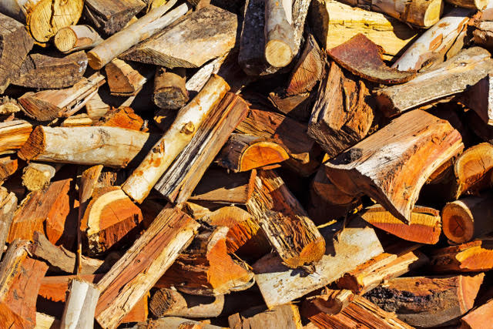
Blue gum is a firewood that burns hot.
It has a density of 0.82 tonne per cubic metre.
What does a thrown cubic metre (0.7 m³) of blue gum weigh?

Slide 8

If 7 x 82 = 574, what is 0.7 x 0.82 = ?
Write this multiplication in fraction form.
0.7 x 0.82 = $\frac{7}{10}×\frac{82}{100}=\left[ \right]$?
$$\frac{574}{1000}$$
What is the decimal for $\frac{574}{1000}$?

Slide 9
$$0.7 ×0.82= \left[ \right]$$
0.574
0.7
1
0.82

Slide 10
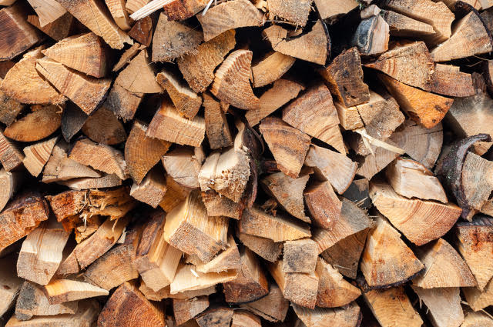
Douglas Fir is also a common firewood.
It has a density of 0.53 tonne per cubic metre.
What does three thrown cubic metres (2.1 m³) of Douglas Fir weigh?

Slide 11

If 21 x 53 = 1 113, what is 2.1 x 0.53 = ?
Write this multiplication in fraction form.
2.1 x 0.53 = $\frac{21}{10}×\frac{53}{100}=\left[ \right]$?
$$\frac{1 113}{1000}$$
What is the decimal for $\frac{1 113}{1000}$?

Slide 12
$$2.1 ×0.53= \left[ \right]$$
1.113
2.1
1
0.53

