Slide 1
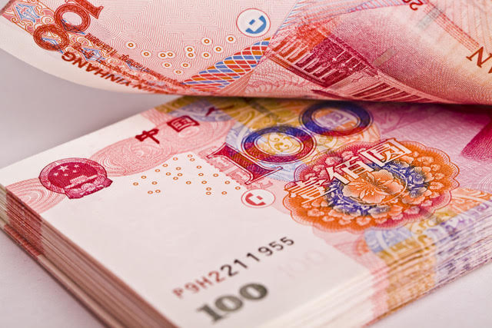
$NZ 1.00 (New Zealand Dollar) exchanges for ¥4.51 (Chinese Yuan).
How many Yuan will you get for $NZ 100.00?
a. $400.5100
b. $45.10
c. $451.00
d. $4.5100

Slide 2
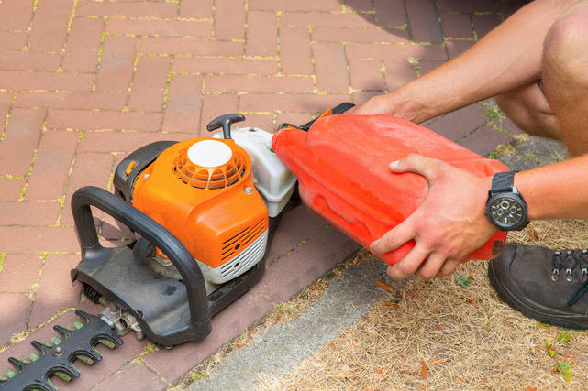
Kevin ran out of fuel for his hedge trimmer.
He bought 4.5 litres of petrol at a cost of $2.08 per litre.
Which answer below is closest to the amount he paid?
a. $93.60
b. $9.36
c. $0.93
d. $936.00

Slide 3
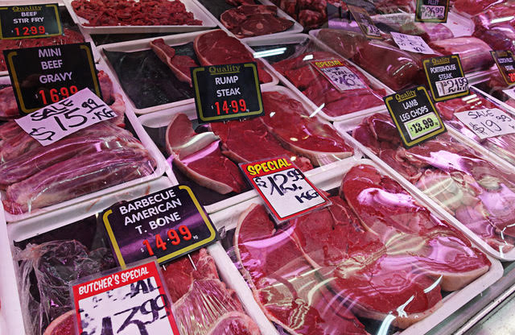
Rump steak is on special at $15.00 per kilogram.
How much do you pay for 0.537 kg?
a. $80.55
b. $5.37
c. $8.06
d. $805.50

Slide 4
0.24
$$0.4 ×0.6= \left[ \right]$$
0.4
1
0.6

Slide 5
0.21
$$0.7 ×0.3= \left[ \right]$$
0.7
0.3
1

Slide 6
1.28
$$1.6 ×0.8= \left[ \right]$$
1.6
0.3
1
1
0.8

