Slide 1
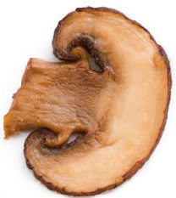
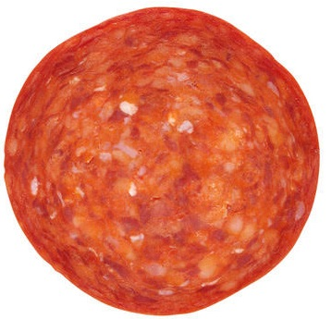
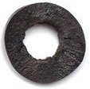
Margherita’s new Italiano topping mix is a real hit.
Not a single crumb is left on the plate!
How would you describe the mix to a classmate?

Slide 2
You probably noticed that there were:
4 slices of olive
6 slices of mushroom
8 slices of pepperoni
What could you have said that uses fractions?

Slide 3
Did you say?
$\frac{4}{18}$ of the mix is olive slices
$\frac{6}{18}$ of the mix is mushroom slices
$\frac{8}{18}$ of the mix is pepperoni slices
What other fractions might you have used?

Slide 4
Did you say?
$\frac{2}{9}$ of the mix is olive slices
$\frac{3}{9}$ of the mix is mushroom slices
$\frac{4}{9}$ of the mix is pepperoni slices
You might have noticed that $\frac{3}{9}=\frac{1}{3}$ .

Slide 5
Margherita’s new Italiano topping mix can be represented by the ratios 4:6:8 or 2:3:4.
What do the numbers in each ratio represent?

Slide 6
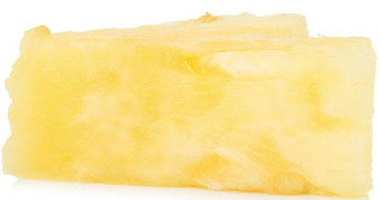
Margherita’s marinara topping mix also has three different toppings.
Discuss with a classmate how to describe the marinara mix using fractions and ratios?

Slide 7
Did you have these ways?
Fractions
$\frac{5}{30}$ of anchovies, $\frac{10}{30}$ of pineapple chunks, $\frac{15}{30}$ of slices of caper
or
$\frac{1}{6}$ of anchovies, $\frac{1}{3}$ of pineapple chunks, $\frac{1}{2}$ of slices of caper
Ratios
$$5:10:15$$
or
$$1:2:3$$

Slide 8
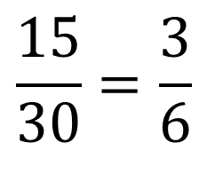
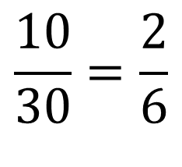
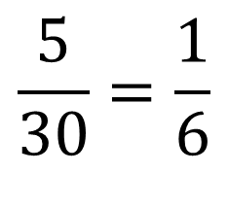
Watch to see how the fractions can be renamed.
$$\frac{5}{30}=\frac{1}{6}$$
$$\frac{10}{30}=\frac{2}{6}$$
$$\frac{15}{30}=\frac{3}{6}$$
What other names for two sixths and three sixths can you think of?

Slide 9
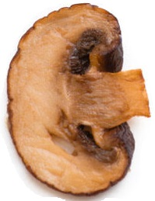
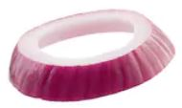
Margherita’s vegetarian topping mix also has three different topping.
Discuss with a classmate how to describe the vegetarian mix using fractions and ratios?

Slide 10
Did you have these ways?
Fractions
$\frac{9}{36}$ of mushroom slices, $\frac{12}{36}$ of caper slices, $\frac{15}{36}$ of onion slices
or
$\frac{3}{12}$or $\frac{1}{4}$of mushroom slices, $\frac{4}{12}or \frac{1}{3}$ of caper slices, $\frac{5}{12}$ of onion slices
Ratios
$$9:12:15$$
or
$$3:4:5$$
Can you explain how the fractions can be renamed in different ways?

