Slide 1
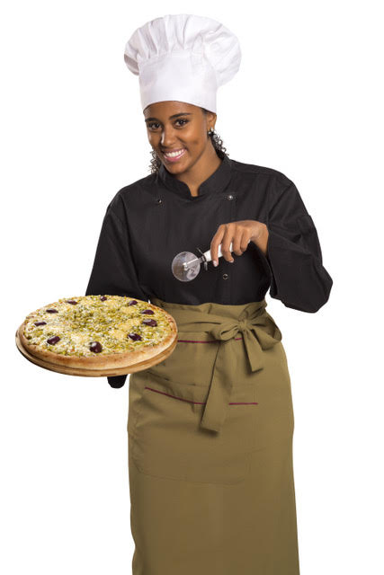
Margherita is a pizza chef.
You can see it is hard for her to get a perfectly balanced pizza.
The toppings must be spread evenly.

Slide 2
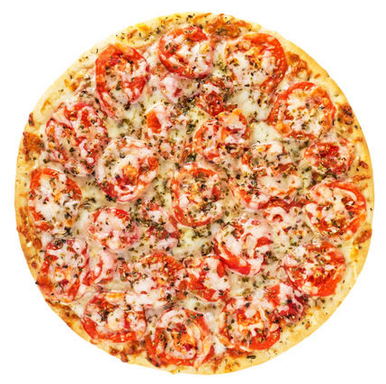
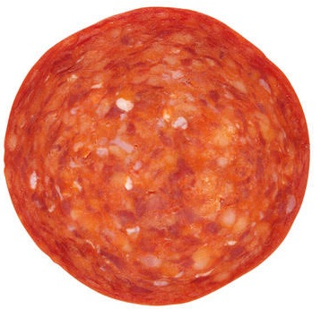
Suppose she wants to spread 24 slices of pepperoni onto a pizza cut into thirds.
How many slices should go on each third?

Slide 3
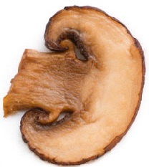
Suppose she wants to spread 36 slices of mushroom onto a pizza cut into quarters. How many mushroom slices should go on each quarter?

Slide 4
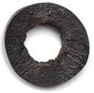
Suppose she wants to spread 40 slices of olive onto a pizza cut into fifths.
How many olives should go on each fifth?

Slide 5
Most people eat more than one piece of Margharita’s pizzas.
Suppose she wants to know two thirds of 30 slices of pepperoni.
First she finds out how many slices go on one third?

Slide 6
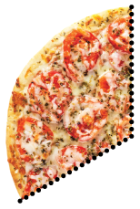
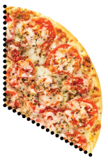
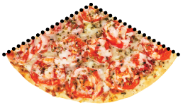
She knows that 10 slices of pepperoni go on one third.
How many slices of pepperoni are on two thirds?

Slide 7
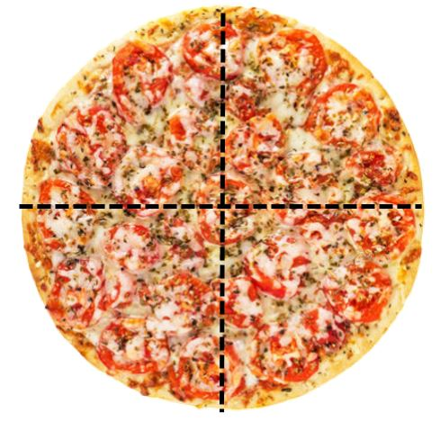
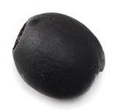
Margharita wants to know three quarters of 32 olives.
First she finds out how many olives go on one quarter?

Slide 8
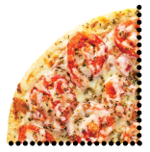
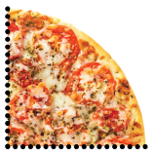
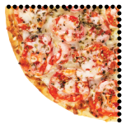
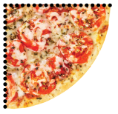
She knows that 8 olives go on one quarter.
How many olives are on three quarters?

Slide 9
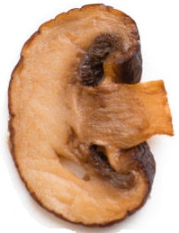
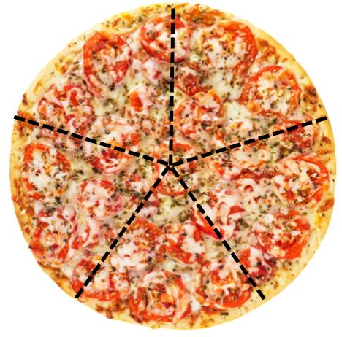
Margharita wants to know four fifths of 35 mushroom slices.
First she finds out how many mushroom slices go on one fifth?

Slide 10
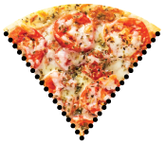
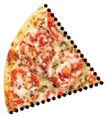
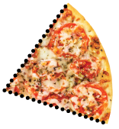
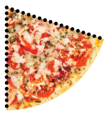
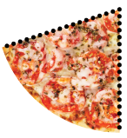
She knows that 7 mushroom slices go on one fifth.
How many mushroom slices are on four fifths?

Slide 11
$$\frac{2}{3}×30=20$$
$$\frac{3}{4}×32=24$$
$$\frac{4}{5}×35=28$$

